Slide 1
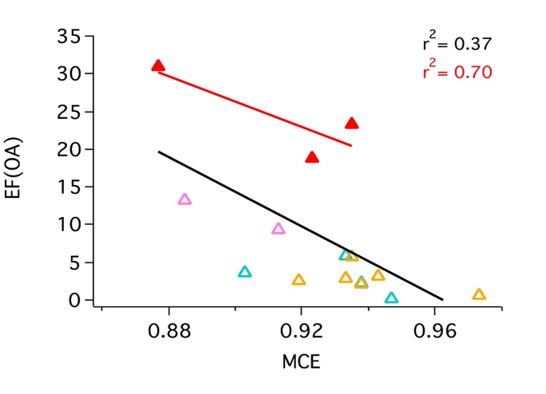
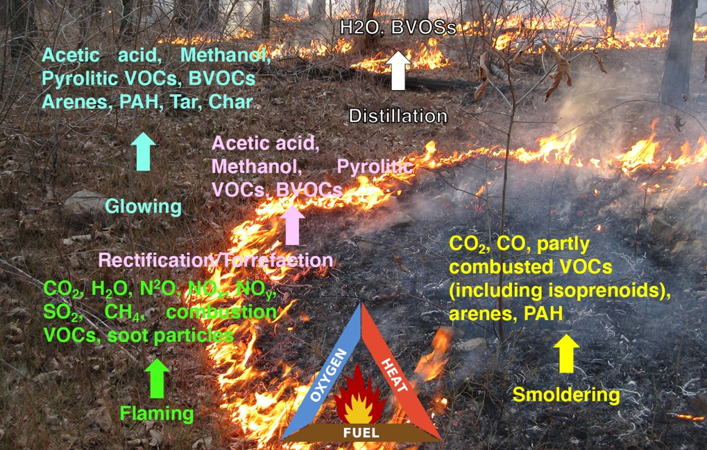
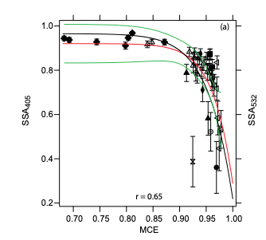
A new satellite data product for studying fire combustion efficiency, fire emission speciation, and fire weather at night and beyond
Jun Wang (PI), Meng Zhou, Lorena Castro Garcia (U. Iowa); Co-Is: Lu Hu, Bob Yokelson (U. Montana); Tara Yacovitch, Scott Herndon (Aerodyne Inc.); D. Peterson (NRL). Collaborator: Zhuosen Wang (UMCP).
Modified combustion efficiency
$$MCE=\frac{{CO}_{2} }{{CO}_{2}+CO}$$
Liu et al., [2017]
Pokhrel et al., [2017]

Slide 2
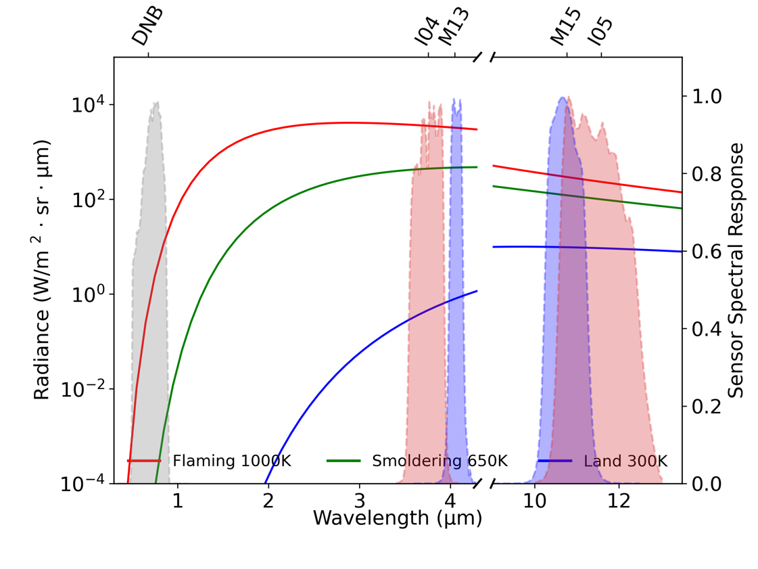
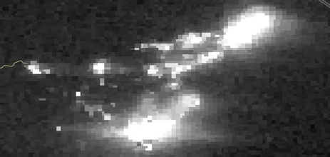
A new satellite data product for studying fire combustion efficiency, fire emission speciation, and fire weather at night and beyond
Fire Light Detection Algorithm version 2 (FILDA-2)
Newly defined parameter for combustion status characterization:
VEF is a robust indictor of combustion efficiency
Fire
sensitive
Ground
sensitive
Visible Energy Fraction (VEF)
Visible light power - provided by Nighttime Visible observation
$$VEF=\frac{VLP }{FRP}$$
Visible light is sensitive to fire too!
Fire radiative power –
Total power retrieved from IR band.
Caldor Fire 2021
Light Climatology
Satellite Pixel #1
Satellite Pixel #2
High fire temp. Small fire area
Cooler fire temp. Large fire area
Fire light, visible anomaly
Visible light is an inherent character of wildfire
Fire is a transient thing
Flaming, more energy distributed in Visible, High VEF.
Smoldering, less energy distributed in Visible, Low VEF.
Same FRF, but different VEF at the pixel level.
Wang et al., Remote Sensing of Environment, 237, 111466, 2020.

Slide 3
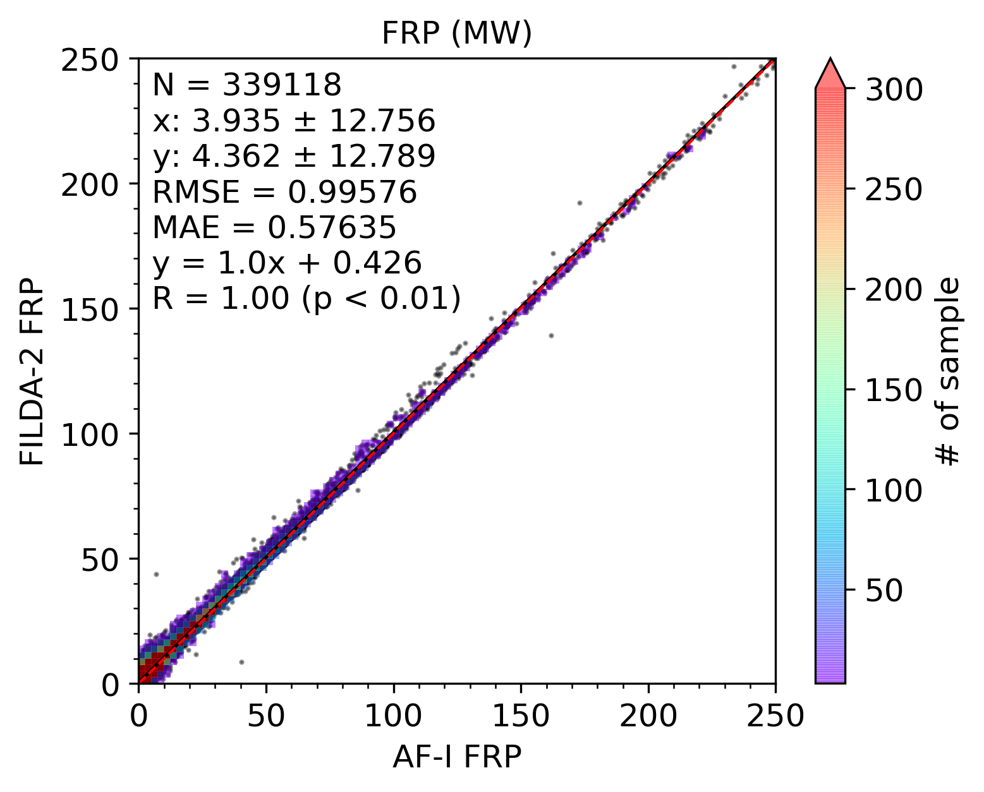
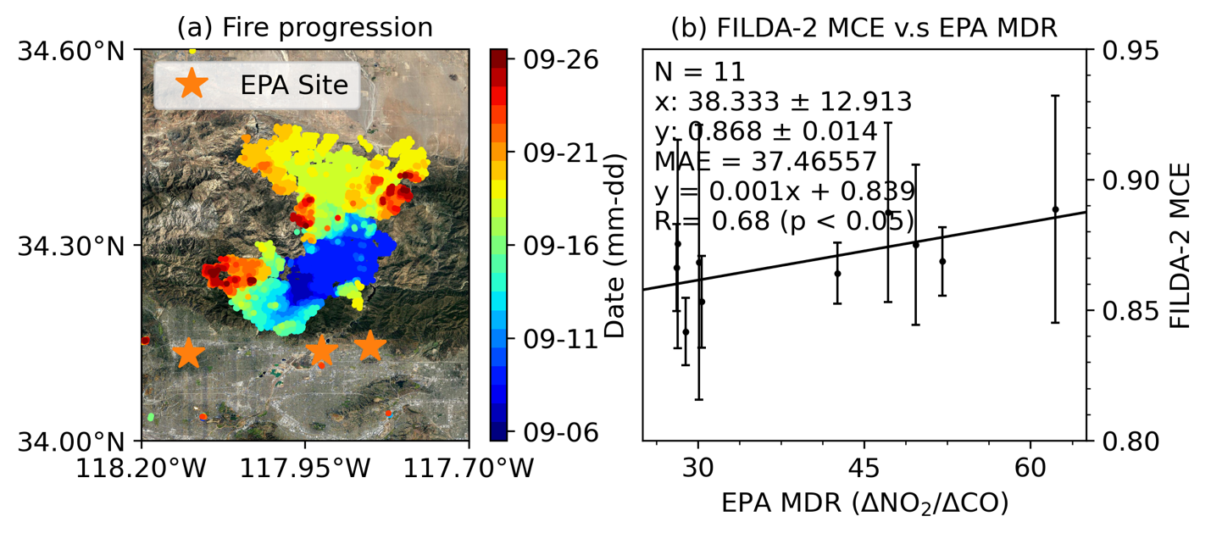
A new satellite data product for studying fire combustion efficiency, fire emission speciation, and fire weather at night and beyond
Validation of FILDA-2
1. FRP validation
3. MCE validation
Time: August 2019 ~ August 2020
Scale: Global
FRP validation against VNP14IMG
VJ1 FILDA is validated against VNP FILDA-2
FILDA-2 MCE is validated against EPA molar density ratio
2. VJ1 validation
Zhou et al., IEEE Transactions on Geoscience and Remote Sensing, vol. 61, 4402420, 2023.

Slide 4
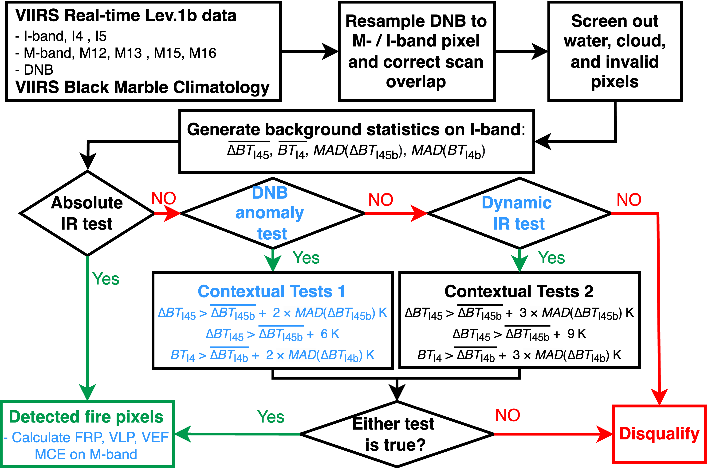
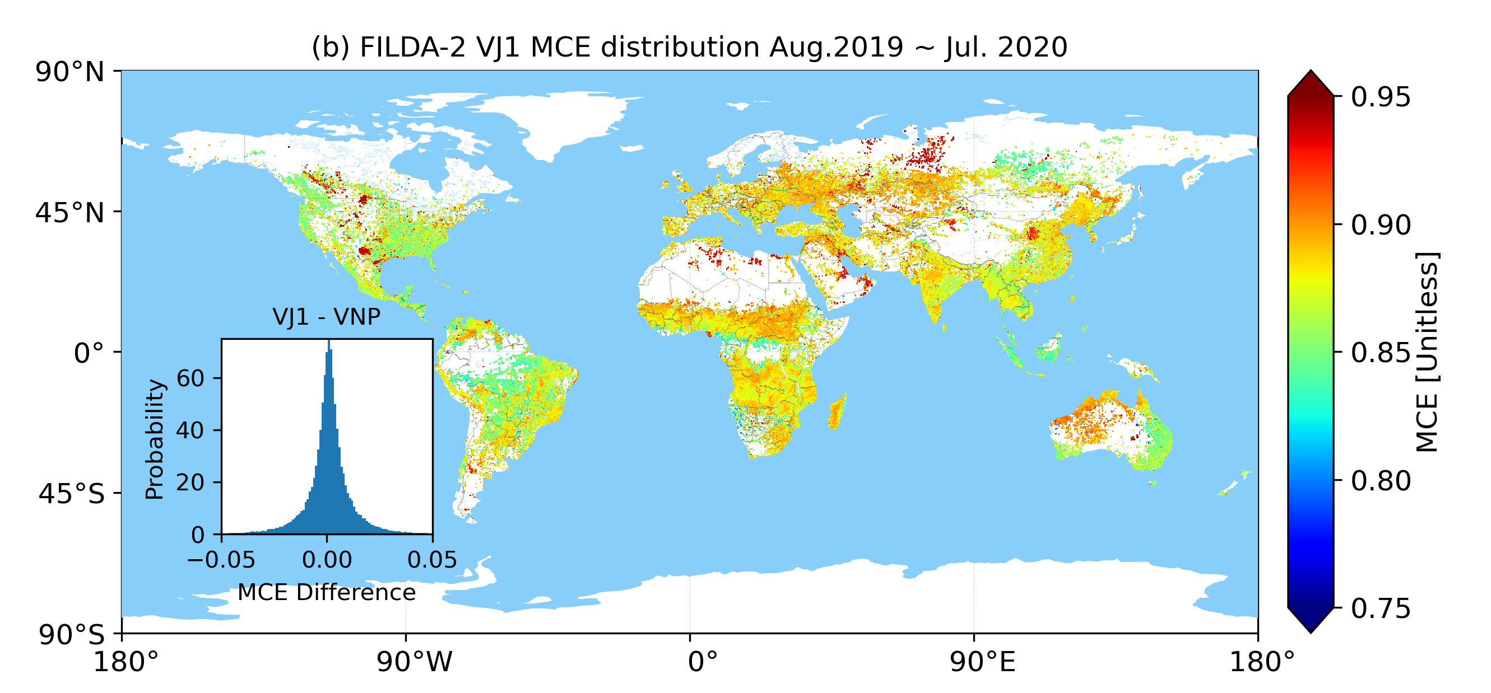
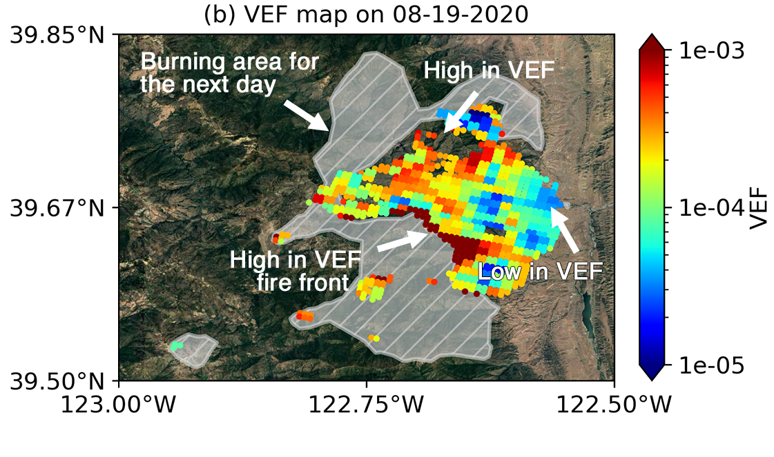
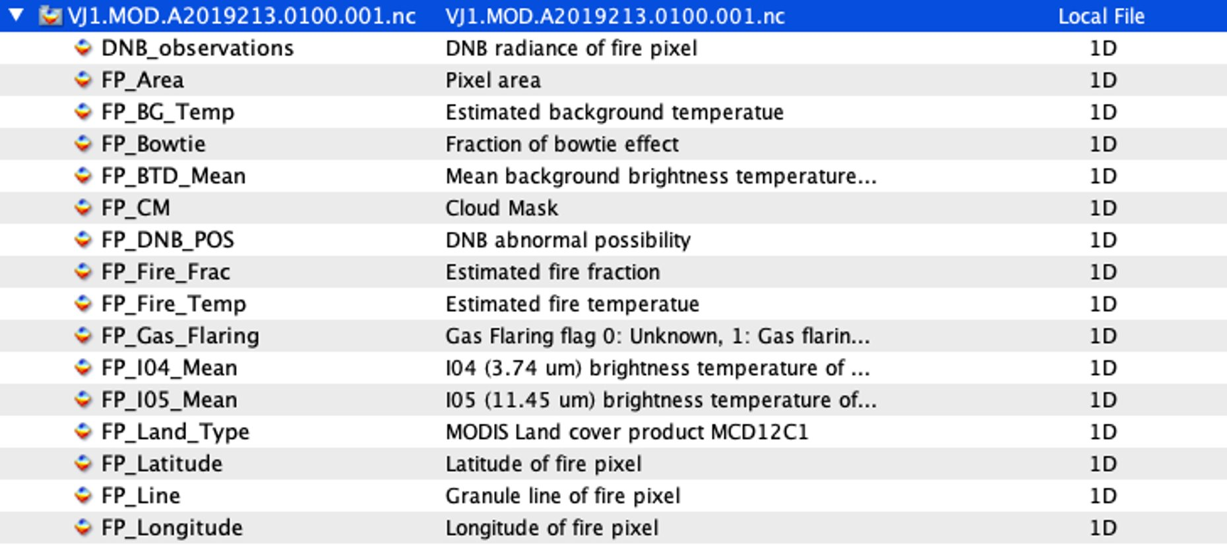
A new satellite data product for studying fire combustion efficiency, fire emission speciation, and fire weather at night and beyond
Progress and next steps
Progress
Challenge & Next Step
Software package are ready and delivered to land team
ATBD are nearly ready and will be published through ATBD tool
Benchmark run for Aug. 2019 ~ Aug. 2020
Validation with multiple products including ASTER, VNP14IMG, EPA trace gas measurements, etc.
Worked with land team to integrate FILDA-2 to SIPS
Provide rules for FILDA-2 run
Provide rules for static input
Worked with a few users already to finalize the data content
spectrum radiances of fire pixel as attributes
Extension to daytime
Fire pixel classification
waste incineration
fracking
oil fracking facility
Assessment & validation
Adapt to NOAA-21
Metadata
Applications…
Fire lines
Fire weather

