Slide 1
`
Strong Aerosol Indirect Forcing from Increasing Low-cloud Coverage
Tianle Yuan
UMBC - GESTAR II
NASA Goddard Space Flight Center
Notes:
How Earth system works. How we can learn from nature about anthropogenic forcings. How natural variability could work.

Slide 2
Acknowledgement:
Co-authors:
Hua Song¹, Chenxi Wang^{2,3} ,Robert Wood⁴, Lazaros Oreopoulos³, Steven Platnick³, Hongbin Yu³, Kerry Meyer³, Eric Wilcox⁵
¹ SSAI, ²UMBC, ³GSFC, ⁴U. of Wash. ,⁵DRI
Funding from the NASA TerraAquaNPP / MEaSUREs programs

Slide 3
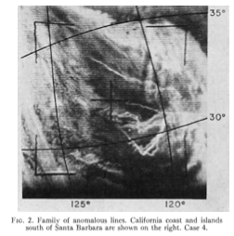
Introduction: Ship-tracks
Conover (1966)
Anomalous cloud lines
Christensen et al., 2022
Excellent ‘opportunistic experiments’ for aerosol indirect effects

Slide 4
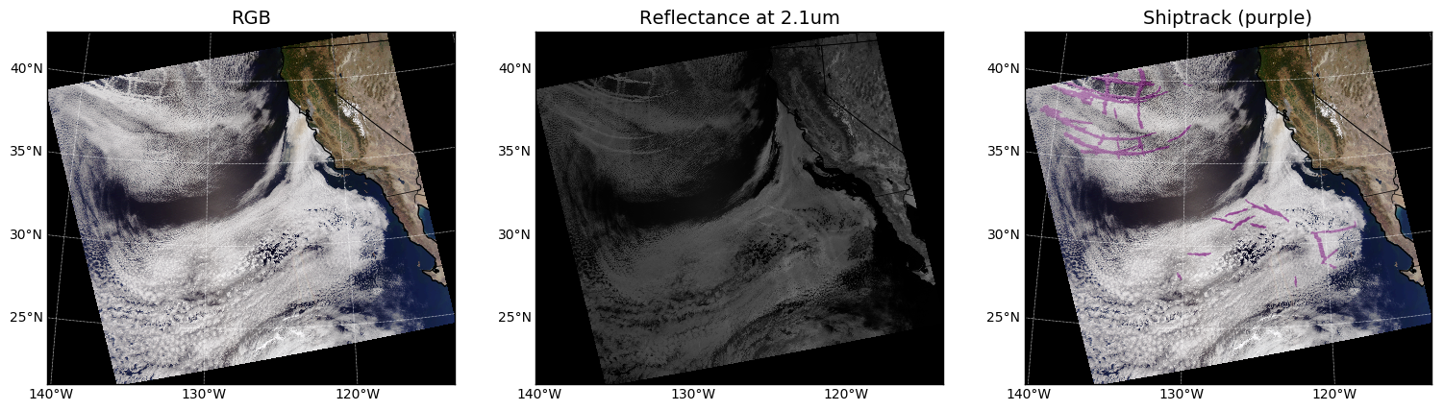
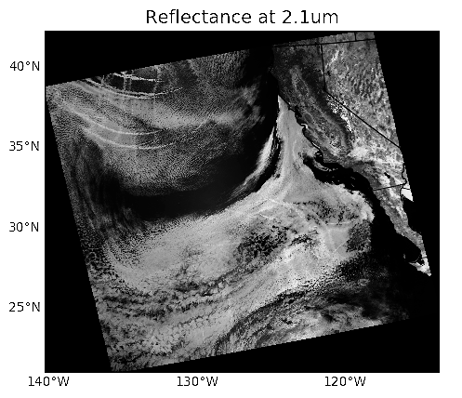
Detection : ML method
Yuan et al (2019 & 2022)
Automatic detection of ship-tracks at both day and night time

Slide 5
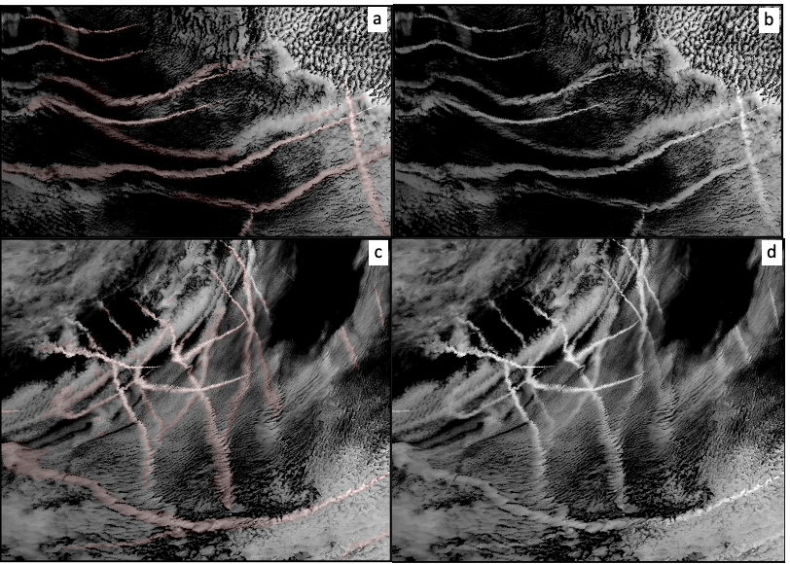
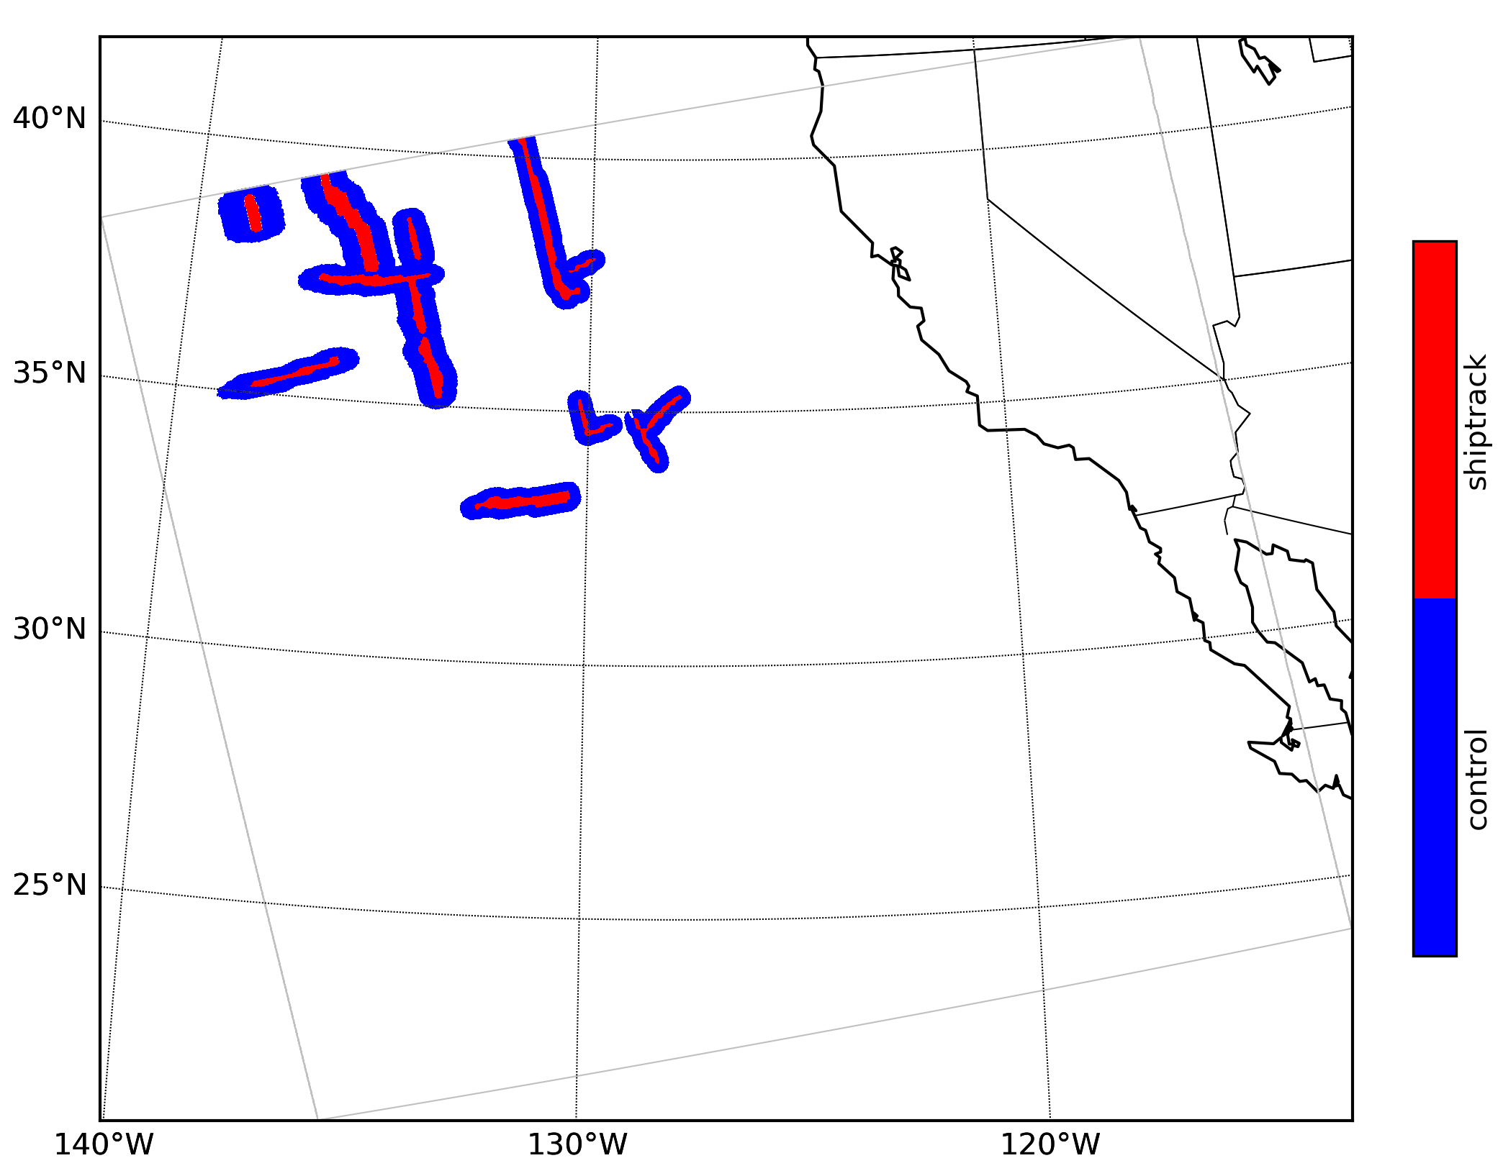
Analysis method: Aerosol-cloud interactions
Study ACI
Detection and analysis

Slide 6
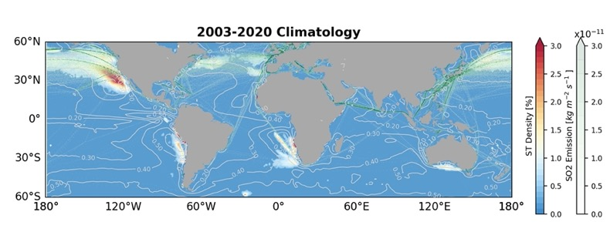
Ship-track distribution
Yuan et al. (2022)
First global climatology map of ship-tracks

Slide 7
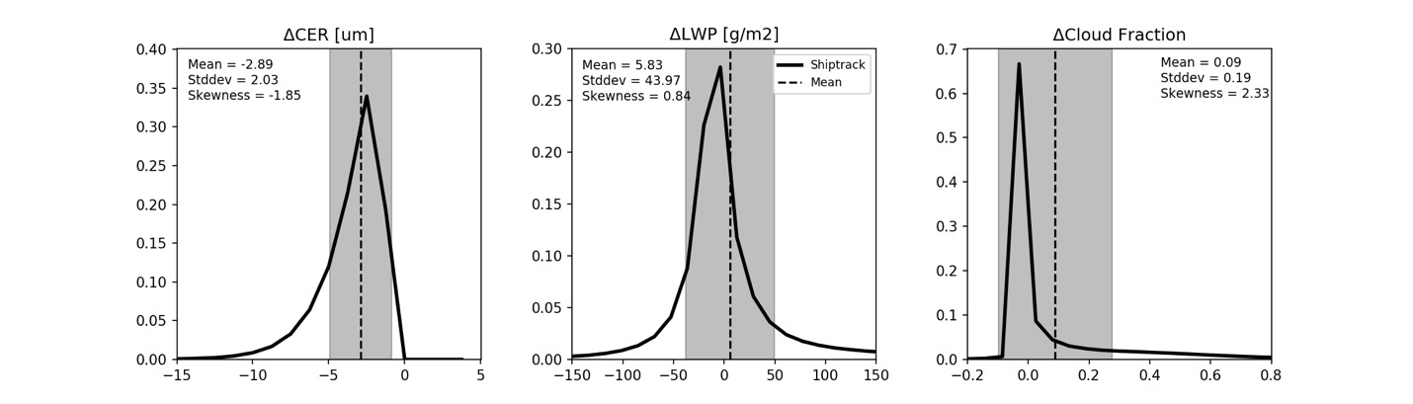
Results: PDFs of bulk changes
Yuan et al. (2022b)
PDFs of changes in cloud properties; high variance

Slide 8
Observation-based AIF estimation: method
Measurement-based
Cloud albedo susceptibility
Scene albedo susceptibility

Slide 9
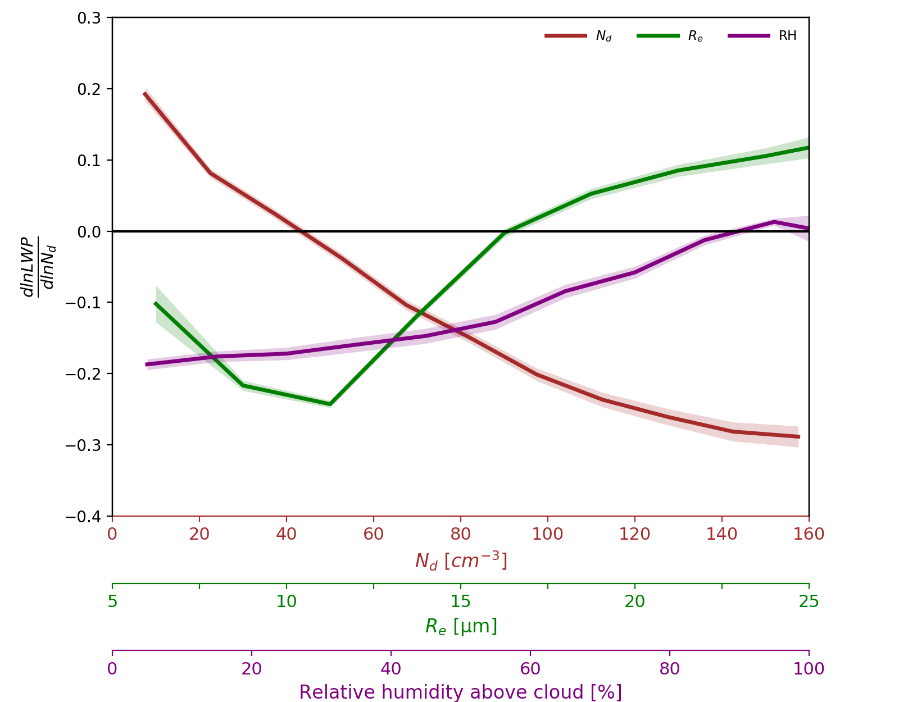
A Few Curious Connections: Aerosol- ML - clouds
dlnLWP/dlnN_{d} systematically depends on background R_{eff}, N_{d}, and above cloud top RH.
Similar to Toll et al. (2019) and refs. in Bellouin et al. (2020).
Drier air above clouds, more polluted and non-precipitating low clouds tend to reduce LWP in response to ship-emitted aerosols.
Such behaviors are often explained by the competing effects of entrainment drying and aerosol-precipitation interactions.
Notes:
Two forces: entrainment impact and aerosol-precipitation impact.

Slide 10
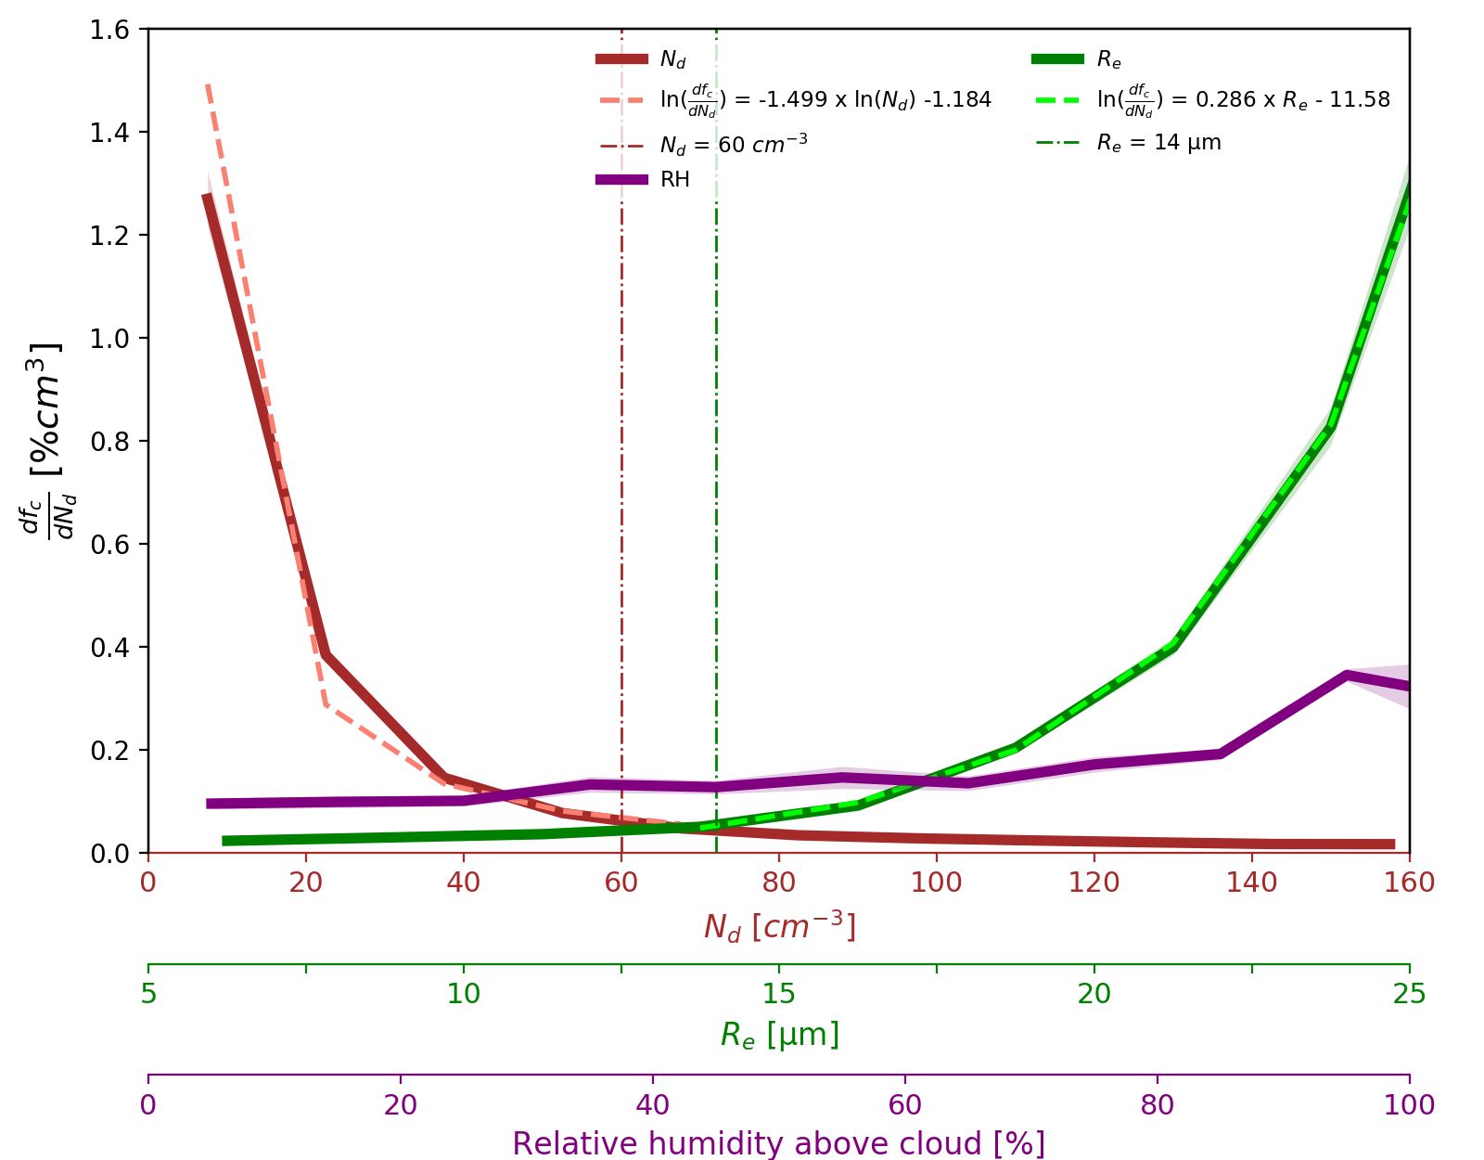
A Few Curious Connections: Aerosol- ML - clouds
CF strongly increases inside ship-tracks once clouds are clean and likely precipitating and the sensitivity is an exponential function of background R_{e}. Minimum CF change under relatively polluted background clouds (e.g. R_{eff} < 14 µm or N_{d} > 60 cm⁻³).
The sensitivity is quantitatively similar to what is reported in Possner et al. (2018).
Rosenfeld et al. (2006); Christensen and Stephens (2011); Goren and Rosenfeld (2012); Wang et al., (2011); Christensen et al. (2020); Possner et al. (2018); Gryspeerdt et al. (2016); Rosenfeld et al. (2019) etc.

Slide 11
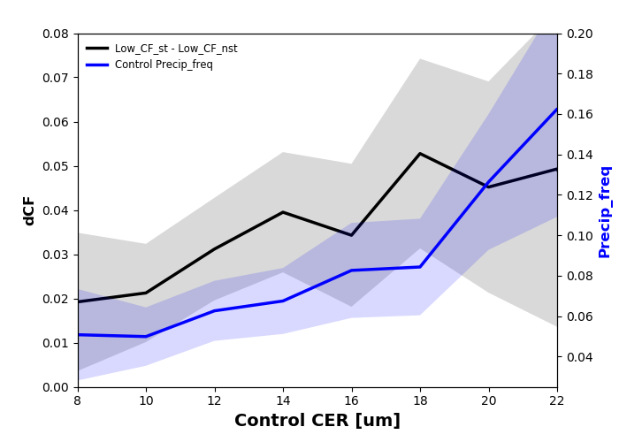
CF changes and precipitation
CF change is proportional to the background cloud droplet size and precipitation frequency.

Slide 12
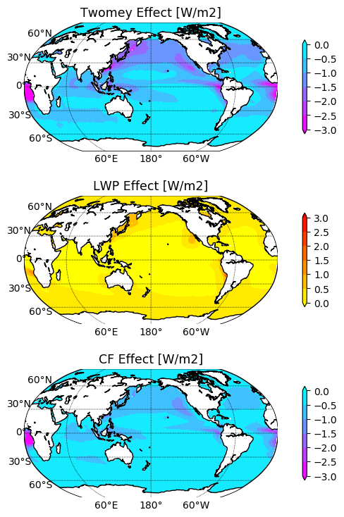
Forcing from three effects: CF effect is strong
CF adjustment amounts to at least 59% of the Twomey effect, could be larger.
LWP adjustment is close to zero when averaged over global ocean.
The CF-effect may be a key driver for the uncertainty in total indirect forcing in low clouds.

Slide 13
Sensitivity: A large variation for CF effect
Table: Forcing Using Different Explanatory Variables (W/m²)
Explanatory variable(s) | Cf Effect/Twomey
N_{d} only | 59%
N_{d} and Cf | 202%
N_{d} and RH | 59%
N_{d} and SST | 130%
N_{d} and EIS | 68%
N_{d}, CF, and RH | 193%
N_{d}, EIS, and RH | 73%

Slide 14
Changes: Impact from shipping fuel regulation
Forcing?
Emission control areas
Global regulation
Yuan et al. (2022)

Slide 15
Conclusions
CF effect is strong and LWP effect is overall weak
Forcing from CF adjustment could be as large as the Twomey effect
59% to 202% of the forcing from the Twomey effect is possible
Precipitation-mediated processes are likely important
Reducing the uncertainty of AIF due to CF effect is critical.

