Slide 1
Land Climate Data Record
Multi instrument/Multi sensor Science Quality Data Records used to quantify trends and changes
81
82
83
84
85
86
87
88
89
90
91
92
93
94
95
96
97
98
99
00
01
02
03
04
05
06
07
08
09
10
11
12
13
14
15
16
17
18
19
20
21
22
A. B. C
AVHRR
N07
N09
N11
N09
N14
METOP
N16
N18
N19
AVHRR
SPOT VEGETATION
Terra
MODIS
Aqua
AVHRR (GAC) 1982-1999 + 2003-2006
MODIS (MO(Y)D09 CMG) 2000-present
VIIRS 2011 – 2025
SPOT VEGETATION 1999-2000
Sentinel 3 2014
NPP
VIIRS
J1
S3A
OLCI/SLSTR
S3B
https://ltdr.modaps.eosdis.nasa.gov
Emphasis on data consistency – characterization rather than degrading/smoothing the data

Slide 2
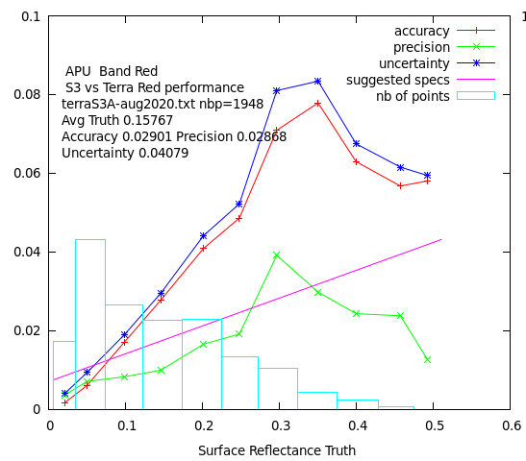
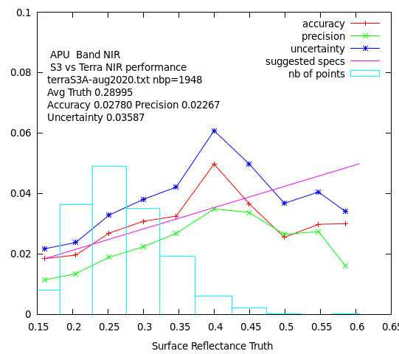
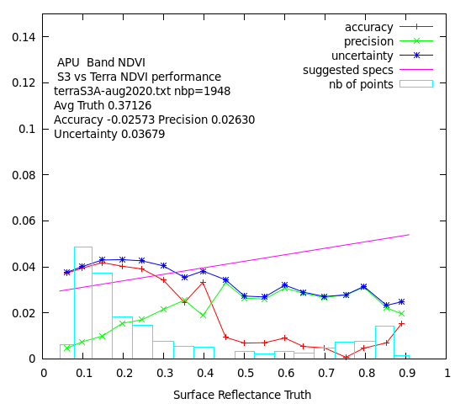
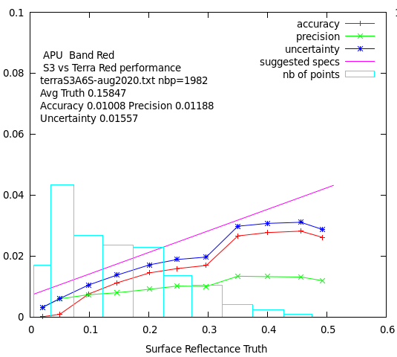
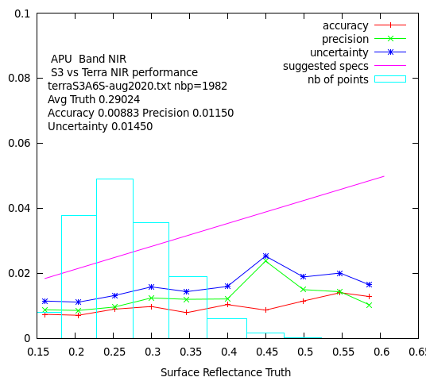
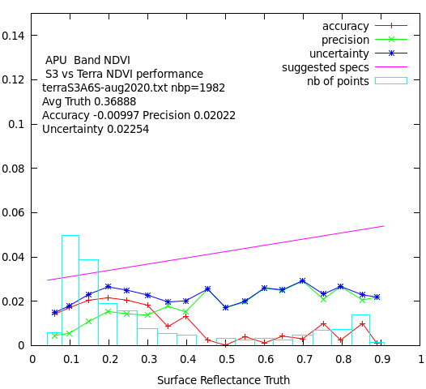
Beyond Terra MODIS…
Sentinel 3 official ESA SR versus Terra (APU) Aug 2020
Sentinel 3 Synergy (OLCI/SLSTR) 10:00am orbit
Covers MODIS spectral range including thermal (cloud screening)
Spatial resolution from 300m to 1km
S3A (2016), S3B(2018), S3C,D (TBL), S3-NG (planned)
Level 1,2 archive in MODAPS
Status and Updates:
Evaluation of L2 (surface reflectance) official ESA product shows room for improvement.
Development of a simple LaSRC prototype on the Level1 data shows promising results.
We are part of the ESA Expert working group on S3-NG
Sentinel 3 prototype LaSRC style SR versus Terra (APU) Aug 2020
Eric Vermote NASA/GSFC

Slide 3
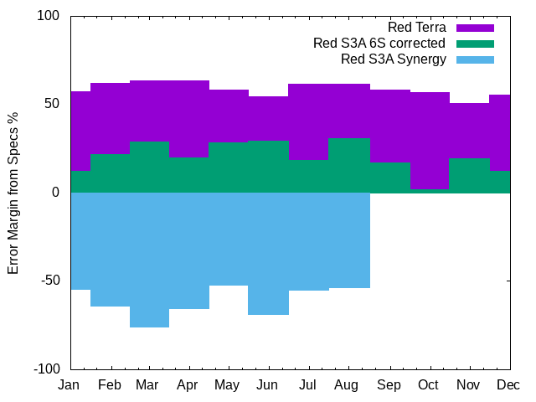
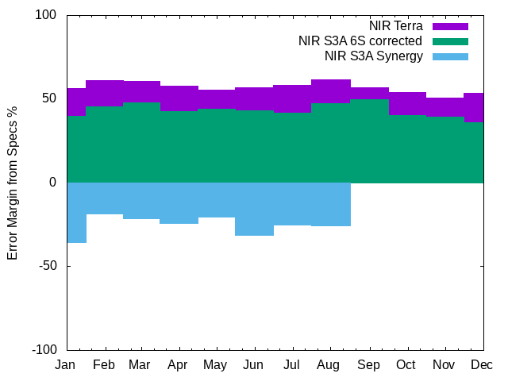
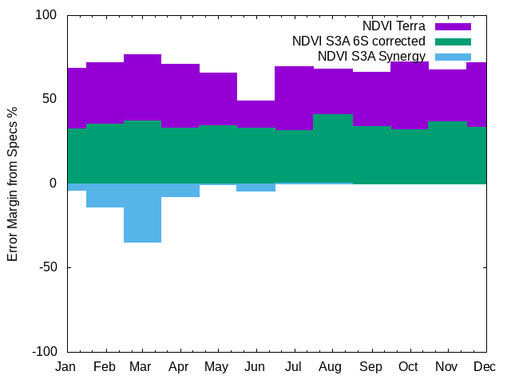
Summary performances for 2020 (Uncertainty)

Slide 4
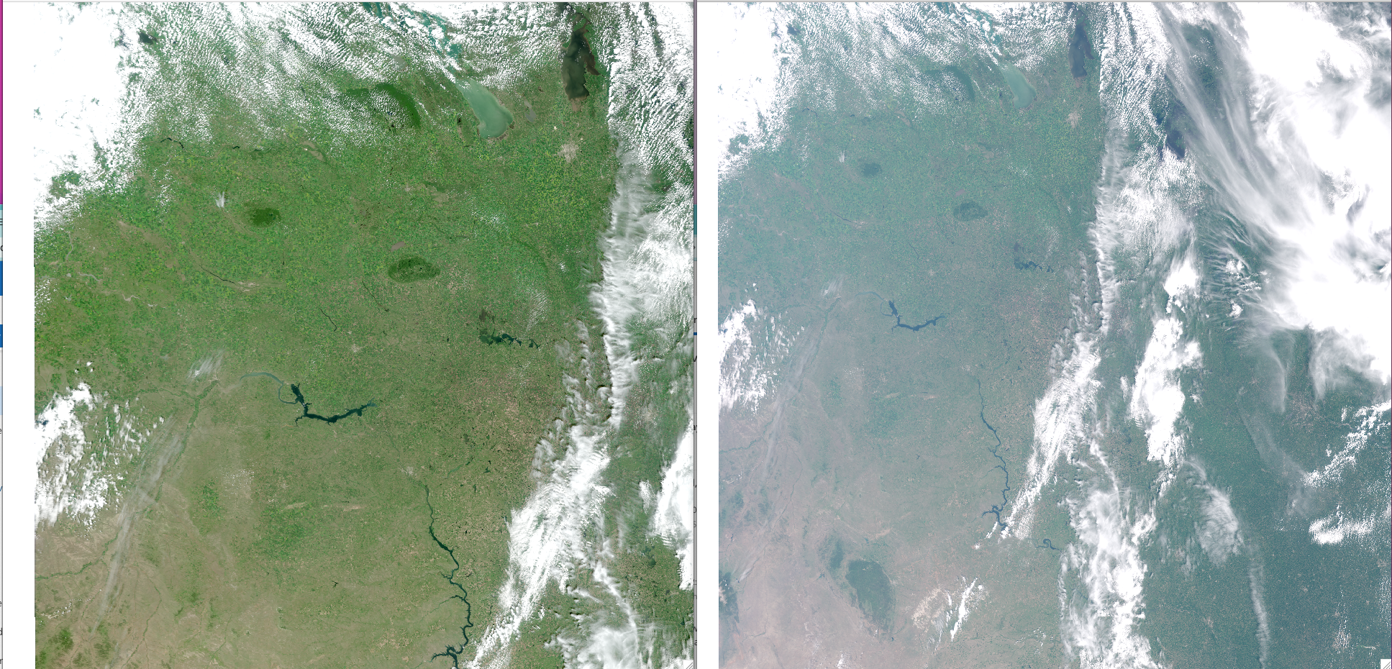
Sentinel 3 Corrected Reflectance (CREFL) Update (E. Vermote)
Two PGE’s, CREFL-O (OLCI), CREFL-S (SLSTR) (L1 inputs netcdf)
CREFL-O (300m bands R,G,B NIR), completed
CREFL-S (500m bands, R,G,NIR SWIR1 (1.6mic), SWIR2 (2.1mic)
Delivered in testing
Corrected reflectance’s (OLCI)
RGB
Top of the atmosphere reflectance’s (OLCI)
RGB
Sentinel 3 Surface Reflectance (SSREFL) development is starting

