Slide 1
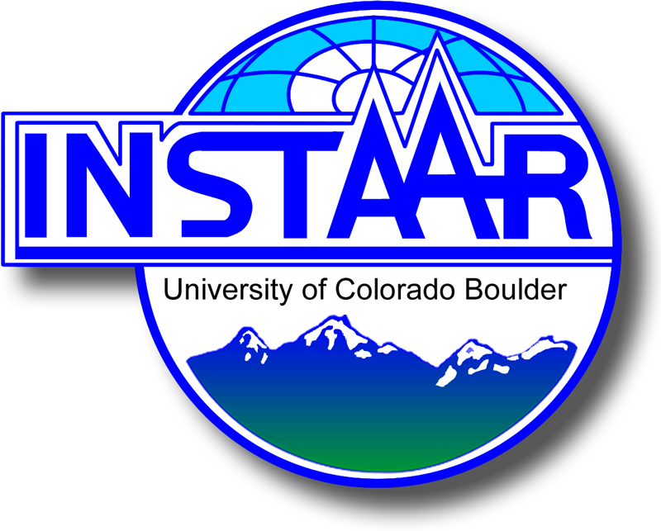

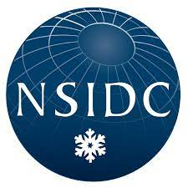


Co-production of snow cover and snow albedo at sub-pixel scale with analysis, uncertainty, and data distribution in near real-time
Karl Rittger, Mark Serreze, Mary J. Brodzik, Mark Raleigh, McKenzie Skiles, Keith Musselman, Sebastien Lenard, Thomas H. Painter, Jeff Dozier, Ned Bair, Timbo Stillinger, and the NSIDC team

Slide 2
Project description
Funded through NASA Terra Aqua Suomi to provide snow surface properties for MODIS and VIIRS
Products include snow cover fraction, snow surface albedo, and snow radiative forcing
Analyze, distribute, and share with researchers, applications groups, and the public
Balance scalability with accuracy for potential global production
Estimate daily uncertainty using higher resolution HLS
Analyze long term MODIS – VIIRS continuity

Slide 3
Year 1 accomplishments and Year 2 plans
July 2022 – July 2023
July 2023 – July 2024
Updated baseline data based on SCAG and DRFS models to address known issues
Redesigned Snow Today website to improve usability, access, and visibility to general public/media
Developed a new interactive web application with many features
Introduced flexibility to expand coverage globally
Published first three Snow Today Articles
Published 4 peer reviewed studies of validation, use in regional snow simulation, snow darkening, and application to wildfire impact on snow melt
Transition to SPIReS data processing and analysis
Transition from MODIS Terra only to MODIS Terra (2001-) & VIIRS NPP (2012-)
Process North America and Greenland addressing scalability
Use HLS to estimate uncertainty regularly for representative areas
Assess range of differences for snow surface properties across MODIS Terra and VIIRS NPP
Continue baseline SCAG/DRFS production for continuity during transition (separately funded)

Slide 4
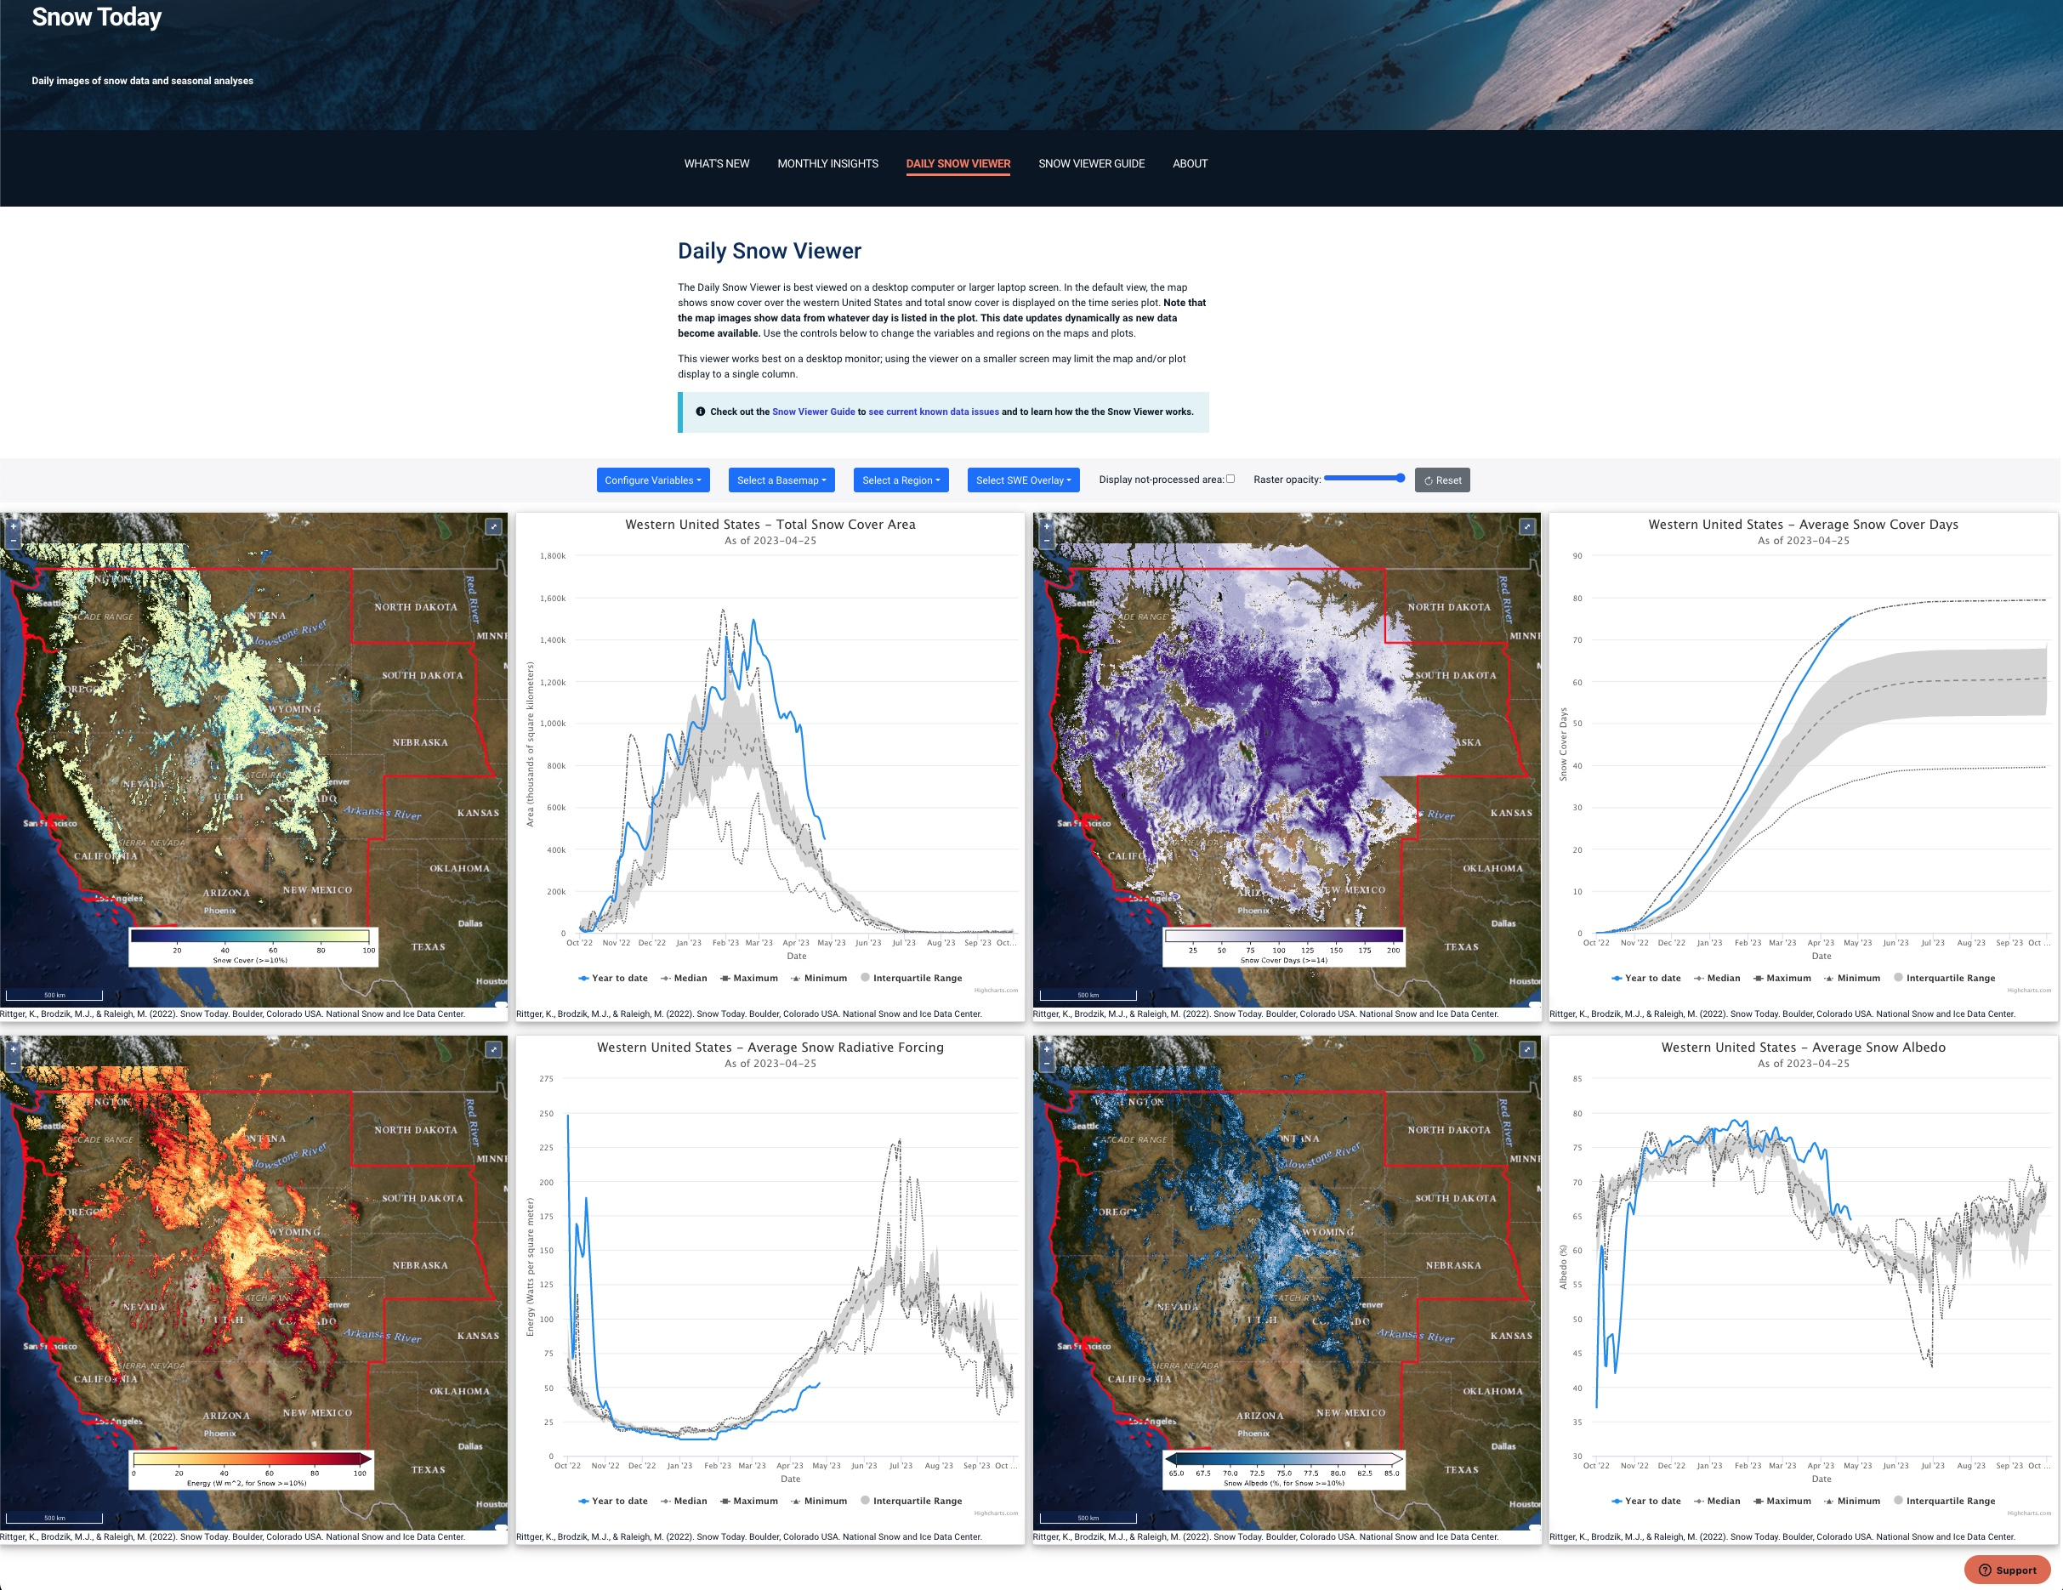
New interactive web application: https://nsidc.org/snow-today/snow-viewer
Configure variables:
  maps and summary plots of snow cover, snow duration, snow albedo and snow radiative forcing
Select a Basemap:
  8 options
Select a Region:
  State, HUC2, and HUC4
SWE overlay:
  amount, change, and percent of normal

Slide 5
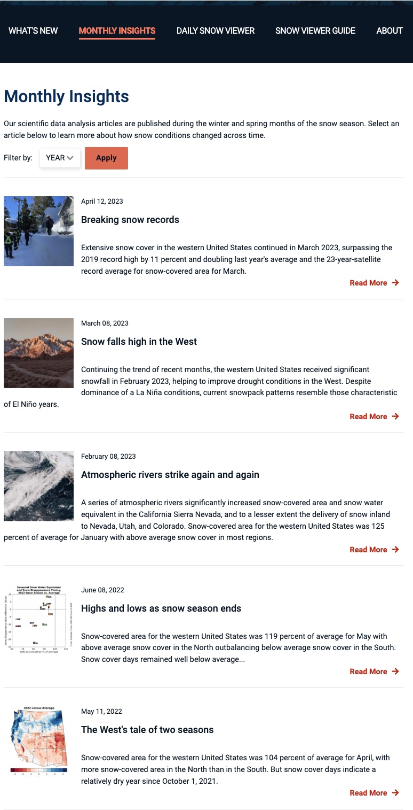
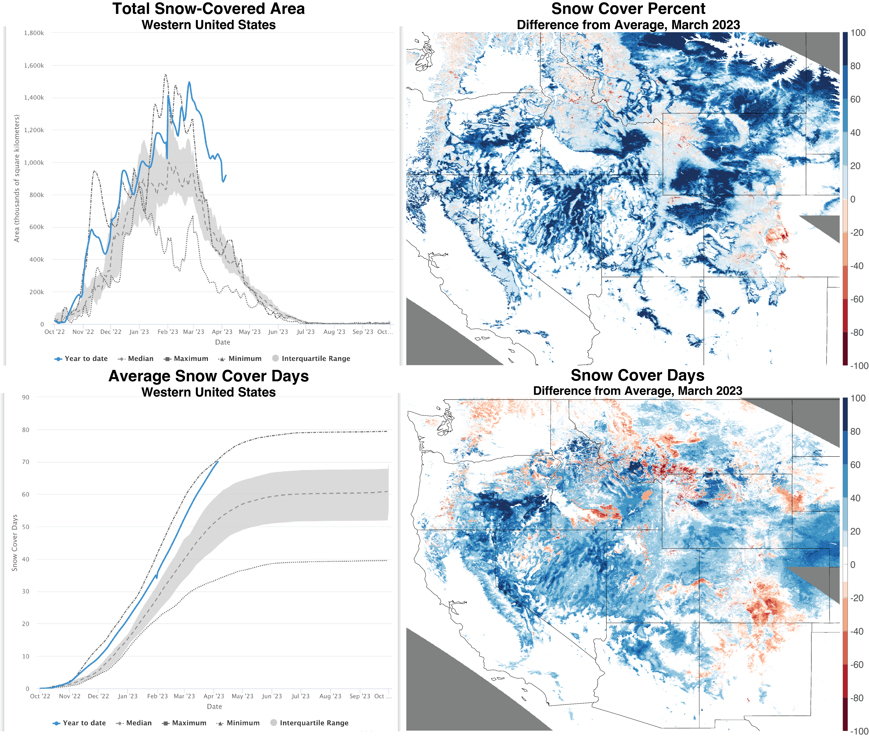
2023 Monthly Insights for January, February, and March https://nsidc.org/snow-today/monthly-insights

Slide 6
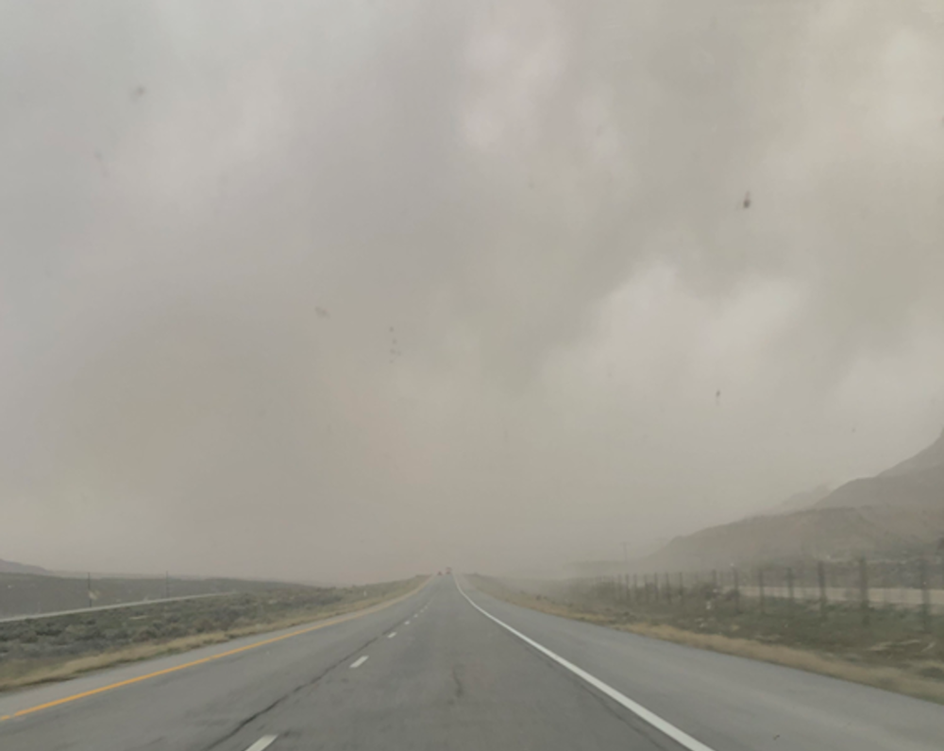
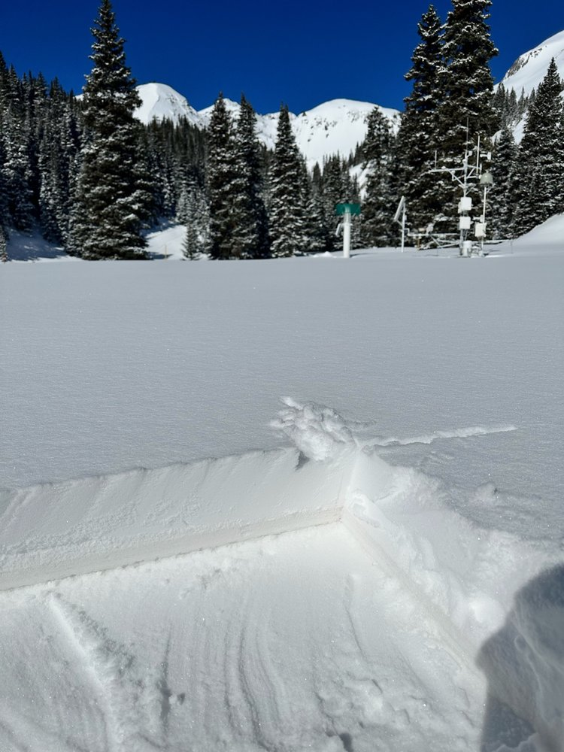
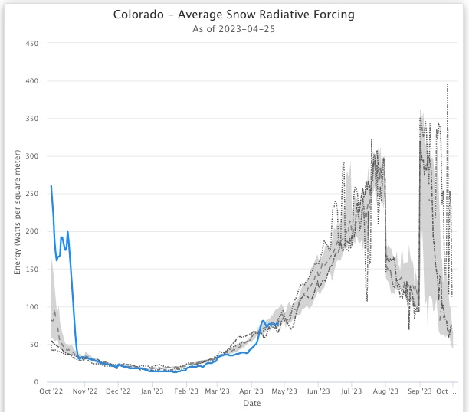
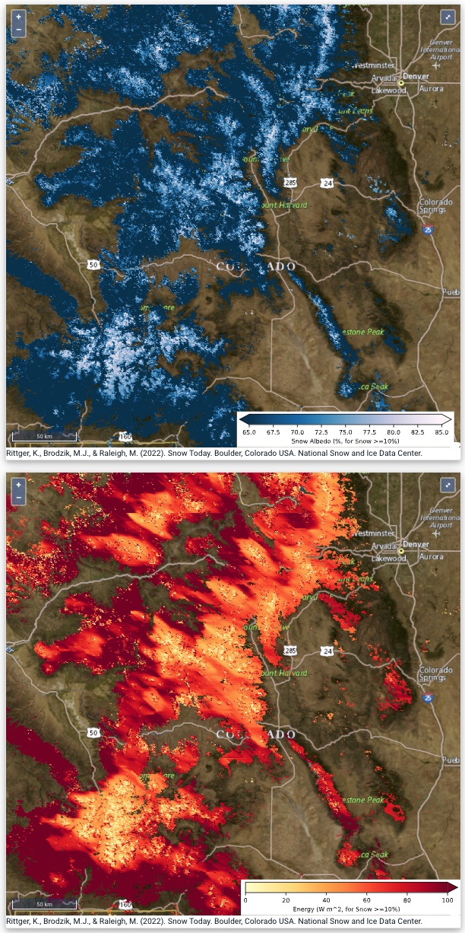
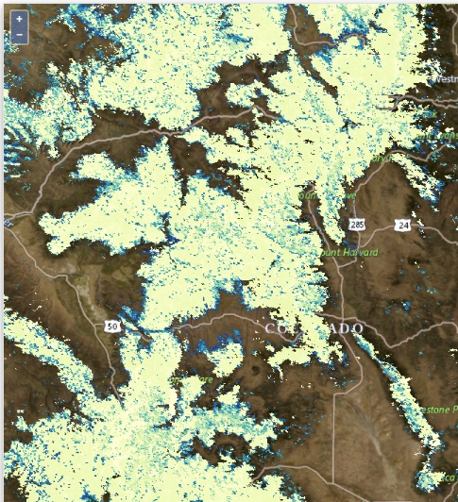
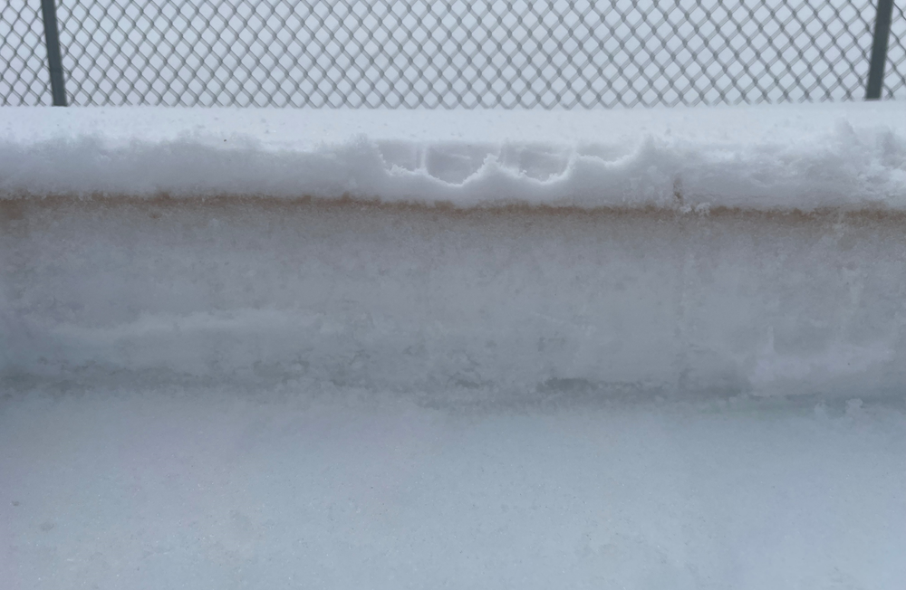
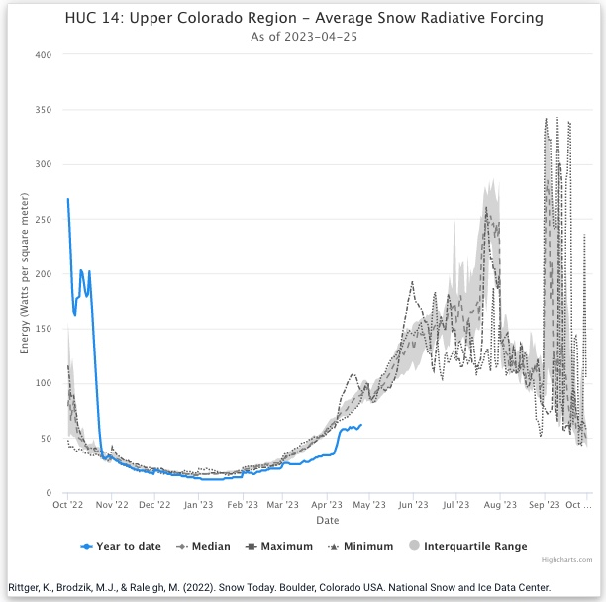
New products snow albedo and snow radiative forcing
Karl Wetlaufer, West of Rifle
State of Colorado
Snow cover fraction
Jeff Derry, Red Mt Pass.
MODIS repositioning
Rifle
Snow Albedo
Aspen
Steve Hunter, City of Aspen
Red Mt Pass
This event turned out to be widespread and a nasty event in terms of the amount of dust deposited on a relatively pristine snowpack that has essentially reached maximum accumulation. It just takes one bad dust event to change things – this one dust event is going to change the characteristics of snow melt and runoff for the duration of spring dramatically. – Jeff Derry
Upper Colorado basin
Snow Radiative Forcing
MODIS repositioning
http://www.codos.org/codosupdates/april062023

Slide 7
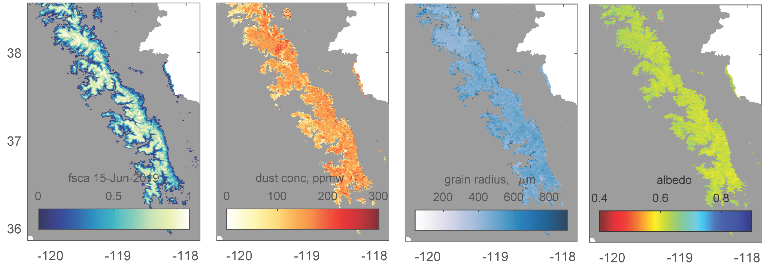
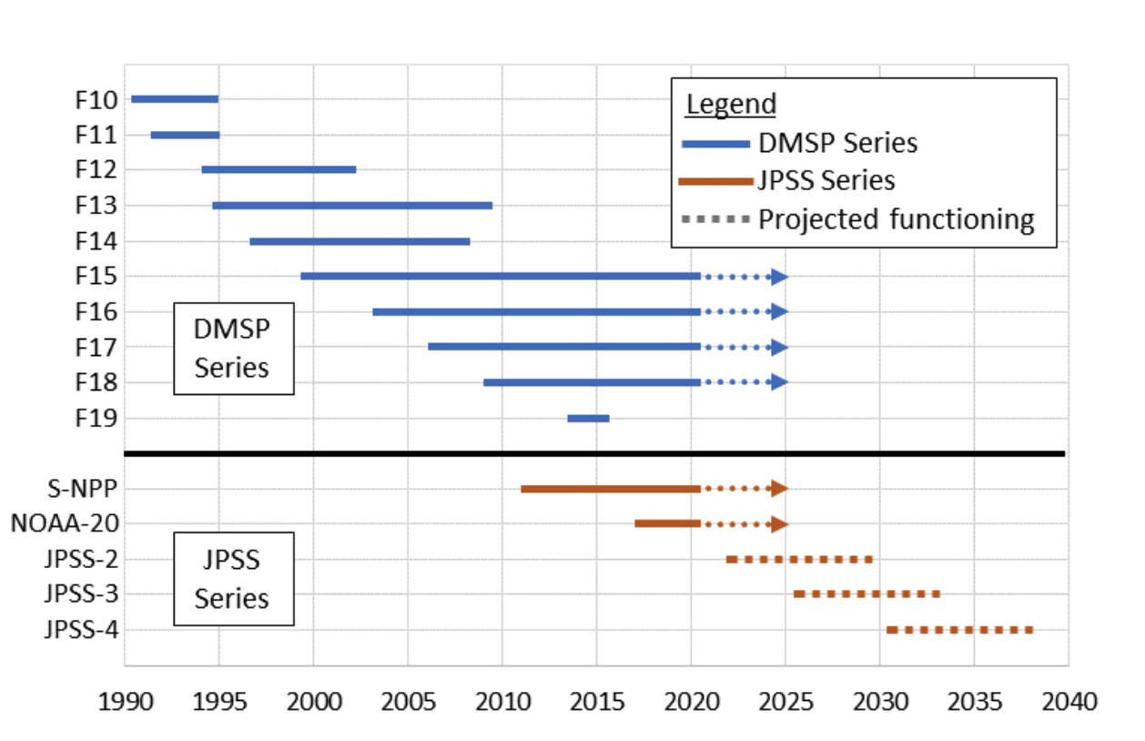
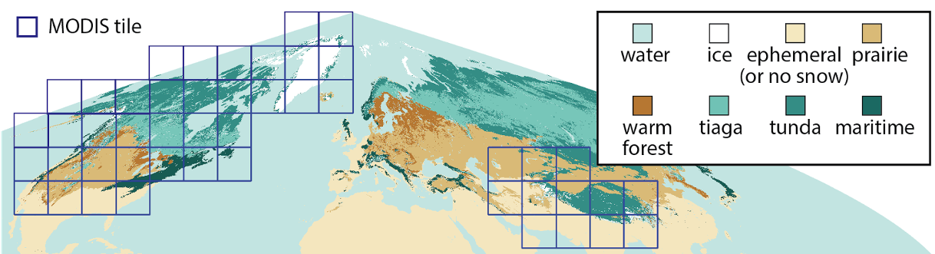
MODIS and VIIRS - SPIRES
SPIReS: subpixel measurement of snow properties for multi or hyperspectral sensors.
Snow Covered Area
Physical properties of the snowpack
                Contaminant Concentration
                Snow grain size
                Snow albedo
Snow
cover
Dust
conc.
MODIS Terra Era
Grain
radius
Albedo
Planned tiles this project

Slide 8
Recent publications
Comparing snow mapping methods to airborne lidar 3m snow maps
Stillinger, T., Rittger, K., Raleigh, M.S., Michell, A., Davis, R.E., & Bair, E.H. (2023). Landsat, MODIS, and VIIRS snow cover mapping algorithm performance as validated by airborne lidar datasets. The Cryosphere, 17, 567-590, https://doi.org/10.5194/tc-17-567-2023
Evaluating modeled snow simulations
Hao, D., Bisht, G., Rittger, K., Stillinger, T., Bair, E., Gu, Y., & Leung, L.R. (2023). Evaluation of E3SM land model snow simulations over the western United States. The Cryosphere, 17, 673-697, https://doi.org/10.5194/tc-17-673-2023
Assessing the impacts of wildfire on snow duration and snow albedo
Hatchett, B.J., Koshkin, A.L., Guirguis, K., Rittger, K., Nolin, A.W., Heggli, A., Rhoades, A.M., East, A.E., Siirila-Woodburn, E.R., Brandt, W.T., Gershunov, A., & Haleakala, K. (2023). Midwinter dry spells amplify post-fire snowpack decline. Geophysical Research Letters, 50, e2022GL101235. https://doi.org/10.1029/2022GL101235
Investigating snow darkening
Huang, H., Qian, Y., He, C., Bair, E.H., & Rittger, K. (2022), Snow albedo feedbacks enhance snow impurity-induced radiative forcing in the Sierra Nevada. Geophysical Research Letters, 49, e2022GL098102, https://doi.org/10.1029/2022GL098102

