Slide 1
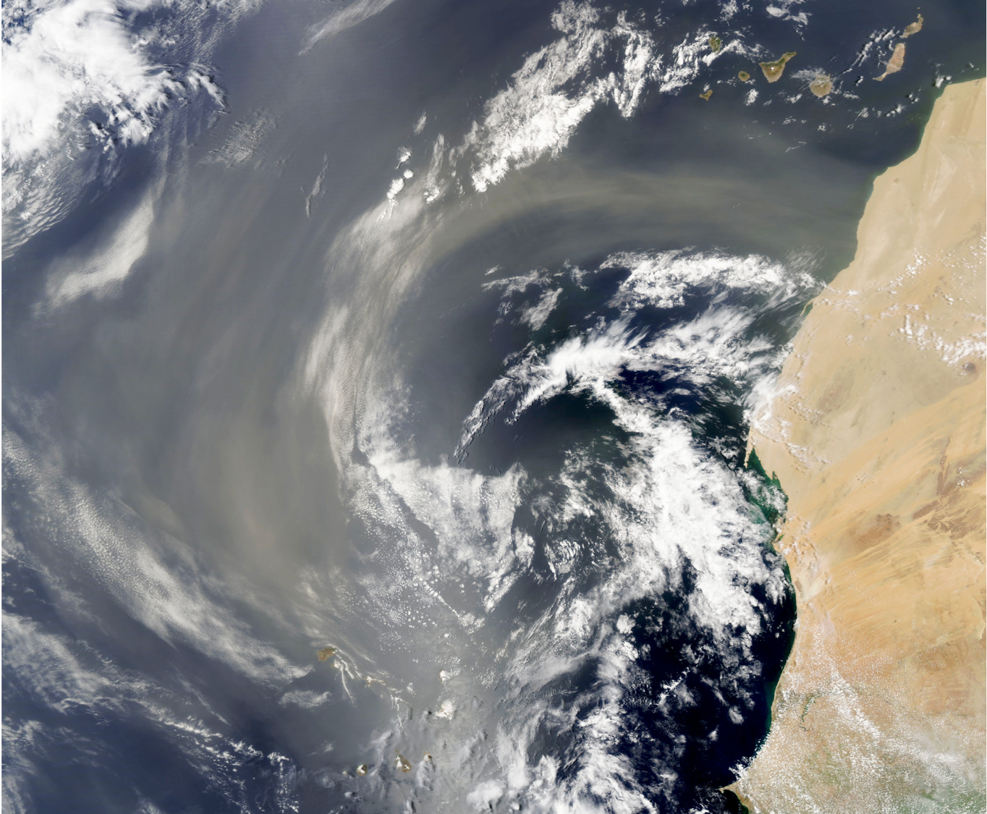
Nourishment of the Global Oceans
from Deposition of Atmospheric Dust Aerosol
Toby Westberry, Michael Behrenfeld,
Yingxi Rona Shi, Hongbin Yu
Huisheng Bian and Lorraine Remer
Publication in Science 04 May 2023

Slide 2
The story begins in 2016 with a comprehensive IDS proposal to study “Aeolian fertilization of marine ecosystems” in a carbon budget framework.
DECLINED by NASA
The story continues in 2017 with a pared down TASNPP proposal to “Understand airborne fertilization of oceanic ecosystems”.
SELECTED by NASA
Woo hoo!
And now 7 years later… we have our paper in Science.

Slide 3
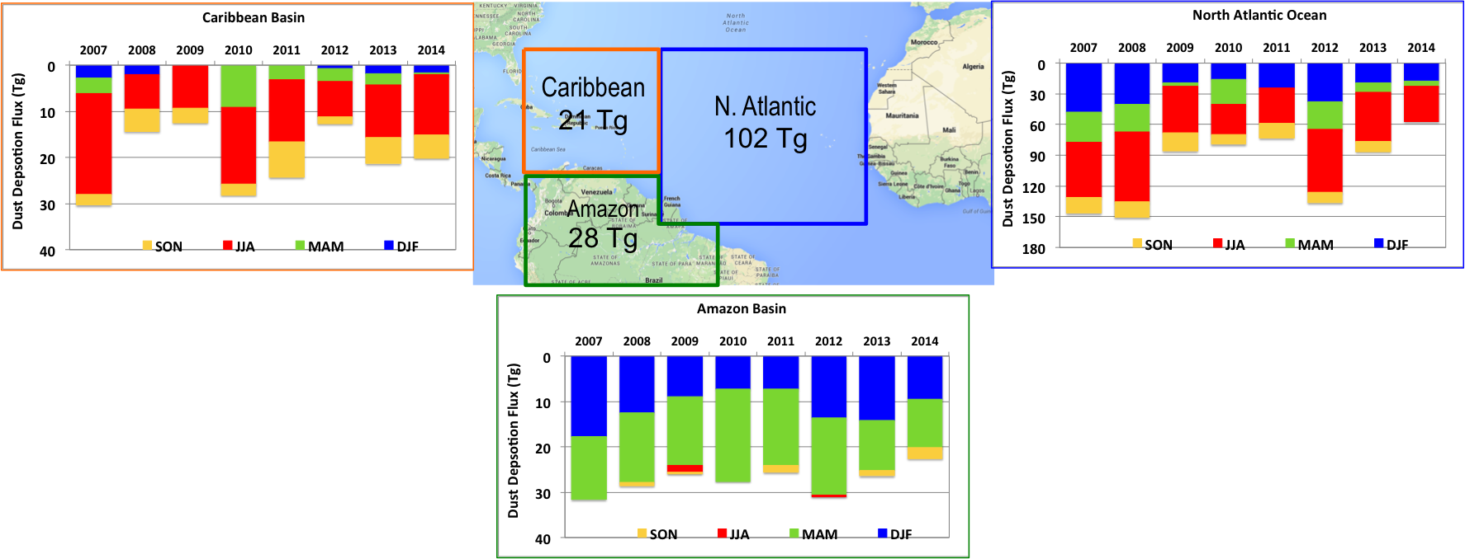
Remote sensing estimates of dust deposition in ocean and land basins
Illustration box 1 – Satellite-Based estimates of dust deposition into 3 different basins. Estimates were made using only CALIPSO observations.
Bars indicate annual totals in Tg with colors denoting totals by season. Interannual variability of deposition into oceans can vary by 50%. Strong seasonal shifts occur.
Yu et al. (2015)

Slide 4
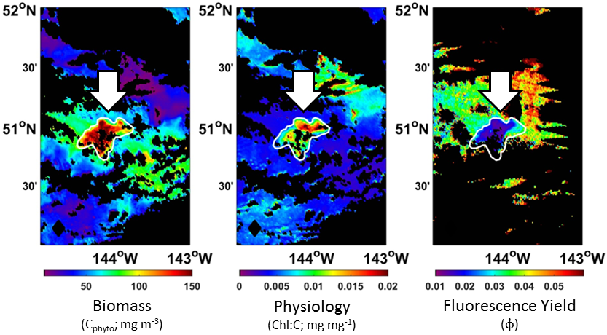
Remote sensing signal from in situ iron fertilization experiments
Westberry et al. (2013)

Slide 5
The atmospheric deposition remote sensing methods were useful on time scales of moths to seasons.
The ocean response took place on the order of days.

Slide 6
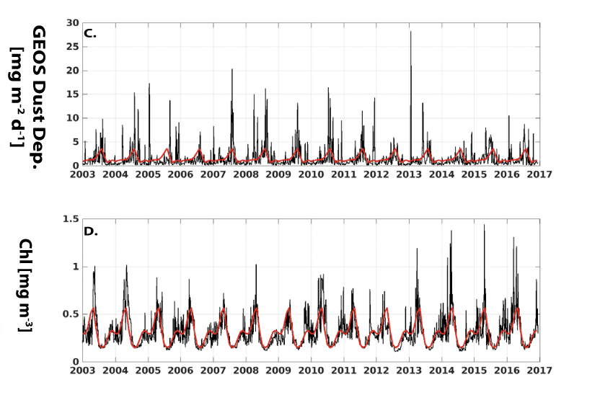
We addressed the issue by going to the Goddard Earth Observing System (GEOS) model to quantify dust deposition over 5º latitude by 10º longitude in 4-day tetrads.
GEOS aerosol loading has a long history of comparison using satellite products.
GEOS systematically underestimates magnitudes of deposition, but captures events
Westberry et al., 2023

Slide 7
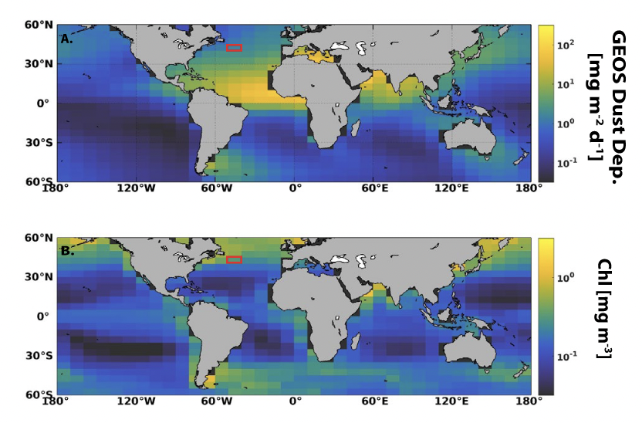
There is no spatial correlation between deposition and chlorophyll
Westberry et al., 2023

Slide 8
Solution: Attack the problem temporally.
What is the response of the ocean to dust deposition events?
Response =
OP(t_{event} + 4 days)
- OP(t_{event} – 4 days)
Westberry et al. (2023)

Slide 9
The atmospheric deposition of dust was most easily quantified in the Atlantic
The iron limited regions of the ocean ecosystems were not in the Atlantic

Slide 10
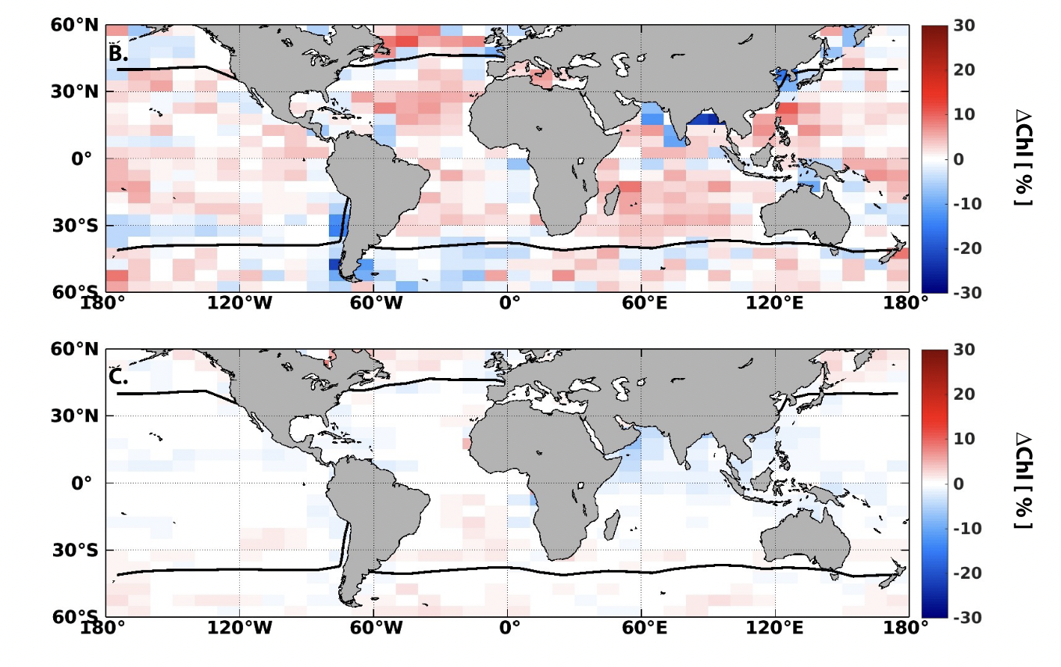
Chlorophyll response from Aqua
Top 10% of events
10% Randomly sampled

Slide 11
Phytoplankton Carbon Biomass response from Aqua

Slide 12
Chlorophyll to carbon ratio response from Aqua

Slide 13
Chlorophyll fluorescence quantum yield (φ_{f}) response from Aqua

Slide 14
Take home messages
Nourishment, not iron. Dust holds other nutrients like phosphorous.
Global, not just HNLC regions.
Dust events relative to background conditions. May be very modest amounts of dust, absolute
Response may be increased biomass or may be physiological changes
Atmospheric nutrients are not extraordinary, but part of the ocean system, which could change in a changing climate
7 years to get to this point. Many questions unanswered, especially concerning sources and chemical transformations of the dust.

