Slide 1
MODIS-Aqua perspective
Lazaros Oreopoulos NASA-GSFC
Aqua Project Scientist

Slide 2
Happy 21st anniversary Aqua!
Aqua launched on May 4th, 2002

Slide 3
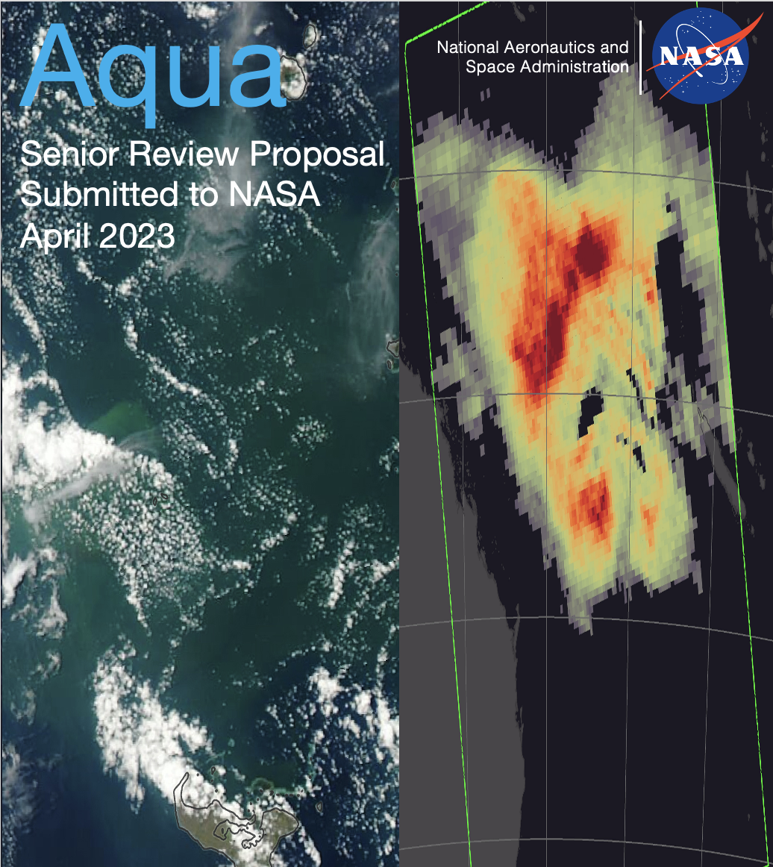
Likely Aqua Future
Will be extended for ~ 3 years of science operations (~July 2026) + ~ 3 years of Science Phase F (FY27-FY29)
Will reach ~3:30 MLT by July 2026
MLT projection different than in 2022 EOS Drifting Orbits Workshop (no PLMs in Summer 2024)
Subject to successful Senior Review
Proposal submitted on April 14, 2023 (284 pages!)
Lean “inguide” budget (~50% of optimal)
Continue science/applications despite drift, enable new science/applications because of drift

Slide 4
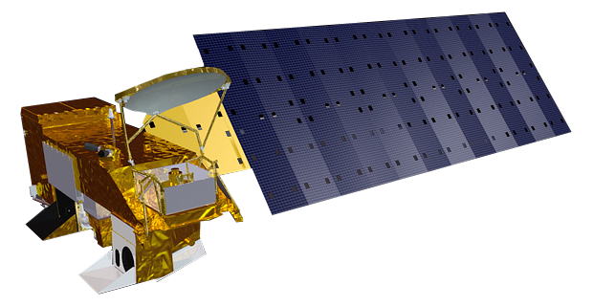
Highlights of Aqua SR2023 proposal
Accomplishments of last 3 years in science and applications
Value of extended mission: most came from RFI responses and Drifting Orbits workshop
Relevance to 10 Decadal Survey Targeted Observables (TOs)
Hardware is in good shape
Flight software (clock rollover) anomaly in January 2026 will be prevented
Not enough power because of drift and deteriorating beta angle by August-September 2026
Need to satisfy 25-year re-entry requirement

Slide 5
MODIS-specific
36 of 109 RFI EOS Drifting Workshop responses had MODIS content
Aqua SR2023 proposal highlighted:
Unique spectral information of MODIS (531, 678, 940 nm, IR O3, WV, CO2 bands)
Wide swath allows fixed Local Time observations at different geometries
More observations of fires and convection at their peak (later MLTs)
Diurnal cycle (LST for heat stress, ET for plant stress)
Overlap with PACE and CLARREO-PF
Can correct historical imagers that drifted
24 MODIS algorithm maintenance proposals, 22 common with Terra, one unique to Aqua, one unique to Terra
Budgets generally restrained, hope to be able to fund at levels reasonably close to requests

Slide 6
Challenges
Aliasing of CDR time series
Less clear-sky over land later in the afternoon
Lower SNR may be problem in some cases (e.g., ocean R_{rs})
Reduced geographical coverage for some products
Algorithm mods because of MLT drift beyond maintenance?
Future ROSES (e.g., TASNPP) with element on new science because of drift?
Continuity (upcoming workshop May 23-25)

