Slide 1
Seasonally varying bias in MODIS/Aqua ocean color retrievals and its potential relationship to polarization sensitivity
Amir Ibrahim and Gerhard Meister
NASA
MODIS/VIIRS Science Team Meeting
May 2nd, 2024

Slide 2
Outline
Background on the seasonal bias
Investigating bias in SeaWiFS, MODIS Aqua, Terra, and SNPP
SeaBASS validation at MOBY
Conclusion

Slide 3
Elements with potential impact on seasonal bias
Instrument calibration (cross-calibration, polarization correction, RVS, trends, etc.)
MOBY timeseries data (calibration issues, BRDF correction, vertical depth Lu extrapolation, surface effects).
Vicarious calibration procedure (i.e., absolute calibration at NIR, data filtering, spatial variability).
Atmospheric correction (BRDF correction, glint, aerosol type).
Uncertainties in both in-situ as well as satellite retrievals.

Slide 4
Background
Much of this work stemmed from a comparative analysis by K. Bisson between the backscattering coefficient derived from MODIS Aqua, CALIOP and Argo floats.
It was discovered that there is a seasonal and latitudinal discrepancy between MODIS and CALIOP and Argo floats.
This work summarized in the GRL paper.

Slide 6
Global comparison

Slide 7
Bias in the remote sensing reflectance (Rrs) Analysis at MOBY
MOBY
Satellite

Slide 8
Bias in the remote sensing reflectance (Rrs) Analysis at MOBY
Ratio to MOBY
bias in the summer

Slide 9
Multiple linear regression
Ideally all independent
variables will have a slope of 0 and Rrs_moby of 1
Potential contributors to the bias:
BRDF
The aerosol type and optical depth

Slide 10
Study summary
Ocean color data are seasonally biased in low biomass regions.
In terms of IOPs, bbp is the most affected as it’s directly related to the magnitude of Rrs, while aph and adg are not.
The bias in Rrs is more pronounced towards longer wavelengths.

Slide 11
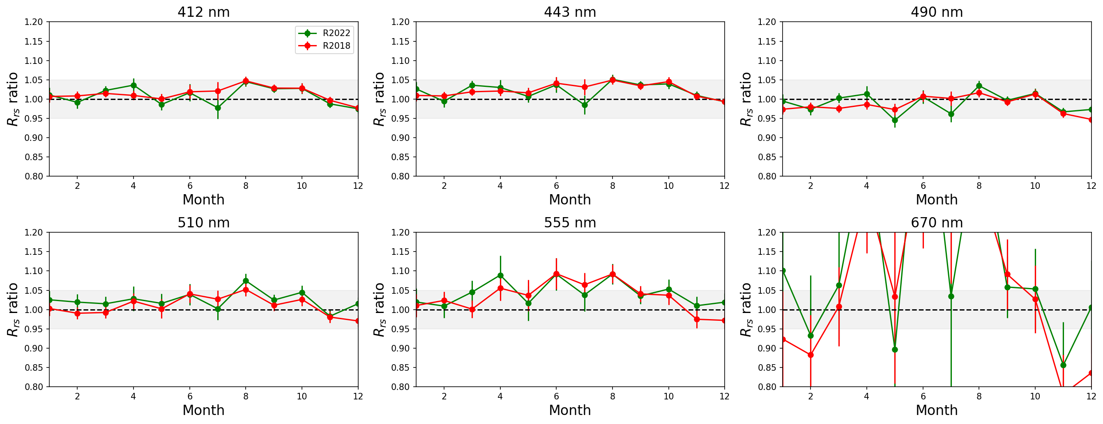
Standard processing: 2018 vs 2022 SeaWiFS
small seasonal bias

Slide 12
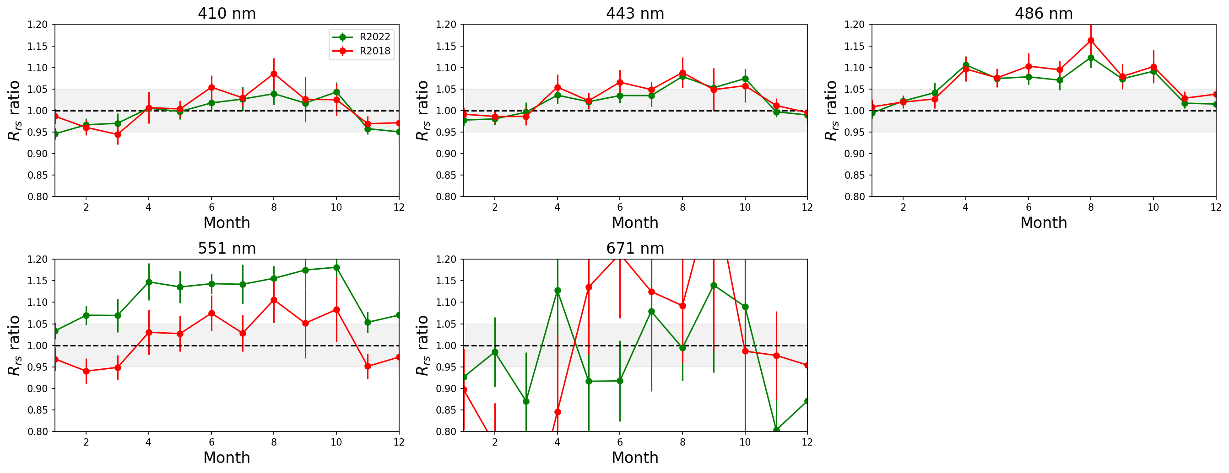
Standard processing: 2018 vs 2022 SNPP
some seasonal bias

Slide 13
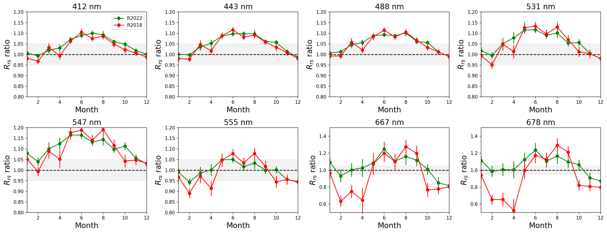
Standard processing: 2018 vs 2022 MODIS Aqua
Strong seasonal bias
Improvement in R2022

Slide 14
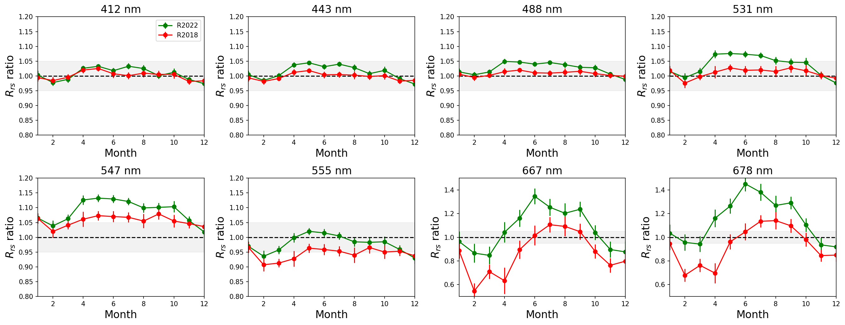
Standard processing: 2018 vs 2022 MODIS Terra
Small seasonal bias

Slide 15
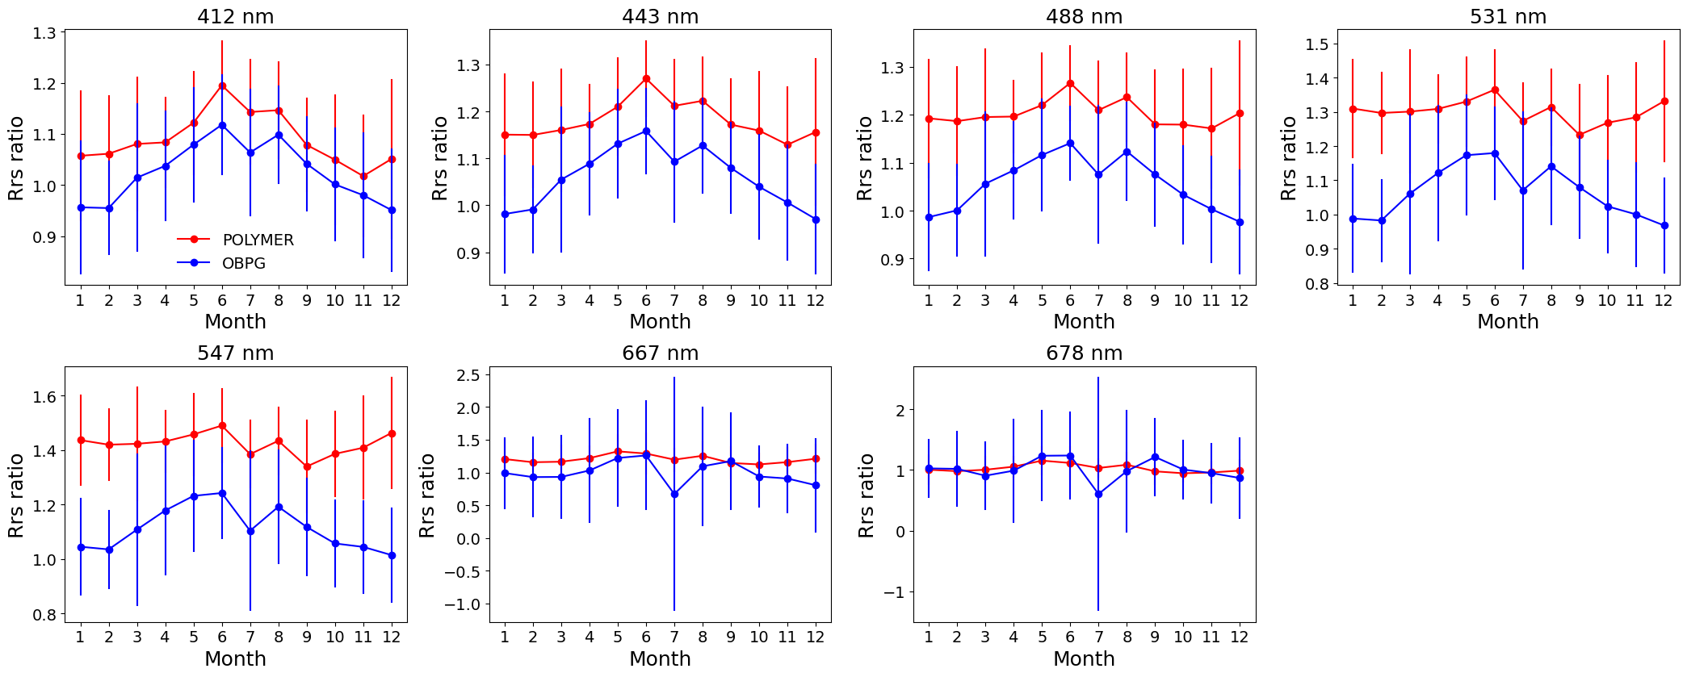
POLYMER algorithm versus OBPG: MODIS Aqua
Strong seasonal bias in the blue
Results from Robert Frouin
No SVC applied
Ratio of Rrs POLYMER or OBPG and Rrs MOBY

Slide 16
A further assessment of calibration
All sensors use the same algorithms for data processing but exhibit different seasonal biases.
The primary differences between sensors are related to their cross-calibration and polarization correction.
Cross-calibration aims to improve the Response versus scan calibration and estimate the polarization sensitivity.
Cross-calibration is performed differently for each sensor:
SeaWiFS - no cross-calibration
MODIS Aqua - cross-calibrated to itself
MODIS Terra - cross-calibrated to Aqua
VIIRS - no cross-calibration
The polarization correction for Terra is derived from Aqua, but Aqua utilizes pre-launch polarization characterization.
We are investigating cross-calibration of Aqua to SeaWiFS to derive new polarization elements m12 and m13.

Slide 17
Polarization sensitivity impact on ocean color
The measured at-sensor radiance $I_{m}$ is the summation of unpolarized radiance* $I_{t}$ and the polarized radiance $Q_{t}$ and $U_{t}$ modulated by the Mueller elements of the instrument.
If the the TOA radiance is unpolarized (i.e., $Q_{t}$ and $U_{t}$ are zeros) or if the instrument has no sensitivity to the polarization (i.e., $m_{12}$ and $m_{13}$ are zeros), then $I_{m}$ = $I_{t}$.
TOA radiance is highly polarized and with a polarization sensitive instrument, $I_{m}≠I_{t}$
The polarization sensitivity is defined as follows:
$$P_{s}=\sqrt{m_{12}^{2}+m_{13}^{2}}$$
To perform correction, we need knowledge of:
The polarized at-sensor radiance $Q_{t}$ and $U_{t}$ (if not measured then approximated from Rayleigh scattering)
$m_{12}$ and $m_{13}$ (pre-launch characterization of sensorss)
$I_{m}=I_{t}$+ $m_{12}Q_{t}+m_{13}U_{t}$
$$P_{c}=\frac{1}{1−m_{12}{Q_{t}}/{I_{m}}−m_{13}{U_{t}}/{I_{m}}}$$
Polarized radiance unknown
$$P_{c}=\frac{1}{1−m_{12}{Q_{R}}/{I_{m}}−m_{13}{U_{R}}/{I_{m}}}$$
Approximate the polarized radiance from Rayleigh model
*$I_{t}$is the radiance that would be measured by a sensor with no polarization sensitivity
More details in Meister et al., 2005

Slide 18
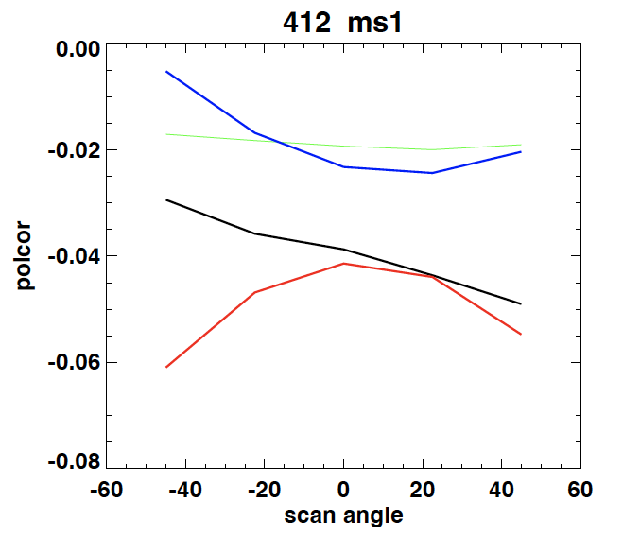
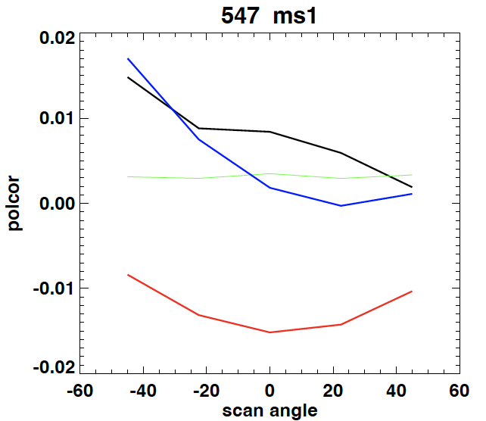
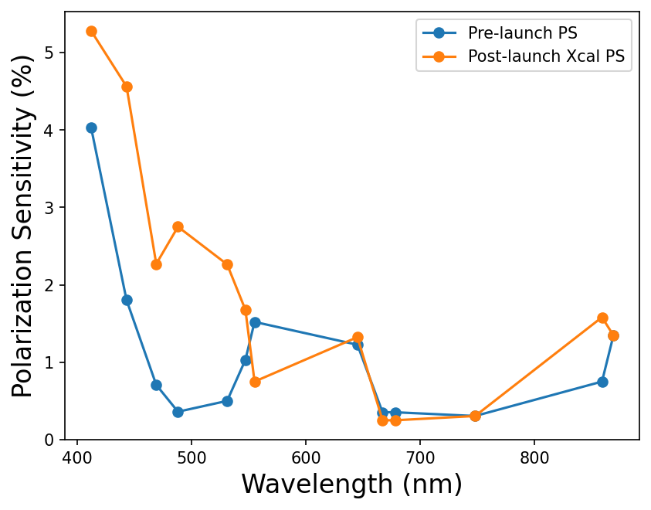
Polarization sensitivity xcal derived vs pre-launch
For ms1 and -20 scan angle

Slide 19
Cross-calibration of Aqua to SeaWiFS (M11, m12, and m13)
LUT version axc61e

Slide 20
Cross-calibration of Aqua to SeaWiFS, M11 Aqua xcal to Aqua
LUT version V2.7e

Slide 21
Conclusion
OBPG is actively working on a resolution, as additional insight is needed.
The multispectral treatment of MOBY data introduces a constant bias in the validation process compared to SVC, which considers the full RSR of the satellite. Therefore, the validation process is being re-evaluated.
This constant bias exacerbates the impact of the seasonal bias magnitude.
Aqua shows significantly larger biases than SeaWiFS, Terra, and SNPP, suggesting an instrument-dependent issue (calibration) with Aqua.
While there may be residual algorithm biases (AC, BRDF, PS correction, etc.), they are likely not the primary cause of the seasonal bias in Aqua.
Cross-cal derived polarization sensitivity shows some improvement in reducing the seasonal bias. RVS has a strong impact in the blue and will be further investigated.

Slide 22
Appendix

Slide 23
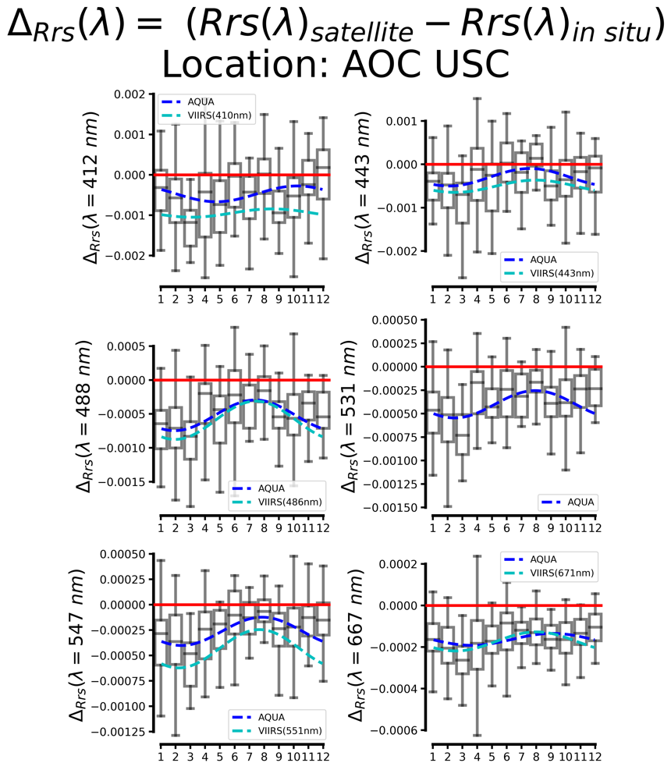
Seasonal Bias at AERONET-OC sites

Slide 24
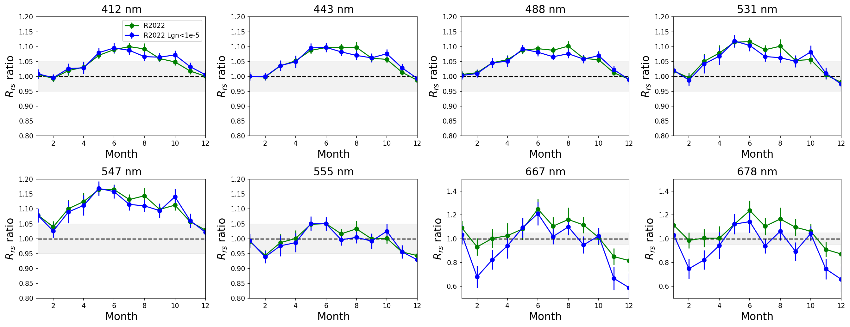
Impact of glint

Slide 25
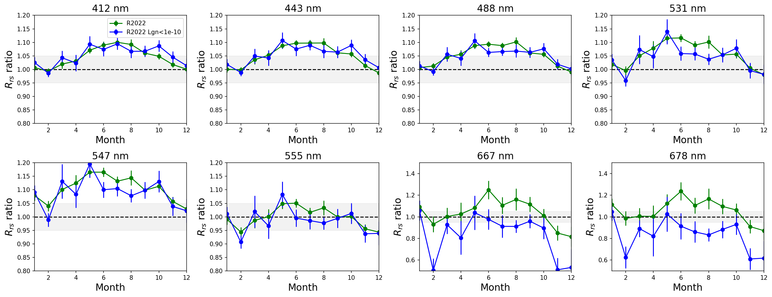
Impact of glint

Slide 26
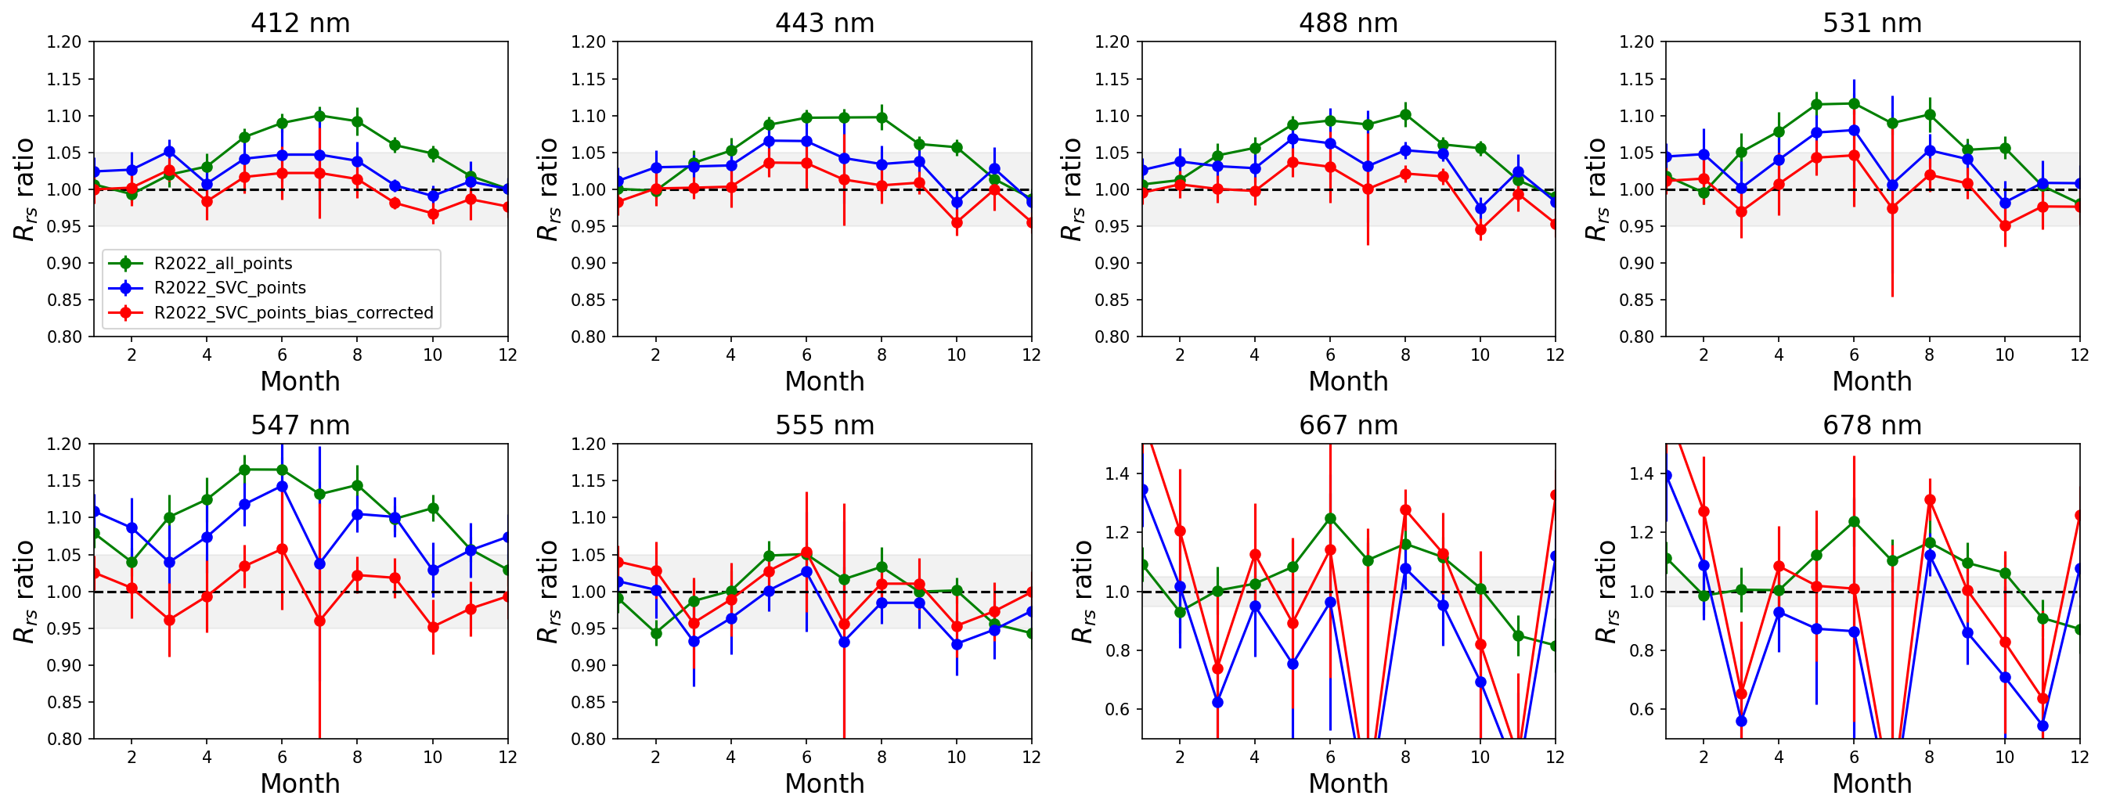
Standard processing: 2018 vs 2022 MODIS Aqua
Seasonal bias exists
Improvement in R2022

Slide 27
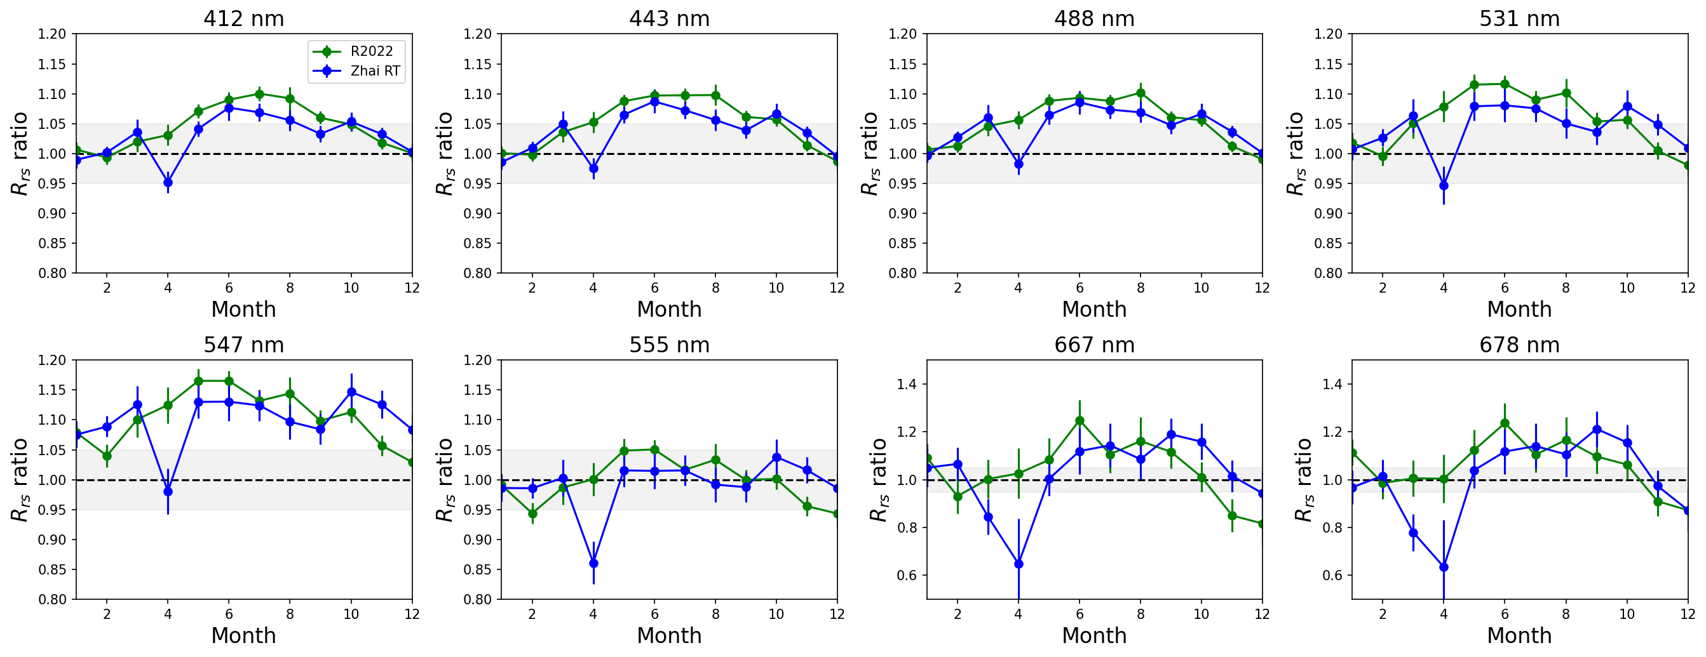
Impact of LUTs generated by PW Zhai RT code

Slide 28
Cross-calibration of Aqua to SeaWiFs but with a normalized M11

