Slide 1
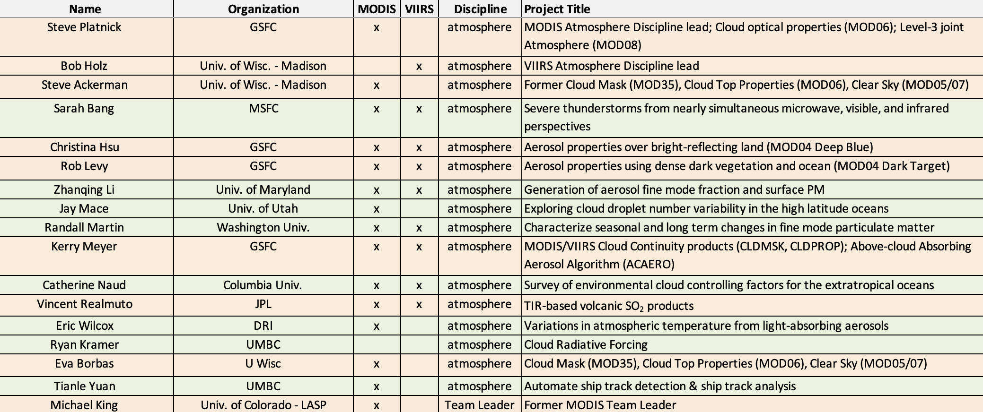
MODIS/VIIRS Atmosphere Discipline Team Session
3 May 2023, College Park, MD
Product PIs/Leadership
(Sen. Review, ROSES20 A.52, A.33)
Sci. Analysis PIs (ROSES20 A.33)
MODIS/VIIRS Atmos. Disc. Team, May. 2023
Notes:
Alg. Dev. PIs: 7 + 2 emeriti
Sci/Analysis: 8

Slide 2
MODIS/VIIRS Atmosphere Discipline Team Session
3 May 2023, College Park, MD
Atmosphere Discipline Overview: Holz, Platnick 8:30
Science Analysis (15 min each w/questions) 8:40
Aerosols
Jing Wei/ Zhanqing Li: In person. Tracking Ambient Particulate Matter and Chemical Composition from Space using Artificial Intelligence
Eric Wilcox: In person. Quantifying impacts of light-absorbing aerosols on atmospheric temperature and circulation
Clouds
Catherine Naud: Virtual. Cloud controlling factors in the extratropics
Aerosols & Clouds
Jay Mace/Sally Benson: Virtual. Systematic Changes in Cloud Droplet Number Concentrations Along Air Mass Trajectories in the High Latitude Southern Ocean
Tianle Yuan: In person. Strong aerosol indirect forcing from increasing low cloud coverage suggested by ship-tracks in Aqua MODIS
MODIS/VIIRS Atmos. Disc. Team, May. 2023

Slide 3
MODIS/VIIRS Atmosphere Discipline Team Session
3 May 2023, College Park, MD
Atmosphere SIPS/LAADS Data Access: Liam Gumley, Elaine Prins 10:00
Break 10:30
Continuity Products: Status, Challenges, Future Directions (15 min each + discussion) 10:45
Christina Hsu: In person. VIIRS Deep Blue aerosol product (AERDB)
Rob Levy: In person. VIIRS Dark Target aerosol product (AERDT)
Kerry Meyer: In person. VIIRS/MODIS cloud products (CLDMSK, CLDPROP)
Eva Borbas: In person. VIIRS+CrIS Fusion product (FSNRAD)
Open discussion
Lunch noon
* Vince Realmuto, A.33 new product: poster. TIR-Based Volcanic SO2 Science Products for MODIS and VIIRS – 2023 Update
MODIS/VIIRS Atmos. Disc. Team, May. 2023

Slide 4
MODIS/VIIRS Atmosphere Discipline Team Session
3 May 2023, College Park, MD
NASA’s Terra, Aqua, and Aura Data Continuity Workshop
23-25 May 2023
11-4p EDT
MODIS/VIIRS Atmos. Disc. Team, May. 2023

Slide 5
Existing Atmosphere Product Collection/Version History
MODIS Terra & Aqua Standard Products (MOD/MYD 04, 05, 06, 07, 35, 08, ATML2)
Collection | Start of MODIS Terra Reprocessing | Start of MODIS Aqua Reprocessing
6.1 | Sept. 2017 (completed Dec. 2017) | Dec. 2017 (completed March 2018)
6.0 | 2014 | 2013
5.1 | 2008 | 2008
5.0 | 2005 | 2005
4 | 2002 | 2002
3 | 2001 | 2002
1 | 2000 | –
Continuity Products (AERDB³, AERDT³, CLDMSK², CLDPROP³, FSNRAD¹)
Version | SNPP A-SIPS delivery to LAADS
1.1 (CLDPROP) | Jan. 2020
1.0 | Dec. 2018–Feb. 2020 (depending on product)
NOAA-20 availability started: ¹Nov. 2019, ²Nov. 2020, ³Dec. 2020
MODIS/VIIRS Atmos. Disc. Team, May. 2023
Notes:
v1.1: * improved thermodynamic phase wrt MOD06 heritage
Working on C7 science testing now
NOAA 20 dates from a Liam LAADS UWG slide Starry provided.
Data availability details on atmo web site

Slide 6
Existing Cloud Product Collection/Version History
MOD35, MOD06: 1030 MLT
Standard
Products
(Senior Review,
MODAPS/GSFC)
MODIS Terra
MYD35, MYD06: 1330 MLT
MODIS Aqua
MODIS Aqua
Continuity
Products
(ROSES,
Atmosphere SIPS/U. Wisc.)
CLDMSK, CLDPROP:
1330 LT
VIIRS SNPP
VIIRS N20
MODIS/VIIRS Atmos. Disc. Team, May. 2023
Notes:
Also: GEO, high-res imagery (Landsat) and airborne imagery, not shown

