Slide 1
Examples of Forest Service Operational Use of MODIS and VIIRS
Everett Hinkley
USDA Forest Service Geospatial Management Office (GMO)
National Remote Sensing Program Manager
Brad Quayle
USDA Forest Service Geospatial Technology and Applications Center (GTAC)
Disturbance Assessment and Services Program Lead
MODIS-VIIRS Science Team Meeting
May 4, 2023

Slide 2
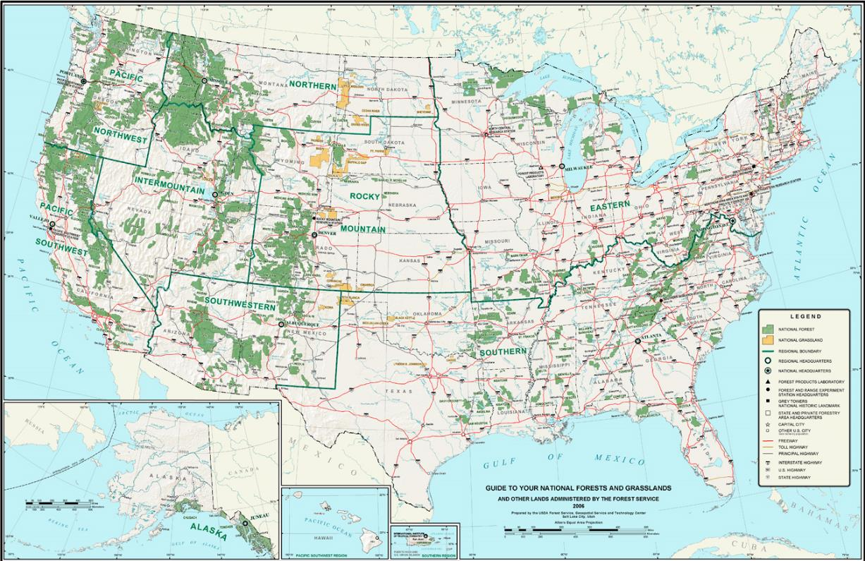
National Forest System Lands https://www.fs.usda.gov/managing-land/national-forests-grasslands
National Forest System lands include:
193 million acres
155 National Forests
20 National Grasslands
NFS Lands cover 8.5% of the US land area (roughly the size of Texas)
Maintain and improve the health, diversity, and productivity of the nation’s forests and grasslands
Guide to Your National Forests Map - https://www.fs.usda.gov/sites/default/files/GuideMap-2020.pdf
Notes:
93 million acres of NFS lands in 43 states and Puerto Rico.
~75% are forested.

Slide 3
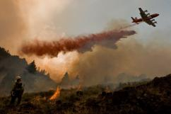
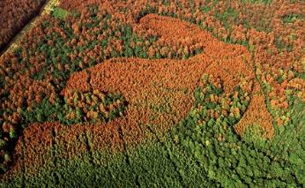
State, Private & Tribal Forest Lands https://www.fs.usda.gov/about-agency/state-private-forestry
Provide technical and financial assistance to sustain the nation’s forests & grasslands
Protect and restore forest lands and protect communities
Major program activities include:
Wildfire management
Forest health protection
Cooperative forestry
Conservation education
Notes:
766 million acres of forested lands in the US.
31% federal, 11% state and 58% private

Slide 4
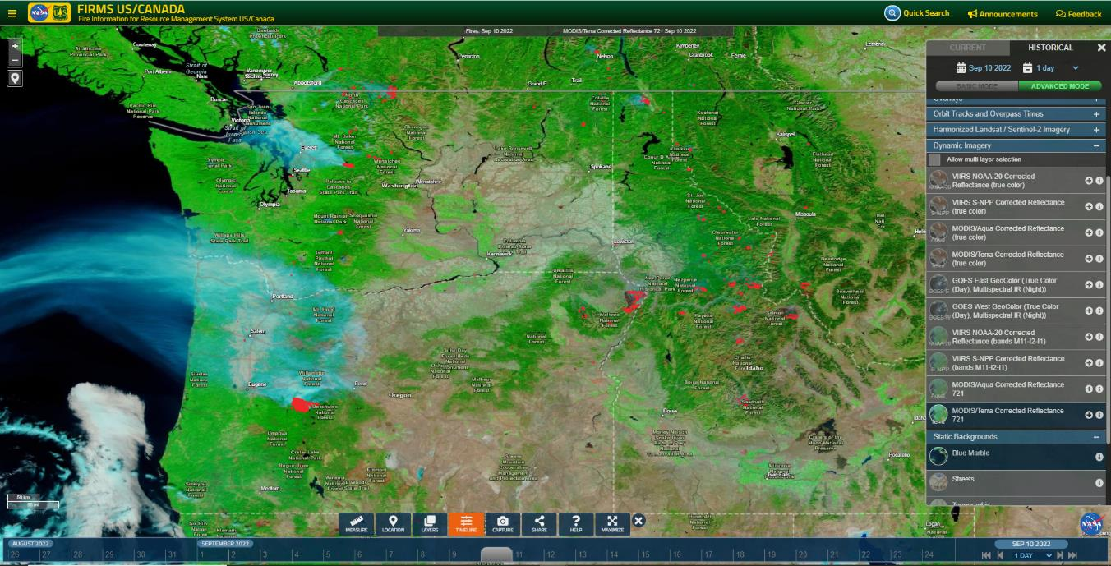
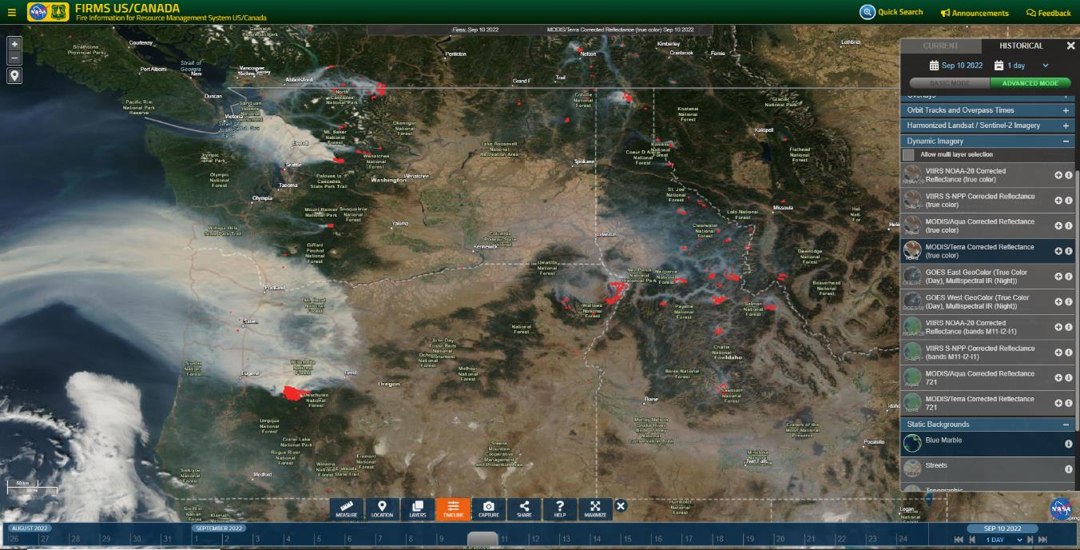
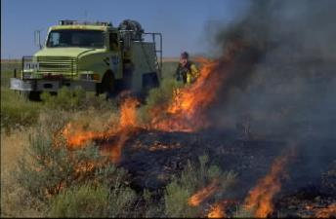
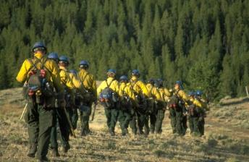
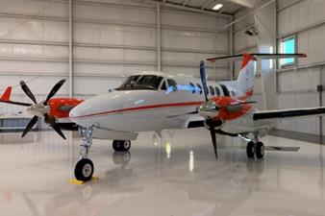
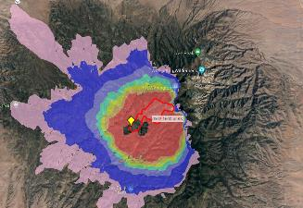
Wildland Fire Management
Objectives:
Comprehensive fire detection and monitoring for US and Canada
Leverage low latency MODIS/VIIRS land and atmosphere products from NASA LANCE and direct readout
24/7/365 coverage
Outcomes:
Increase situational awareness
Inform strategic planning and response
Focus tactical scale mapping assets
Key input data for fire DSS applications
NIFC
NIFC
NIFC

Slide 5
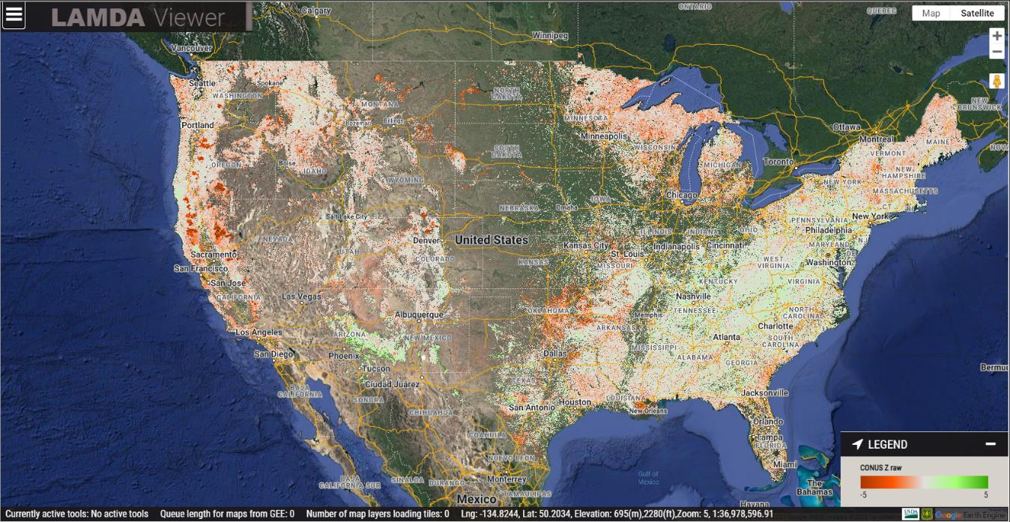
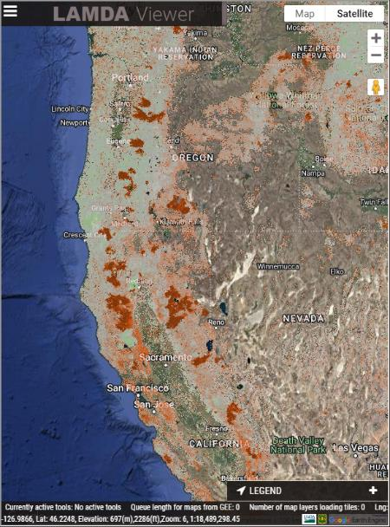
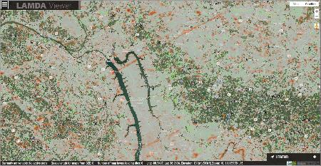
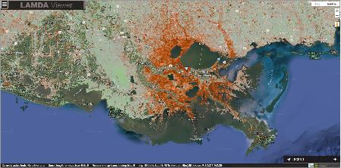
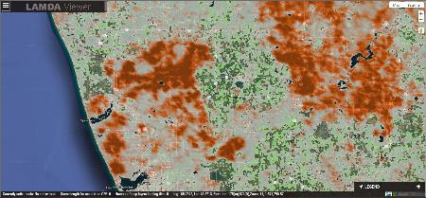
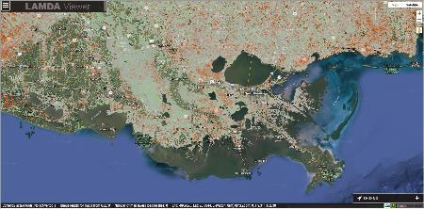
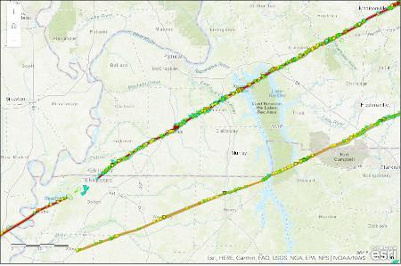
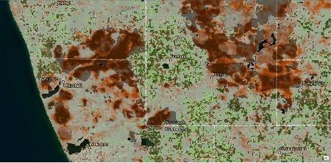
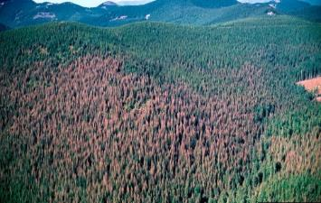
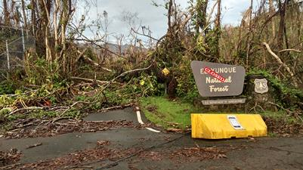
Forest Health Protection
Objectives:
Detect forest disturbance and mortality events throughout the US
Biotic and abiotic events
Leverage MODIS surface reflectance data and cloud computing/analytics
Monitor throughout the growing season
Outcomes:
Focus higher resolution analyses
Inform timing and location of aerial surveys
Increase safety of FS staff
Inform strategic planning and response to catastrophic events
2021 & 2022 Western Wildfires
December 2021 Tornados
2021 Hurricane Ida
2021 Spongy Moth Defoliation
Tornado tracks – early May 2022
August 29, 2021
June 26, 2021
August 13, 2021
ADS early-mid July 2021
August 21, 2021

Slide 6
Forest Service Takeaways/Needs
Continue NASA/Forest Service collaborations
Maintain continuity of MODIS-like observations
Continue availability of low latency imagery and data products from LANCE and direct readout
NASA cloud-based computing and analytics

Slide 7
Thanks!

