Slide 1
NASA VIIRS Atmosphere SIPS Update
MODIS/VIIRS Science Team Meeting
May 3, 2023
Liam Gumley
Space Science and Engineering Center
University of Wisconsin-Madison

Slide 2
Atmosphere SIPS Overview
The VIIRS Atmosphere SIPS (ASIPS) is located within the Space Science and Engineering Center at the University of Wisconsin-Madison.
ASIPS is responsible for supporting the development, testing, evaluation, and production of VIIRS atmosphere products created by the ROSES-funded VIIRS Science Team members (aka “Continuity products”).
ASIPS supports global standard and near real time processing in “forward stream” mode and reprocessing of entire mission records.
ASIPS delivers VIIRS atmosphere products to NASA LAADS for archive and distribution.
ASIPS delivers imagery to NASA GIBS for display in Worldview.
LAADS (not ASIPS) is responsible for the production, archive, and distribution of MODIS atmosphere products (MxD35, MxD07, MxD06, MxD04, MxD08, …) supported by NASA Senior Review.

Slide 3
Atmosphere SIPS Responsibilities: VIIRS/MODIS Products
Data Ingest
Ingest and store SNPP, NOAA-20, and NOAA-21 Level 0 data (VIIRS, CrIS, ATMS)
Ingest and store Aqua MODIS Level 1B and MODIS Level 2 Atmosphere
Ingest and store all required ancillary data
Operational Processing
Standard Products are created within 48 hours of observation.
Near Real Time Products are created within 3 hours of observation.
Reprocessing of mission record when new product version is approved by Science Team.
Product Delivery
Level 2 and Level 3 standard products (VIIRS and MODIS) are delivered to LAADS in forward stream and when mission record is reprocessed.
Near Real Time Products are hosted at ASIPS and accessed via LANCE.
Level 2 Product imagery is delivered to GIBS for display in NASA Worldview.
Copies of Level 2 and Level 3 products are stored at ASIPS.

Slide 4
Atmosphere SIPS Responsibilities: Science Team Support
ASIPS provides a local test environment (sipssci2) for product generation software development and testing by ST members.
ASIPS provides a local searchable archive of L1 and L2 products.
When software is ready for more extensive testing by the ASIPS, a delivery system is used to ensure that every delivery is archived and tagged.
Delivered/integrated product generation software can be run interactively.
Each ST member has a dedicated ASIPS point of contact to support product generation software testing, integration into the processing system, and product delivery to LAADS, GIBS, and LANCE.
ASIPS provides extensive tools and resources for product evaluation (e.g., local Worldview, sensor/satellite collocation, Matchmaker collocated products, …).
ASIPS provides GPU server (sipsgpu1) for testing of products using ML/AI algorithms.

Slide 5
Atmosphere Discipline Team Members (Product Creators)
Team Leads | ROSES-20 A.52 and A.33 Funded Proposals
Christina Hsu (NASA GSFC) | Extending Long-Term Aerosol Data Records from MODIS to VIIRS using e-Deep Blue Algorithm. (ROSES – 2020 A.52)
Robert Levy (NASA GSFC) | Upgrading the Dark Target aerosol data record for the 2020s and beyond. (ROSES – 2020 A.52)
Kerry Meyer (NASA GSFC) | The continuation and evolution of the CLDMSK and CLDPROP continuity cloud product suite. (ROSES – 2020 A.52)
Kerry Meyer (NASA GSFC) | Transitioning an existing near real-time MODIS cloud and above-cloud absorbing aerosol retrieval algorithm into a new MODIS/VIIRS continuity product. (ROSES – 2020 A.33)
Vincent Realmuto (NASA JPL) | TIR-Based Volcanic SO2 Science Products for MODIS and VIIRS. (ROSES – 2020 A.33)

Slide 6
Former Atmosphere Discipline Team Members
Team Leads | ROSES-2013 A.29 and ROSES-2017 A.37 Funded Proposals
Eva Borbas (UW – Madison), Bryan Baum (retired) | Fusion of VIIRS and CrIS Data to Construct Supplementary Infrared Band Radiances for VIIRS. (ROSES –2017 A.37)
Bo – Cai Gao (NRL) | Continuation of Standard Cirrus Reflectance Product from the EOS Terra and Aqua MODIS to Suomi NPP VIIRS. (ROSES – 2013 A.29)
Eva Borbas (UW – Madison) | Continuation of EOS Clear Sky Infrared Total Precipitable Water Vapor Product Using a Combination of VIIRS and CrIMSS Measurements. (ROSES – 2013 A.29)
NASA headquarters and ESDIS have indicated that ASIPS can continue to support orphaned products if the former Team member has other NASA funding.

Slide 7
Products Generated by the ASIPS (4/23)
Product Short Name | Product Description | ST Lead | Distribution
AERDB_L2_VIIRS_[SNPP|NOAA20] AERDB_D3_VIIRS_[SNPP|NOAA20] AERDB_M3_VIIRS_[SNPP|NOAA20] | Deep Blue Aerosol (day only) Standard and NRT | Christina Hsu (NASA GSFC) | LAADS (standard) LANCE (NRT)
AERDT_L2_VIIRS_[SNPP|NOAA20] | Dark Target Aerosol (day only) Standard and NRT | Robert Levy (NASA GSFC) | LAADS (standard) LANCE (NRT)
CLDMSK_L2_VIIRS_[SNPP|NOAA20] | Continuity Cloud Mask (day/night) Standard and NRT | Bob Holz (SSEC UW) | LAADS (standard) LANCE (NRT)
CLDMSK_L2_MODIS_Aqua | Continuity Cloud Mask (day/night) Standard | Bob Holz (SSEC UW) | LAADS
CLDPROP_L2_VIIRS_[SNPP|NOAA20] CLDPROP_D3_VIIRS_[SNPP|NOAA20] CLDPROP_M3_VIIRS_[SNPP|NOAA20] | Continuity Cloud Properties (day/night) Standard | Kerry Meyer (NASA GSFC) | LAADS
CLDPROP_L2_MODIS_Aqua CLDPROP_D3_MODIS_Aqua CLDPROP_M3_MODIS_Aqua | Continuity Cloud Properties (day/night) Standard | Kerry Meyer (NASA GSFC) | LAADS
SNDRSNCrISL1BIMG (SNPP) SNDRJ1CrISL1BIMG (NOAA-20) | Collocated VIIRS Level 1 and cloud mask statistical summary | Dave Tobin (SSEC UW) | GESDISC

Slide 8
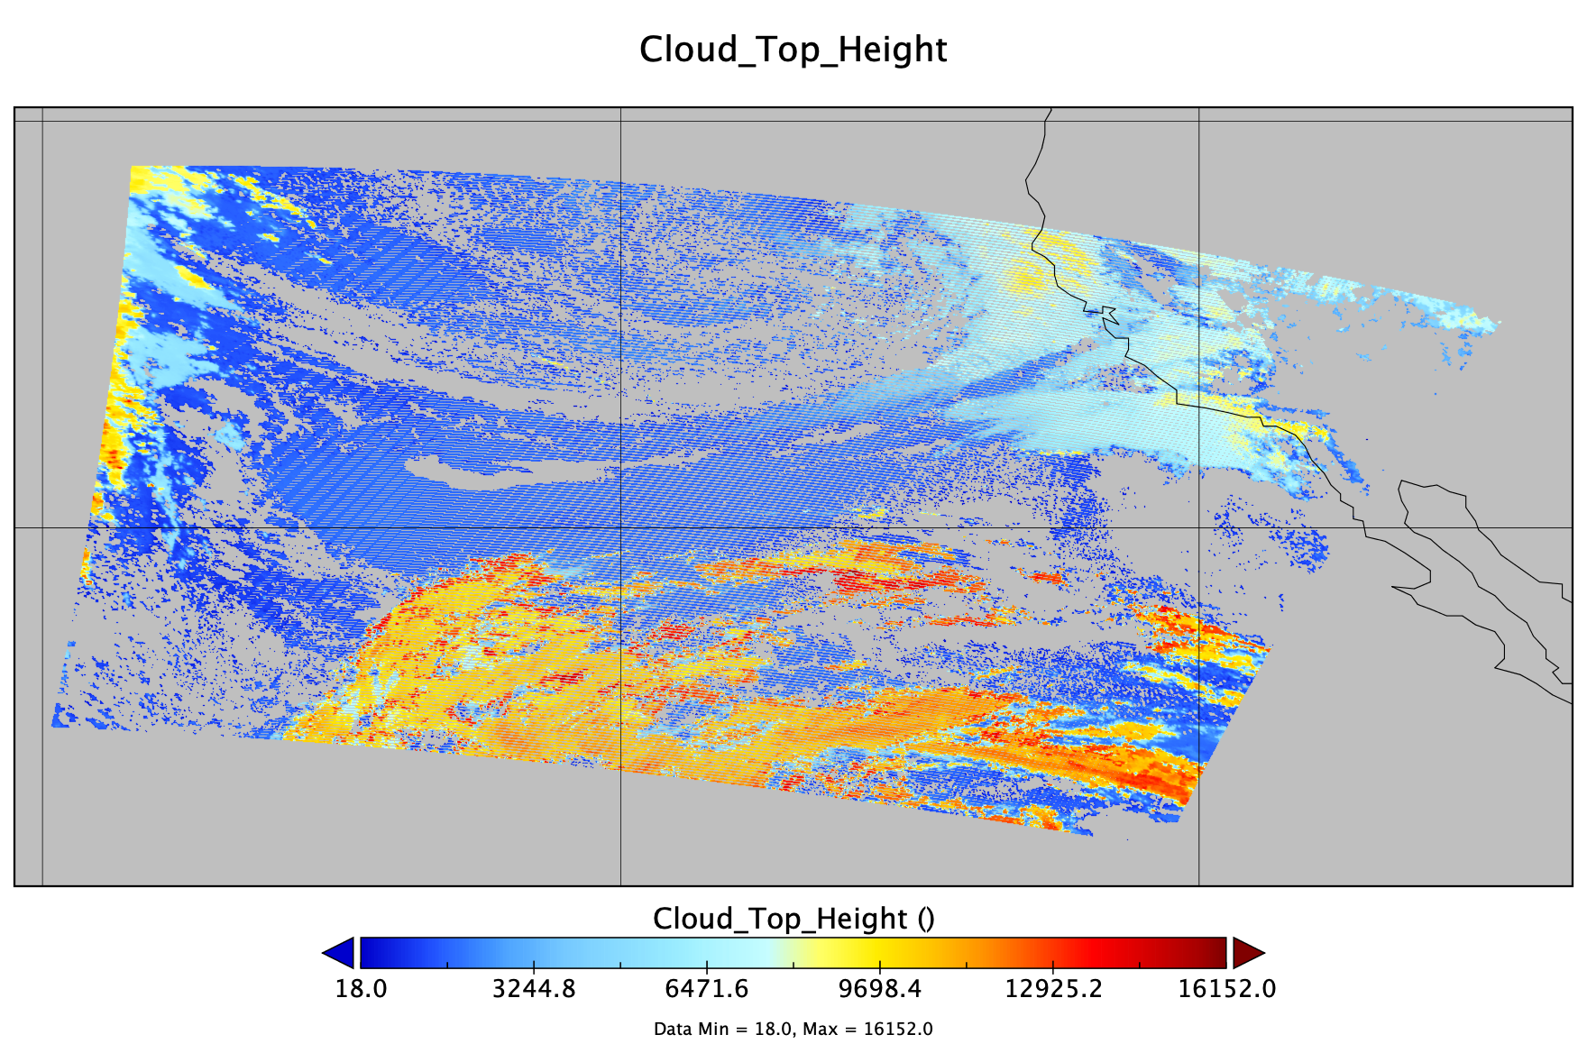
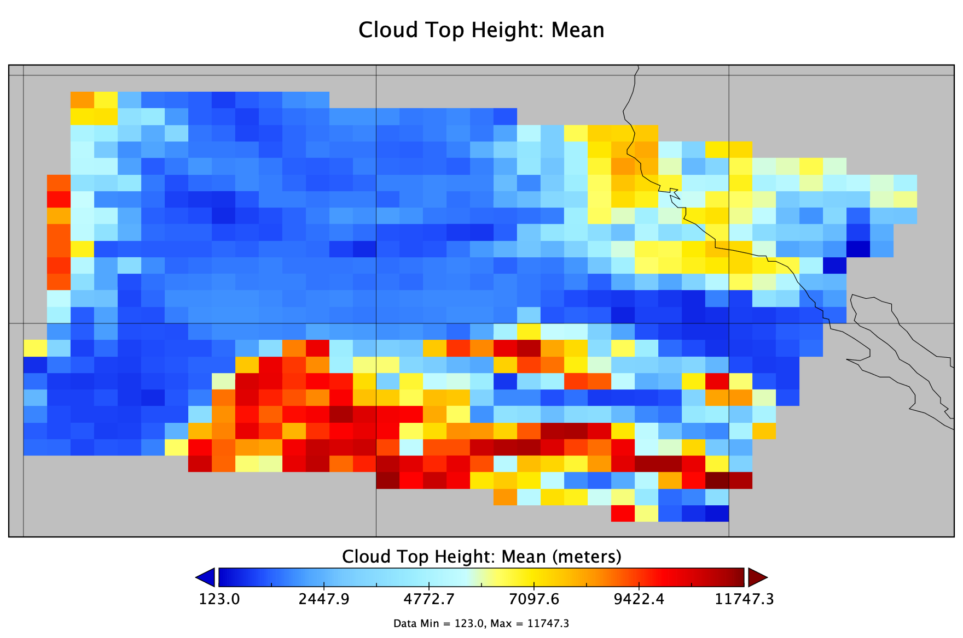
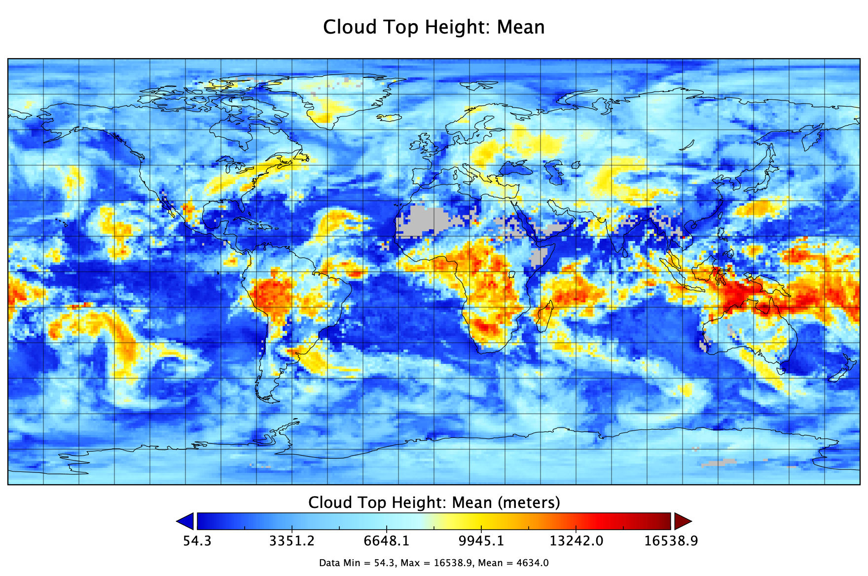
ASIPS Level 3 Software (Yori)
Yori is a user-configurable software package that efficiently aggregates geophysical variables into a Level 3 netCDF4 product file.
Step 1:
The user prepares filtered input data files (e.g., from Level 2 granules) and a Yori configuration file.
The configuration file tells Yori how to grid the filtered input data
Step 2:
yori-grid reads the filtered input data files and produces a gridded granule according to the instructions provided in the Yori configuration file
Step 3:
yori-aggr aggregates multiple gridded granules (from Step 2) into Level-3 products

Slide 9
ASIPS Collocation Tools
Primary sensor geolocation
Secondary sensor geolocation
SIPS multi-sensor collocation tools support:
Calibration assessment of L1 data (e.g., MODIS-VIIRS reflectance biases)
Validation of L2 products (e.g., CALIPSO for analysis of cloud & aerosol retrievals)
Algorithm development using multiple instruments (e.g., Fusion, CrIS IMG)
“Collopak” software performs geometric calculations to identify collocated observations
“Matchmaker” software aligns L1/L2 sensor data into a joint file for easy comparison or combined use
Physical collocation
(Collopak)
Primary sensor L1/L2 data
Secondary sensor L1/L2 data
Data extraction / aggregation
(Matchmaker)
Collocated data
(“match file”)

Slide 10
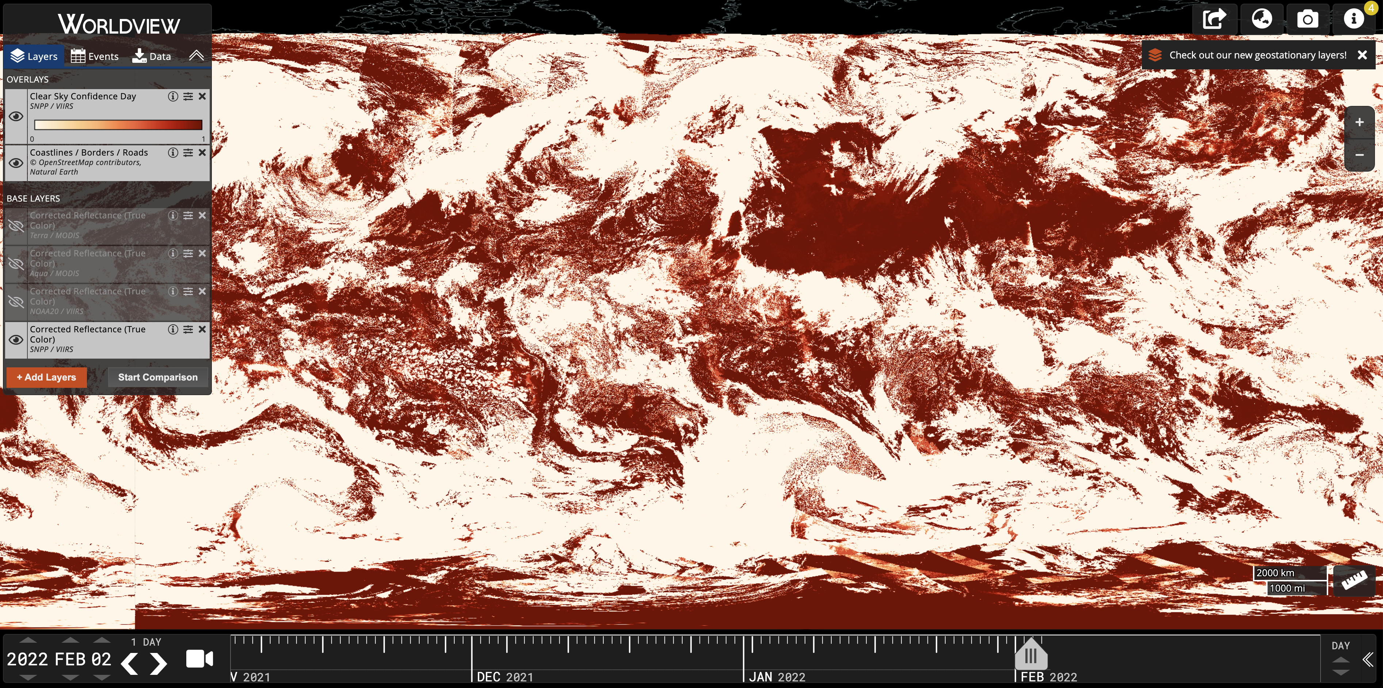
ASIPS Local Worldview
L2 product imagery is generated by ASIPS and displayed in a local instance of Worldview.
Able to display multiple days for test versions of L2 products.
Can create unique colormaps with a specified min/max.
Can create multiple layers for different bands.
Fewer restrictions on the number of layers (compared to NASA Worldview).
https://sips.ssec.wisc.edu/worldview/

Slide 11
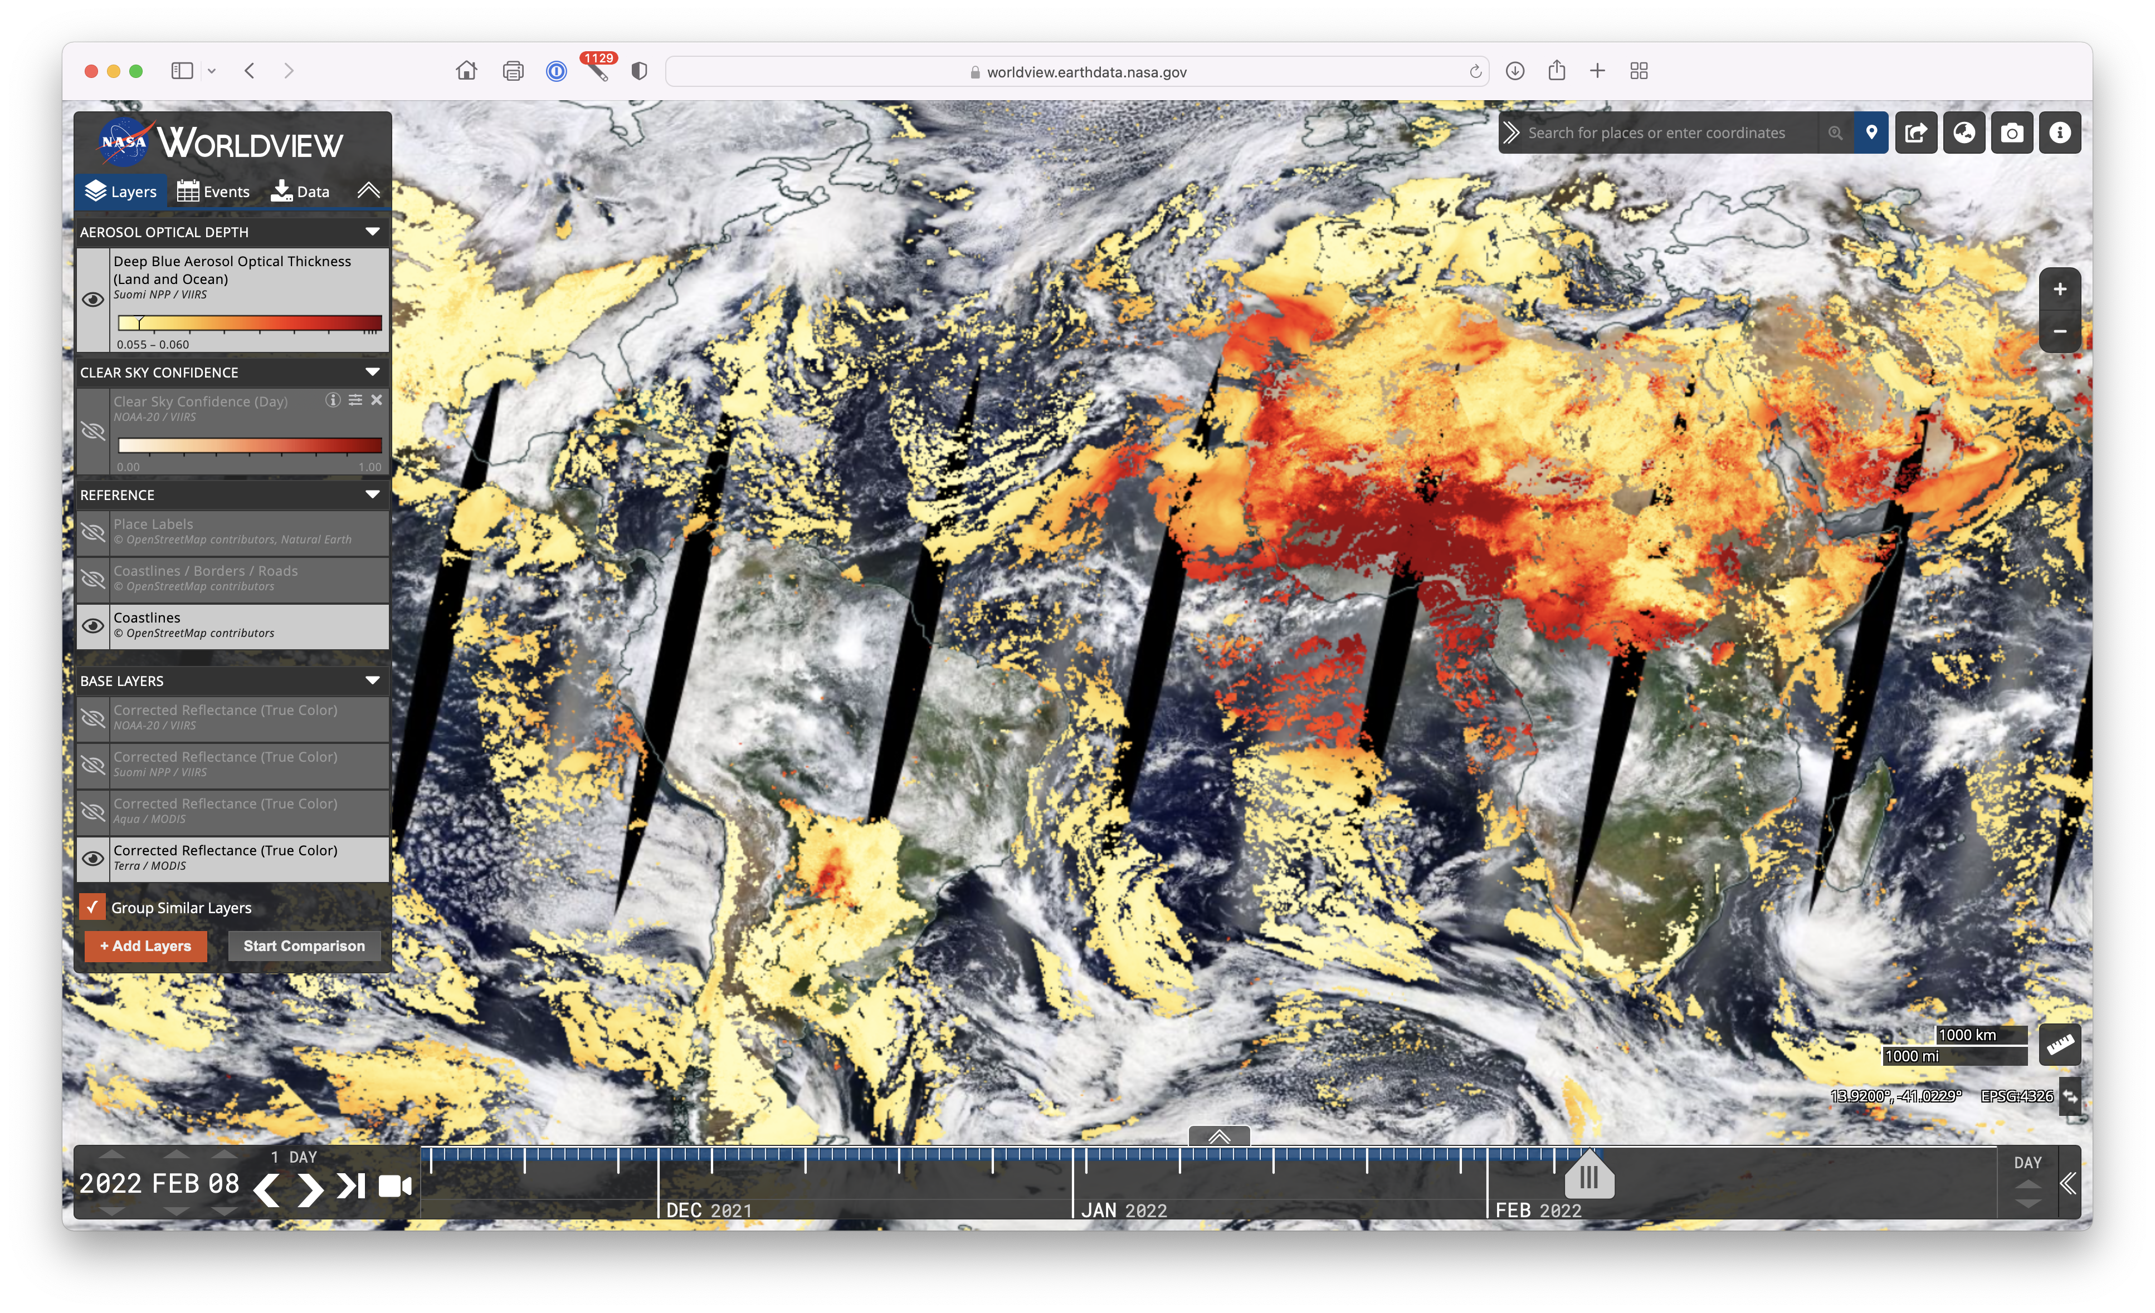
NASA Worldview
L2 product imagery is created by ASIPS and delivered to NASA GIBS (the back end of Worldview).
Recommended maximum of 4 layers per product (Day and night is two layers)
ASIPS can reprocess and deliver a mission record to GIBS.
However, this process can take several months due to resource limits at GIBS.
https://worldview.earthdata.nasa.gov/

Slide 12
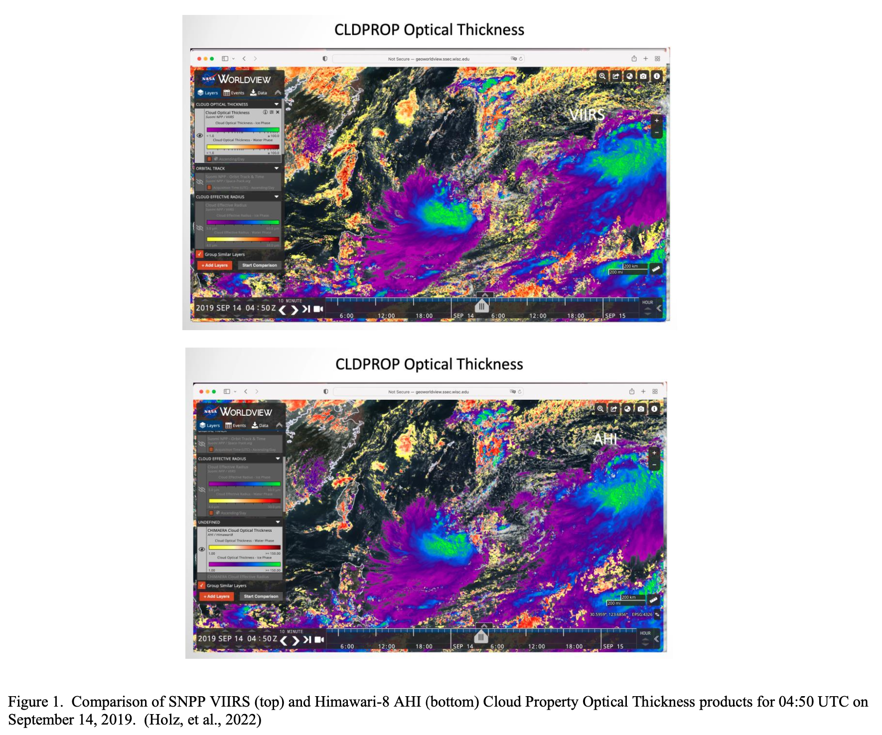
GEO vs. LEO
SNPP VIIRS
Atmosphere SIPS processed 4 months of G16, G17, and AHI cloud products using code delivered by VIIRS ST.
Match files were generated for ABI/AHI with SNPP/NOAA-20 VIIRS, Aqua MODIS, and CALIPSO for both L1B and L2 products to validate and assess continuity with LEO products.
Inter-calibration of AHI vs. VIIRS reflective solar bands was derived.
Himawari-8 AHI

Slide 13
Level 3 Interactive Analysis
A-SIPS developed interactive analysis workflows for the science teams.
Software tools including Zarr, fsspec, xarray, and dask provide the means to access and analyze large remote datasets (e.g., L3 VIIRS cloud products) without needing to downloading entire files.
Figure 1 shows interactive dashboard allowing comparison of L3 products over arbitrary time ranges.

Slide 14
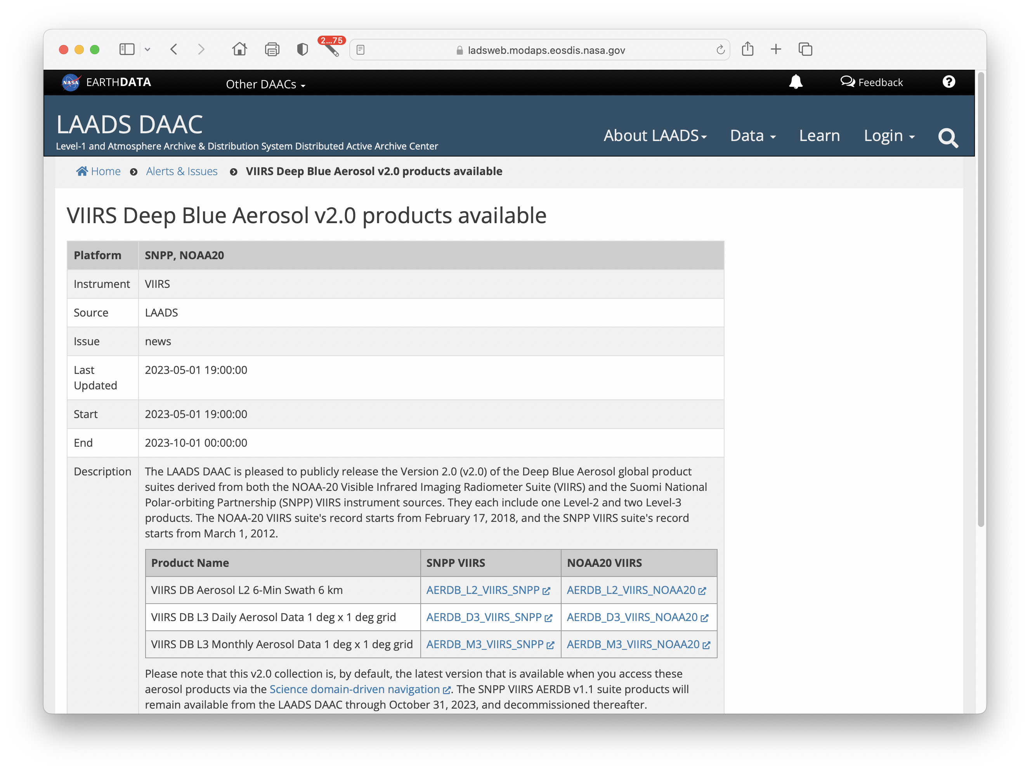
LAADS archive and distribution
VIIRS Deep Blue L2 and L3 for SNPP and NOAA-20 (v2.0 was just released)
VIIRS Dark Target L2 for SNPP and NOAA-20 (v2.0 has been delivered to LAADS; awaiting public release).
MODIS/VIIRS Continuity Cloud Mask for SNPP and NOAA-20.
MODIS/VIIRS Continuity Cloud Product for SNPP and NOAA-20.

Slide 15
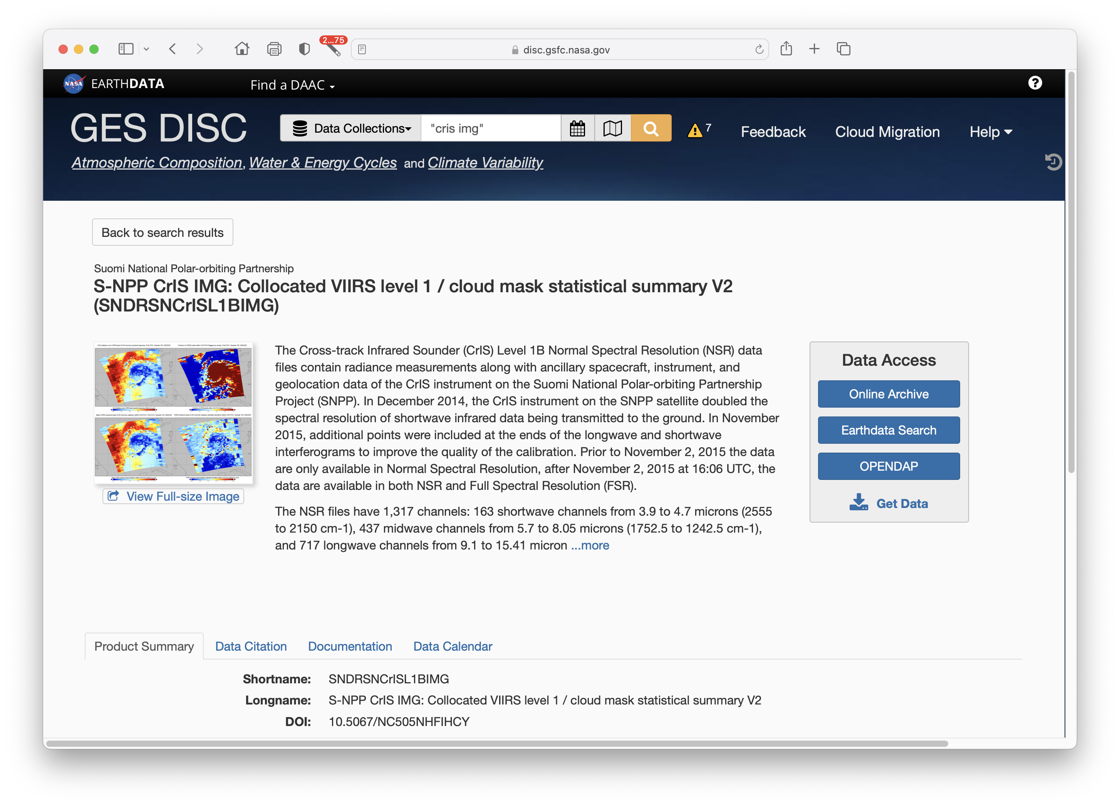
GESDISC archive and distribution
CrIS/VIIRS collocated radiance and cloud mask statistics for SNPP and NOAA-20.
NOAA-21 version (not yet available at LAADS) has already been used to check CrIS/VIIRS TEB inter-calibration.

Slide 16
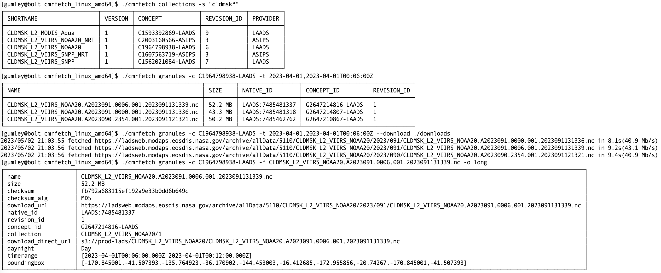
CMR command-line search & download utility
__________________________________________ Find collections containing “cldmsk”
______________ Find NOAA-20 cloud mask for date/time
________Download cloud mask granules
_________Show granule metadata

Slide 17
End
Thanks to the Atmosphere SIPS team:
Elaine Prins, Bob Holz, Steve Dutcher, Bruce Flynn, Greg Quinn, Kevin Hrpcek, Tim Slauson, Geoff Cureton, Nick Bearson, Denis Botambekov, Zach Griffith, Zach Hodge, Jess Braun, Paolo Veglio
Liam.Gumley@ssec.wisc.edu

