Slide 1
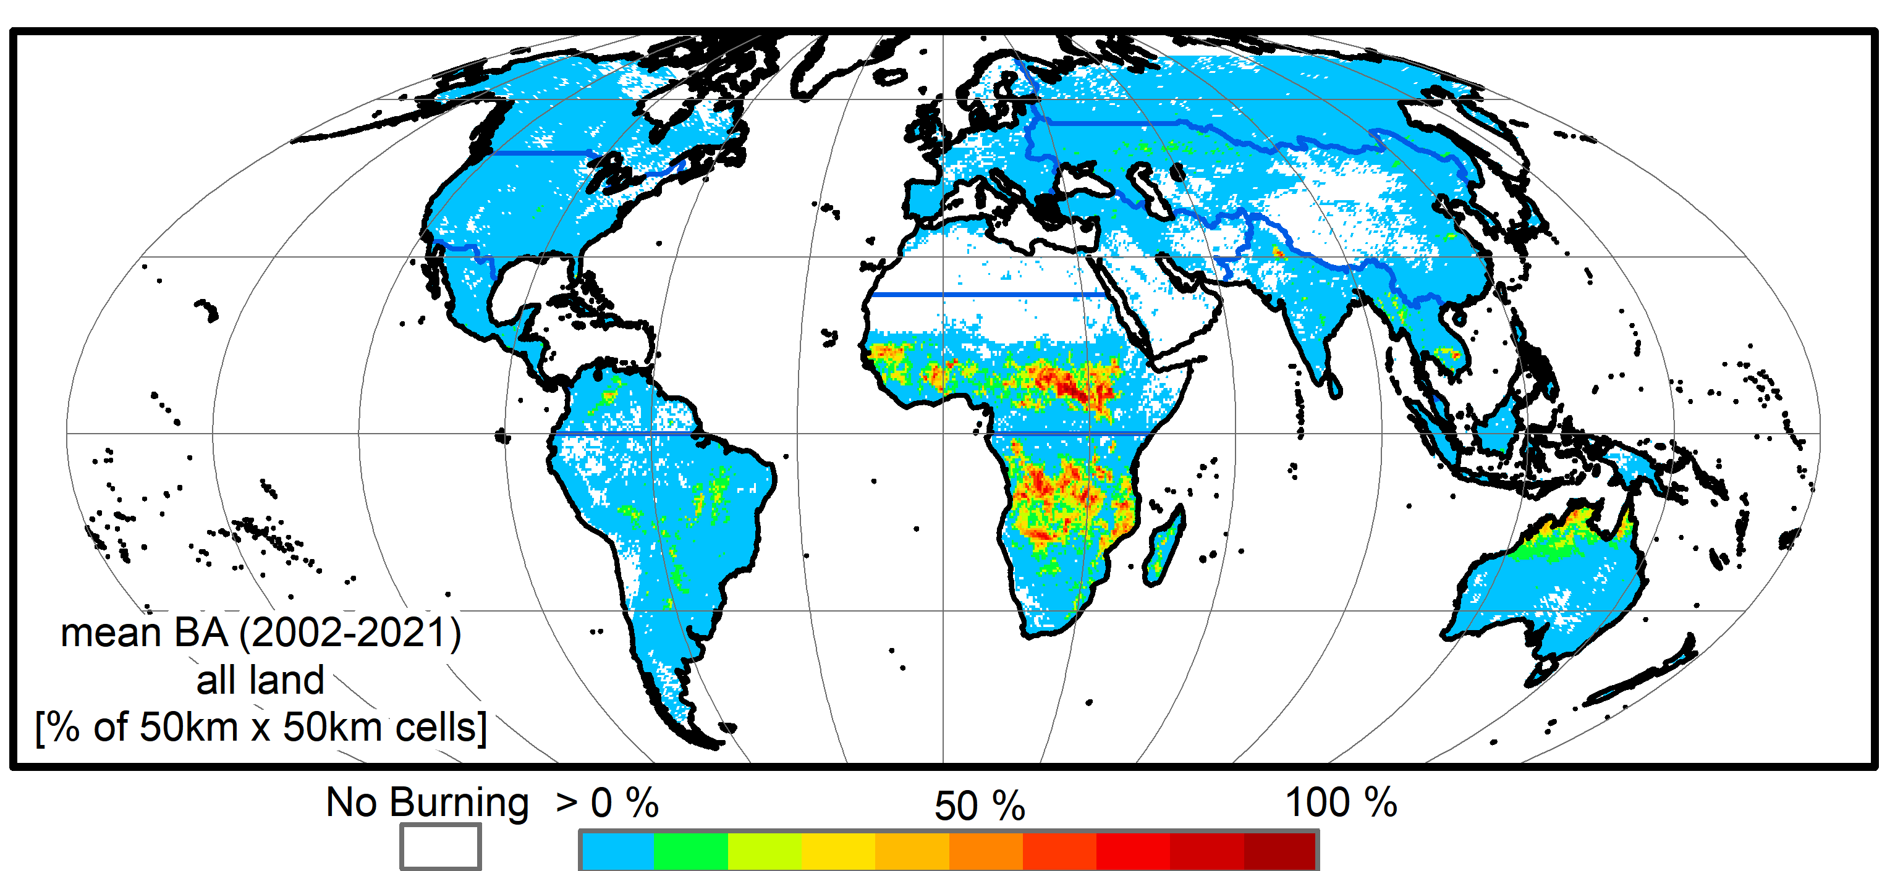
Is the world burning less? Disentangling decadal trends, inter-annual fire variability and product uncertainties, through harmonization of the NASA MODIS and VIIRS fire product record
Luigi Boschetti (UI), David Roy (MSU) and Louis Giglio (UMD)
MODIS provides the only consistent, 20+ year global burned area burned area record.
The harmonized MODIS / VIIRS burned area time series will provide the first ever global fire record covering the 30 years conventionally required for climate analysis.
on average 2.7 % of the land surface burned each year
(paper in preparation)

Slide 2
Is the world burning less? Disentangling decadal trends, inter-annual fire variability and product uncertainties, through harmonization of the NASA MODIS and VIIRS fire product record
June 2017

Slide 3
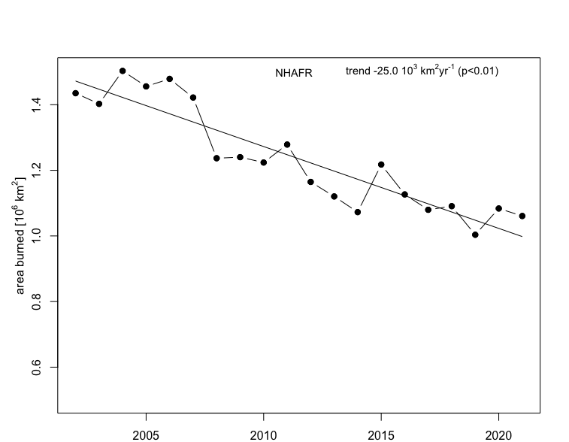
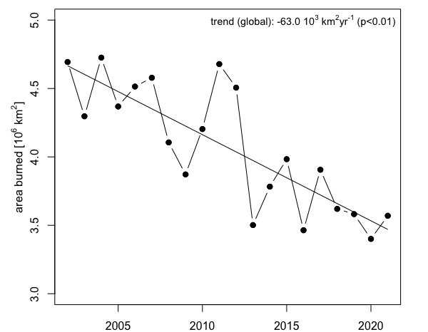
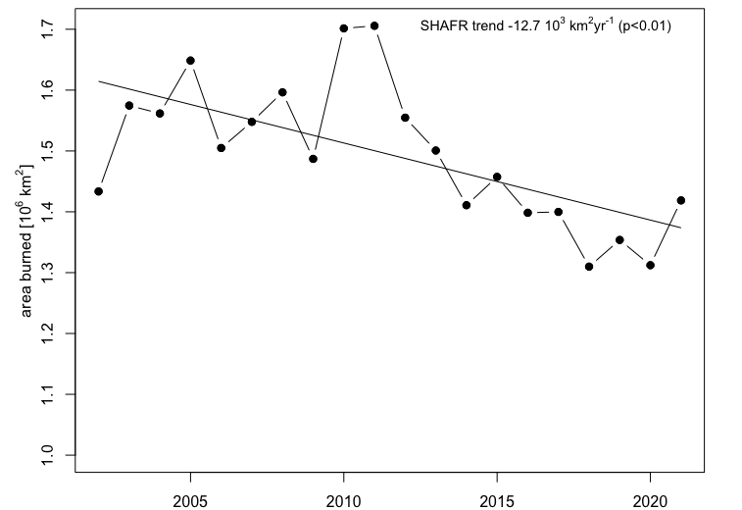
Is the world burning less? Disentangling decadal trends, inter-annual fire variability and product uncertainties, through harmonization of the NASA MODIS and VIIRS fire product record
The decline continues!
2002-2022 data is showing a persistent, statistically significant decline in area burned with the majority concentrated in Africa
27% 20-year decline !
20-year mean
4.1 10⁶ km²
(paper in preparation)

Slide 4
Is the world burning less? Disentangling decadal trends, inter-annual fire variability and product uncertainties, through harmonization of the NASA MODIS and VIIRS fire product record

Slide 5
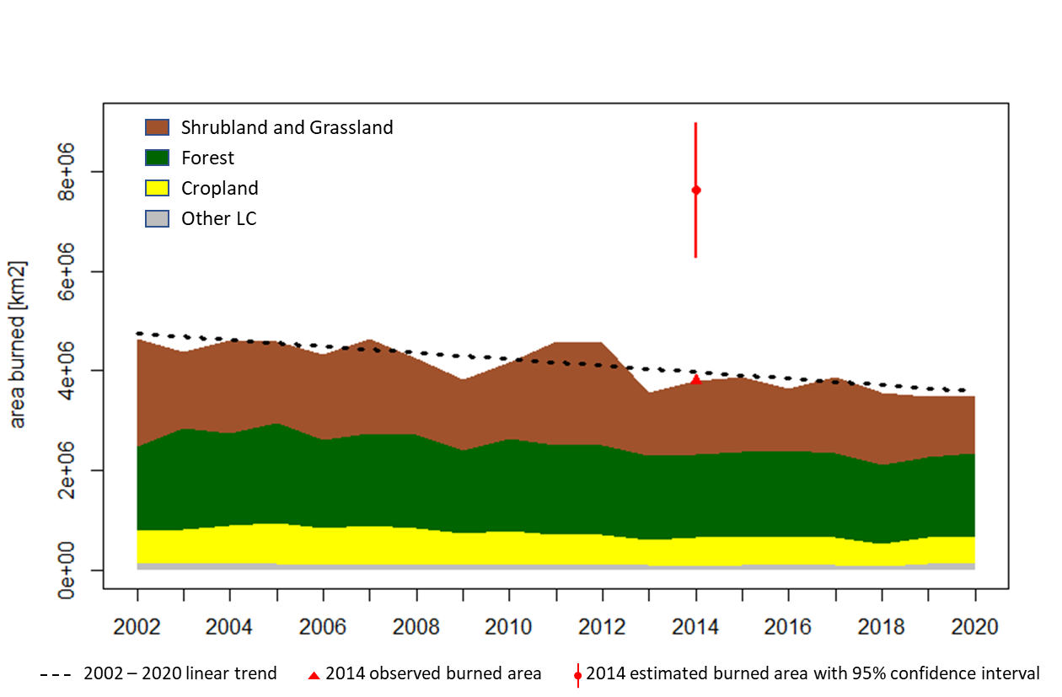
Is the world burning less? Disentangling decadal trends, inter-annual fire variability and product uncertainties, through harmonization of the NASA MODIS and VIIRS fire product record
and Savannah
CEOS Stage 3 validation of the MODIS burned area product with L8 reference data (558 image pairs) shows a large bias due to missing small burns. The bias has similar magnitude as the decline reported.
Is the world really burning less? Or are the burned areas becoming smaller leading to a lower detection rate at the MODIS resolution?

Slide 6
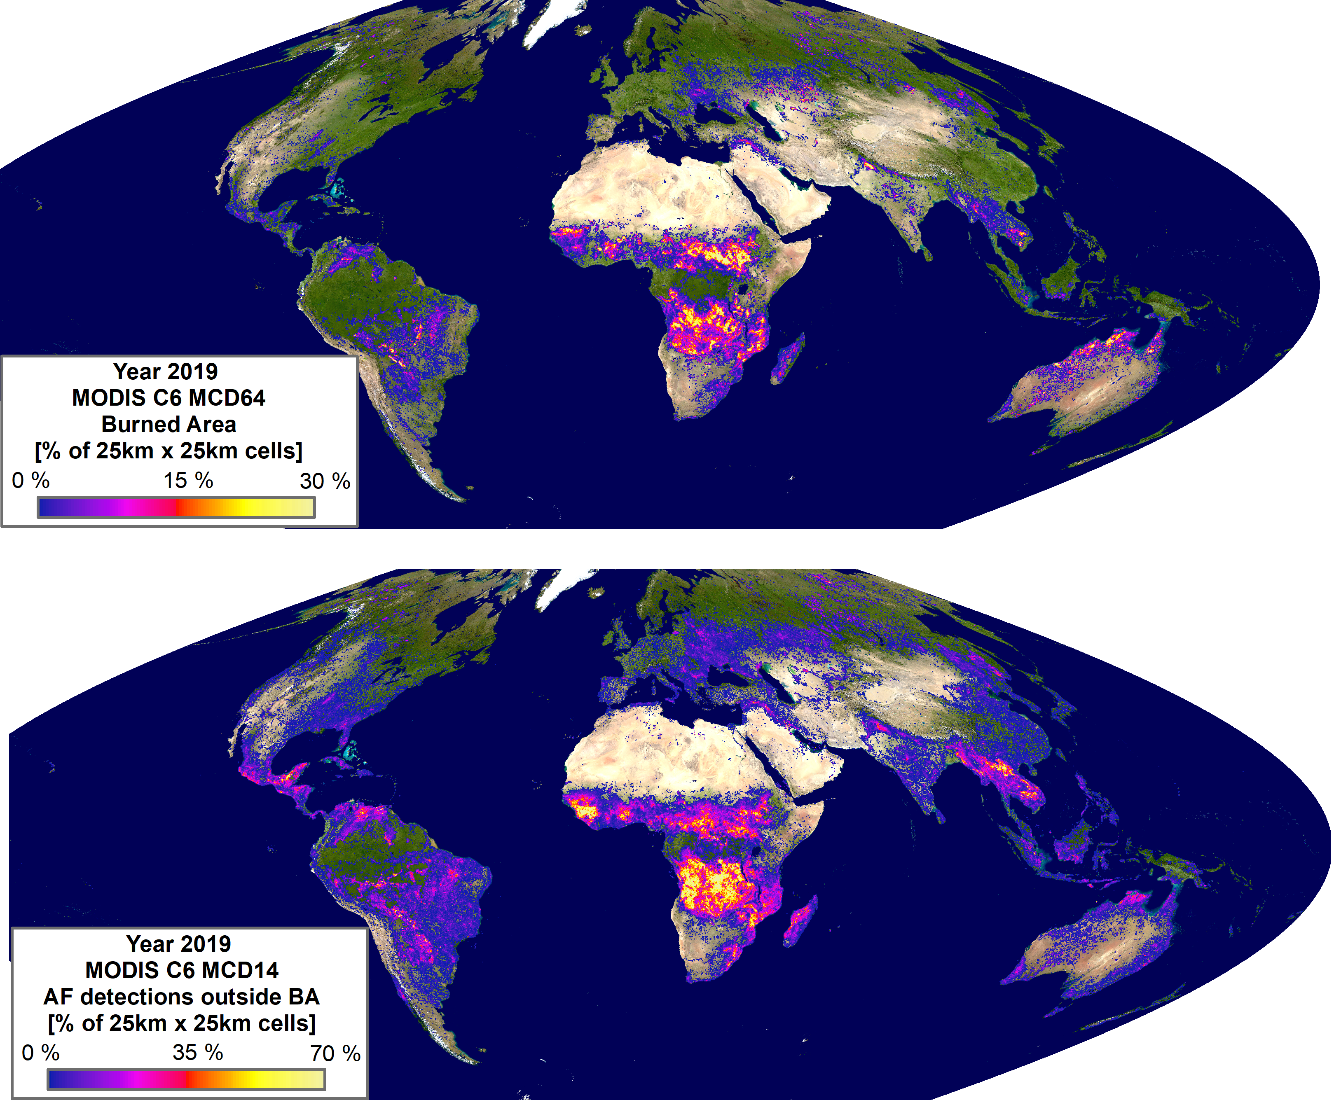
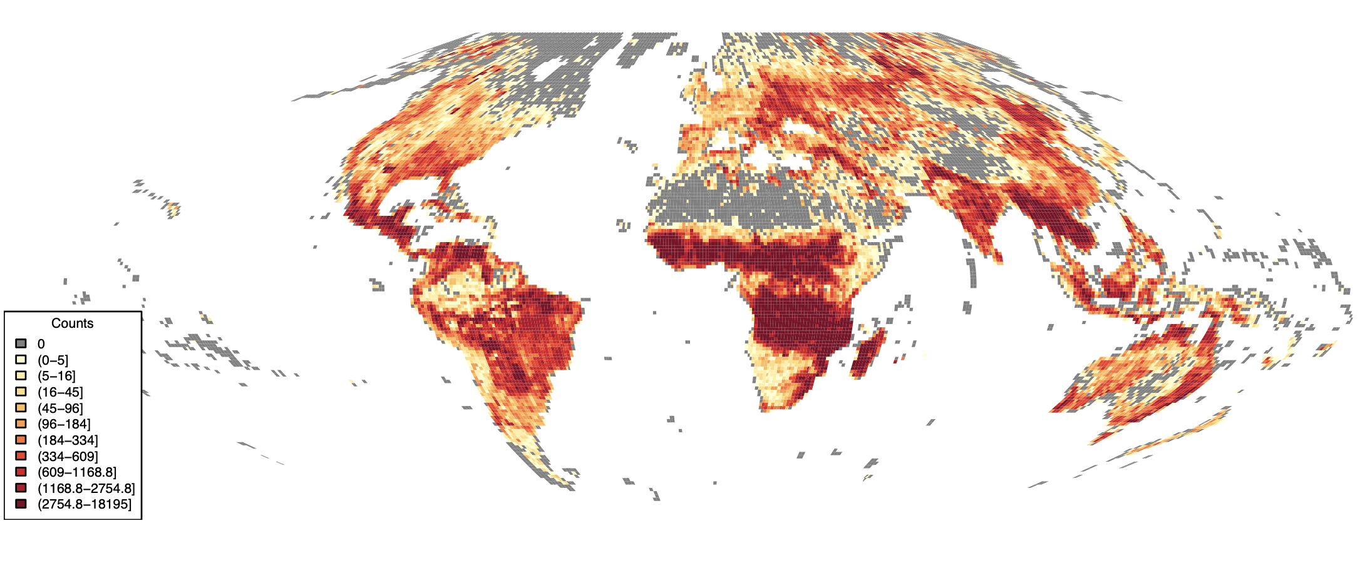
Is the world burning less? Disentangling decadal trends, inter-annual fire variability and product uncertainties, through harmonization of the NASA MODIS and VIIRS fire product record
yr 2019 VNP14 active fire detections outside MCD64 BA – aggregated on HLS grid

Slide 7
Is the world burning less? Disentangling decadal trends, inter-annual fire variability and product uncertainties, through harmonization of the NASA MODIS and VIIRS fire product record
Project Objectives and Tasks
Quantify the discrepancy between active fire counts and burned area detections in the MODIS and VIIRS product record.
Generate reference L8 / S2 burned area time series at representative locations, leveraging on LCLUC/MuSLI funding (Roy PI).
Derive an unbiased 25-year 0.25° harmonized MODIS/VIIRS time series, with uncertainties, calibrated using the L8/ S2 reference burned area
Detect burned area trends and interannual variability, identify if observed trends are significant relative to inter-annual fire variability and to the uncertainties.
Critical delay: Collection 2 VIIRS burned area product not available yet - Global 1 year test currently evaluated
Code prototyped and preliminary results for all tasks with MODIS MCD64/MO(Y)D14 and VNP14.
L8S2 reference locations will be selected as soon as C2 VNP64 is available for three consecutive years

