Slide 1
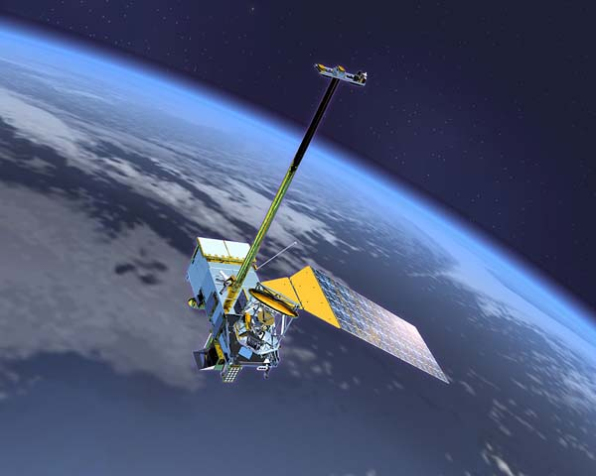
“Surface Reflectance over Land in Collection 6” Eric Vermote NASA/GSFC Code 619 eric.f.vermote@nasa.gov

Slide 2
Overview of collection 6 changes/activities
Evaluation of Calibration /Level 1B
Continuous Assessment over the AERONET sites
BRDF coupling correction (including BRDF database creation)
Internal cloud/snow etc.. Improvements
Improving the aerosol retrieval/correction
Polarization correction

Slide 3
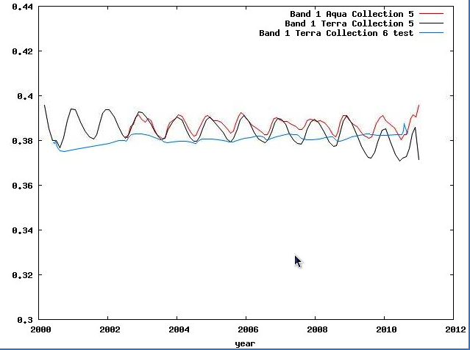
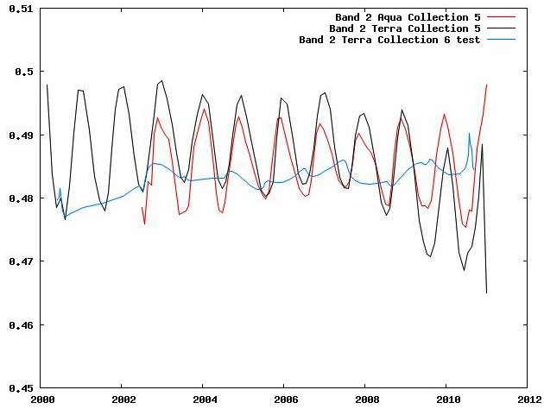
Calibration evaluation monitoring (1/2)
Terra calibration issues
Solar diffuser degradation in NIR ~1.5% (previously assumed non existent) – impact on NDVI (Wang et al.,2012)
Degradation of the mirror function of view of Angle of Incidence (AOI ~ view angle) and mirror side
Polarization sensitivity (AOI and mirror side dependent)
Dongdong Wang, Douglas Morton, Jeffrey Masek, Aisheng Wu, Jyoteshwar Nagol, Xiaoxiong Xiong, Robert Levy, Eric Vermote, Robert Wolfe, Impact of sensor degradation on the MODIS NDVI time series, Remote Sensing of Environment, Volume 119, 16 April 2012, Pages 55-61, ISSN 0034-4257, 10.1016/j.rse.2011.12.001.

Slide 4
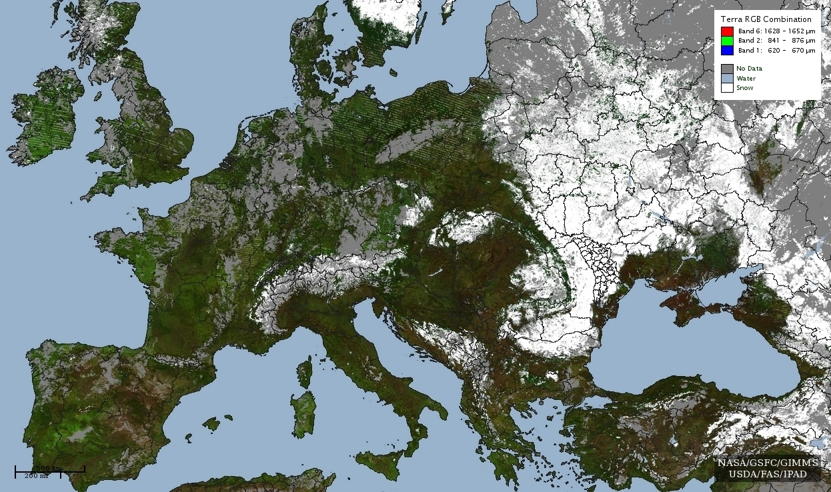
Calibration evaluation monitoring (2/2)
Terra “bad detector” issues
Striping in Terra data apparent over Europe associated with no data flag (GIMMS product) – Issue was fixed in collection 5 by L1B LUT delivery and is fixed in collection 6

Slide 5
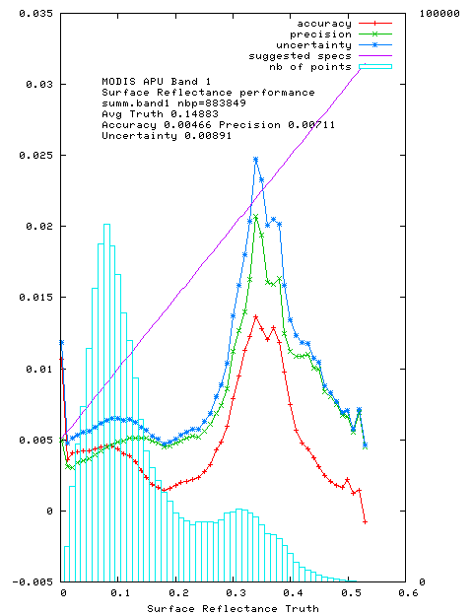
Continuous assesment over Aeronet sites
(November 2012 update)
Red = Accuracy (mean bias)
Green = Precision (repeatability)
Blue = Uncertainty (quadatric sum of
A and P)
On average well below magenta
theoretical error bar

Slide 6
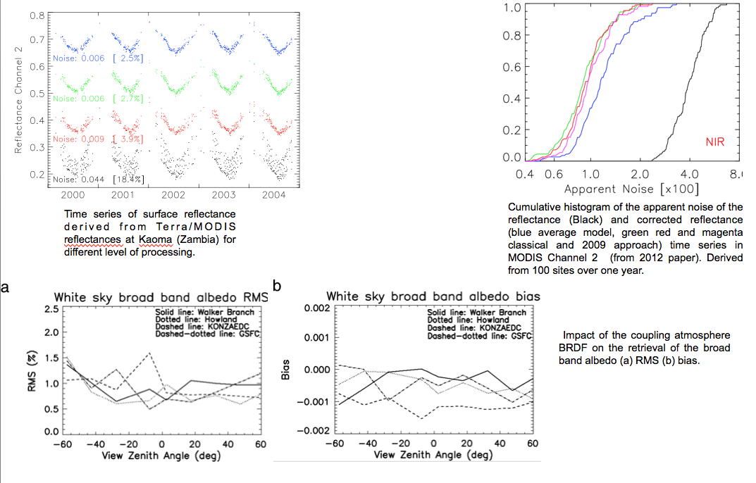
BRDF/Atmosphere coupling correction
Franch B., Vermote E., Sobrino J.A. and Fédèle E. (2013). Analysis of directional effects on atmospheric correction, Remote Sensing of Environment, 128, 276-288.
Breon, F.M., & Vermote, E. (2012). Correction of MODIS surface reflectance time series for BRDF effects. Remote Sensing of Environment, 125, 1-9.
Vermote, E., Justice, C.O., & Breon, F.M. (2009). Towards a Generalized Approach for Correction of the BRDF Effect in MODIS Directional Reflectances. IEEETransactions on Geoscience and Remote Sensing, 47, 898-908

Slide 7
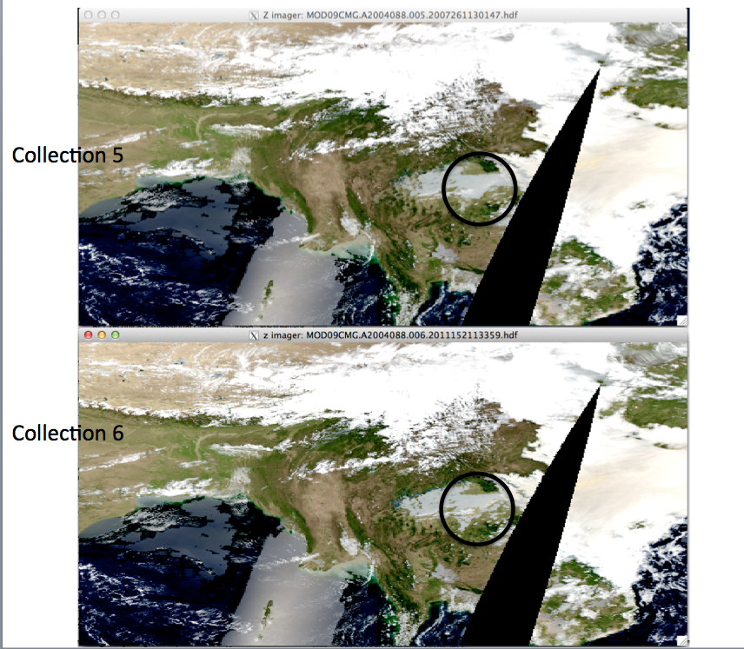
Internal cloud mask improvement

Slide 8
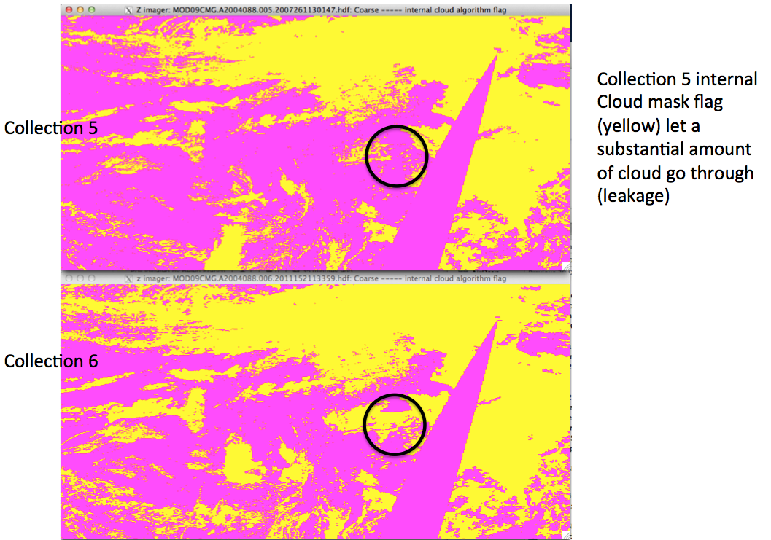
Internal cloud mask improvement

Slide 9
Cross-comparison of MODIS SR with product derived using independent approach 1/2

Slide 10
Cross-comparison of MODIS SR with product derived using independent approach 2/2

Slide 11
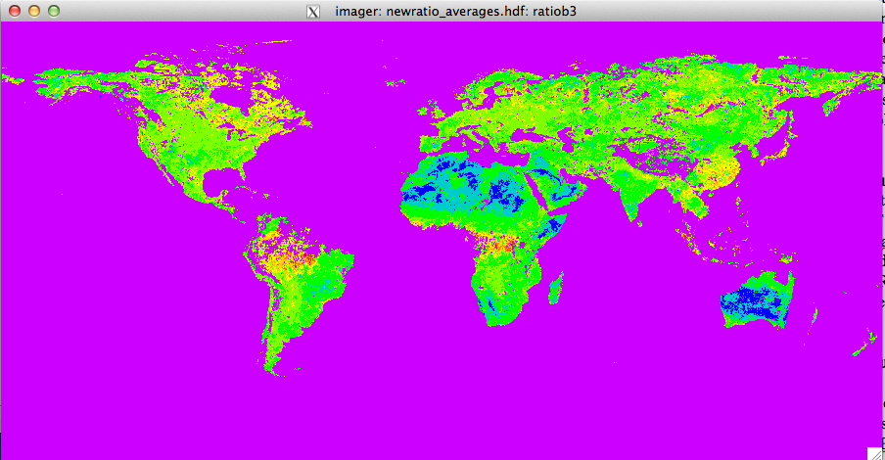
Improving the aerosol retrieval
Revised the aerosol model using the latest result of the AERONET database, in particular the accounting for particles non-sphericity and the version 2, level 2 particles properties inversions. A new model for dust is under development.
(b) Started Improving the ratio used in the visible and swir used in the inversion. Currently a default value is used globally, that value is adequate for vegetated area but not on sparsely vegetated or desert area, We used the MISR data and the CMG product to produce a spatially explicit CMG climatology of these ratios and will use those in the aerosol inversion.
1.1
0.5
0.0

Slide 12
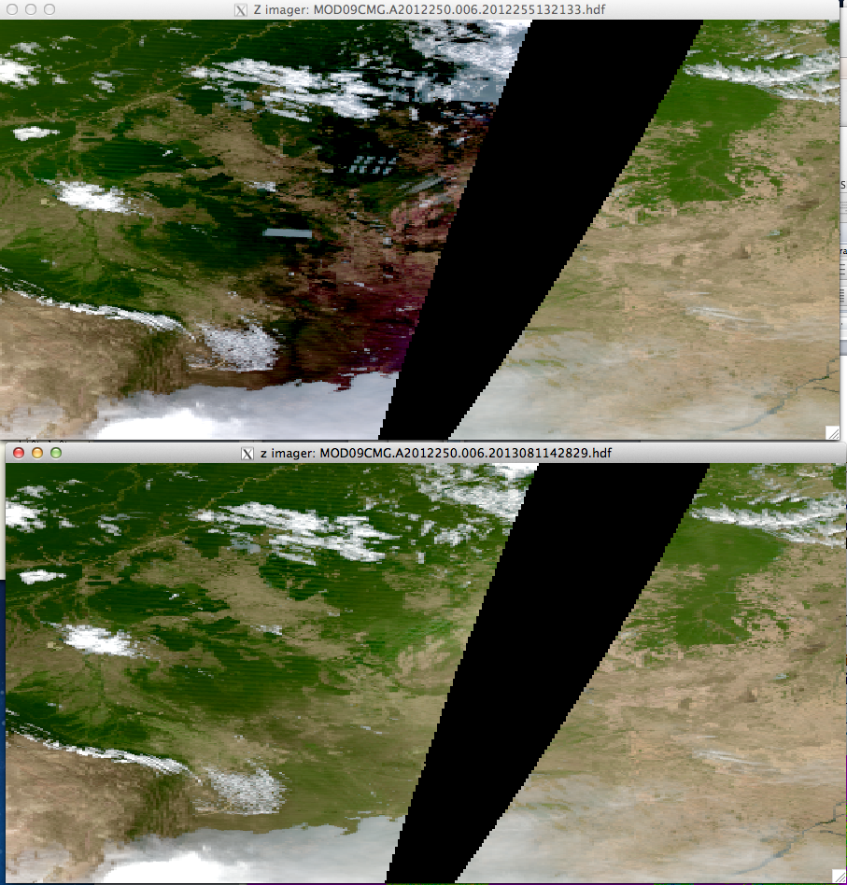
Polarization effect not as bad as previously thought
Collection 5 Level 1B
input
Collection 6 Level 1B
input

Slide 13
Conclusions
Collection 6 development is well on track (BRDF database included, new aerosol by the end of the month)
New reprocessing of the CMG using C6 Level1B will be critical to address additional correction needed (e.g. Polarization on Terra).
Cloud mask will be evaluated using CALIPSO and CMG reflectance time series

Slide 14
