Slide 1



Inherent Optical Properties
(IOPs)
Stéphane Maritorena
Earth Research Institute
University of California Santa Barbara

Slide 2
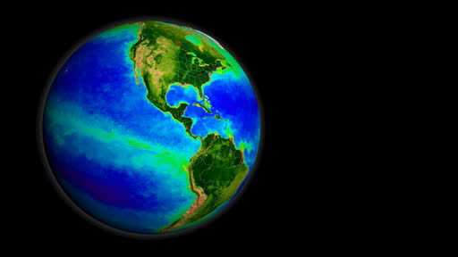
Why look at IOPs?
Chl is the historical OC product
  Routinely measured at sea
  Primary Production
  Proxy for phytoplankton biomass
  Easy to empirically derive from reflectance (Rrs ratio → Chl)
Chl is the OC product with the most complete validation
SeaWiFS
AQUA
Several issues with Chl:
The C/Chl ratio is not constant
Chl is not directly related to reflectance
Phytoplankton (≈Chl) is only one of the components that determine the ocean color signal
Notes:
products (High Latitudes, Coastal areas, High CDOM,….)
Preisendorfer (1961) of the concept of inherent (IOPs) and apparent (AOPs) optical properties. The IOPs were defined as depending only on the substances present in the aquatic medium, while AOPs were defined as depending on both IOPs and the geometric structure of the underwater light field.
additive
f/Q depends on the illumination condition & geometry, surface properties, bidirectional effectsand of the shape of the volume scattering function

Slide 3
Mean Absorption Component Spectra
(Open Ocean, consistently sampled and processed)
1.0
95% c.i.
0.8
Water
0.6
CDOM
Contribution to Spectral Absorption
0.4
a_{t}(λ) = a_{w}(λ) + a_{ph}(λ) + a_{cdom}(λ) + a_{det}(λ)
0.2
Phyto
Detritus
0.0
400
500
600
700
Wavelength (nm)
Global surface measurements (I8/I9, A20/A22, P16N/P16S, P18, BATS; N = 371)
US Global Ocean Carbon & Repeat Hydrography Cruises.
CDOM absorption frequently dominates absorption in the blue

Slide 4
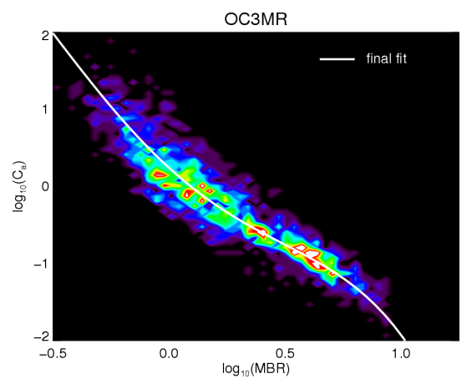
Chl and the band ratio algorithm
MODIS operational Chl: Maximum Band Ratio algorithm (MBR)
Chl retrievals from MBR algorithm are biased by other optically active components. CDOM in particular
In waters with high CDM MBR algorithm will overestimate Chl
Siegel et al. [2005]
Morel & Gentili [2009]
Loisel et al. [2010]
Szeto et al. JGR [2011] analysis of NOMAD data
Sauer et al. [2012] for MODIS
From Szeto et al. JGR [2011]

Slide 5
Semi-analytic OC models can account for CDOM and Chl
For example, the GSM model (Garver & Siegel, 1997; Maritorena et al., 2002) simultaneously retrieves three relevant properties: Chl, CDM [a_{cdom}(443)+a_{det}(443)] & BBP [b_{bp}(443)]
Gordon et al. (1988)
a_{ph}(λ) = Chl a_{ph}*(λ)
a_{cdm}(λ) = a_{cdm}(443) exp(-S(λ – 443))
b_{bp}(λ) = b_{bp}(443) (λ/443)^{-η}
Non-water components of absorption and scattering are expressed as known shape functions with unknown magnitudes which are retrieved through non-linear least-squares fitting.
Validation statistics for Chl_{GSM} with in situ data are as good as for Chl_{MBR} and almost as good with satellite data.
Notes:
a_{ph}*(λ), S and η were optimized for global applications using a large in situ data set.
Unknowns and their confidence intervals are retrieved by fitting the model to the observed Rrs using a non-linear least-square technique.

Slide 6
Comparison of MBR Chl and GSM Chl and influence of CDOM
Relative difference
ΔChl_{norm} = 100*(Chl_{MBR}-Chl_{GSM})/Chl_{GSM}
Contribution of CDM to absorption
%CDM = 100*CDM/(CDM+APH)
r between ΔChl_{norm} and %CDM
Siegel et al., in Press RSE

Slide 7
MBR Algo
GSM Algo
Correlation Chl vs SST
Mission Trend
Regional-scale correlation between Chl and SST in the Tropical ocean is almost identical
Mission trends show same spatial patterns but different magnitudes
Siegel et al., in Press RSE

Slide 8
So…
It’s worth looking at IOPs for the purpose of correcting the Chl estimates from empirical ratio algorithms (or generate a Chl estimate from the IOPs)
Another good reason to look at IOPs is because they provide links to biogeochemistry
Phytoplankton size; Mouw & Yoder, 2010
b_{bp} slope; Loisel et al., 2006
Phytoplankton absorption:
  Pigment composition
  Community structure
  Physiology
CDM (non-algal) absorption:
  Photochemistry
  Correct empirical Chl retrievals
NPP; Behrenfeld et al., 2005
PSD; Kostadinov et al., 2009
Particulate backscattering:
  Particle Size Distribution (size index)
  Primary Production
  POC, PIC

Slide 9
Where are we at with IOP algorithms and products?
Several IOP products are available through the NASA OBPG ocean color web:
- a_{cdm}(443), a_{ph}(443), b_{bp}(443) from different models
- IOPs are not “standard” products, they are “evaluation” products
Several workshops and evaluation exercises for IOP products and algorithms:
SeaBAM, 1996
OCBAM, 2005
IOCCG, 2005
NASA IOP Workshops, 2008, 2010
ESA CCI, 2013

Slide 10
The NASA OBPG IOP algorithms Workshops (2008, 2010)
Goal was mostly to look under the hood of 7 IOP algorithms to interpret their differences and assess their suitability for global application
Since SA algorithms are all based on the same fundamental relationship between Rrs and IOPs, the differences among them come from their overall design
  Assumptions
  Parameterization of the absorption and backscattering components
  Inversion or optimization approach
Seven IOP algorithms were tested against the NOMAD in situ data set and some satellite data
NASA OBPG developed the generalized IOP (GIOP) model software which allows the user to choose the parameterization and inversion method of a SA ocean color model.
Generalized ocean color inversion model for retrieving marine inherent optical properties
(In Press, Applied Optics)

Slide 11
ESA OC-CCI round-robin
Aim is to establish an objective methodology for OC algorithm selection based on performance and suitability for use in climate-change studies.
29 variables
11 semi-analytical algorithms
(IOPs, Chl, Kd(490))
6 empirical algorithms (Chl)
Tested with the NOMAD in situ data set
Developed an objective classification designed to rank the quantitative performance of the models based on various univariate statistics.
(In Press, RSE)
Notes:
The aims of OC-CCI are to create a long-term, consistent, error-characterized time series of ocean-color products, for use in climate change studies.
A key component of the project is the selection of suitable algorithms that meet project aims and user requirements (atmosphere and in-water).

Slide 12
ESA OC-CCI
Brewin et al.,RSE In Press

Slide 13
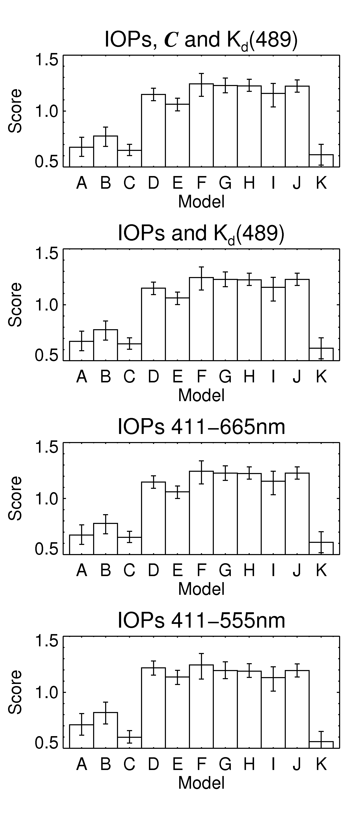
OC-CCI and NASA IOP Workshops Main Conclusions
No perfect algorithm that does it all at all wavelengths
The performance of each model varies depending on product and wavelength
Most semi-analytic models perform well in predicting total absorption, a_{t}(λ), and total backscattering, b_{b}(λ)
Performance is generally degraded when decomposing a_{t} into a_{ph} and a_{cdm}
Difficult to rank the performance of the algorithms, as many of the models have overlapping error bars.
Issues with the in situ data:
No independent data set for model testing
Time and space biases
Mesotrophic waters are over-represented
Need measurement uncertainty quantification (closure issues)
Brewin et al.,RSE In Press
Notes:
Overall, the algorithms that performed best are those used by OBPG. There are clearly issues with some in situ data (no closure). Uncertainties in some measurements is still large. Time and space biases. Mesotrophic waters are over represented.

Slide 14
Summary
IOPs are important for ocean biogeochemistry studies
IOPs are not “Standard” (= operational) products, they are “Evaluation” products
It’s probably time for some of them to become “Standard” products
No “perfect” IOP algorithm or model
There is room for improvement in terms of products and spectral accuracy
Need more diverse and high quality in situ data

Slide 16
Can we improve the IOP models?
a_{ph}(λ) = A(λ) Chl ^{B(λ)} a_{cdm}(λ) = a_{cdm}(443) exp(-S(λ -443)) b_{bp}(λ) = b_{bp}(443) (λ /443)^{-η}
Replace some constant parameters by dynamic expressions (e.g. t/n_{w}², f/Q, S, η).
Improve phytoplankton absorption parameterization through better, bigger, more diverse data sets
Challenges:
Highly non-linear
Dynamic parameterization is not always obvious
Still some empiricism
What is best?
- High accuracy at 1 λ vs a lower but consistent accuracy at all λs?
- High accuracy for some products but lower accuracy for some others?
- High accuracy retrievals but poor spatial and temporal coverage (filtering)
- ….
Notes:
Dynamic parameterization is not always obvious (e.g. S)

