Slide 1

National Aeronautics and Space Administration
Current and Planned MODIS Land Surface Temperature and Emissivity (LST&E) Products
Glynn Hulley, Simon Hook
Jet Propulsion Laboratory, California Institute of Technology, Pasadena, CA
(c) 2013 California Institute of Technology. Government sponsorship acknowledged.
Special thank to the MODAPS team: Ginny Kalb, Teng-Kui Lim Robert Wolfe, Kurt Hoffman, Jerry Shiles, Sadashiva Devadiga
MODIS Science Team Meeting, Silver Spring, MD, 15-18 April, 2013

Slide 2
Outline
Earth science use of LST&E products
Theoretical basis
Current products and upgrades for C6
The MOD21 LST&E product and potential uses
Validation of the current products and MOD21
Long-term calibration and trends
Uncertainty analysis
Future Work

Slide 3
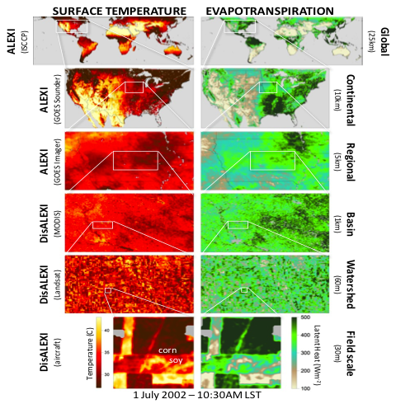
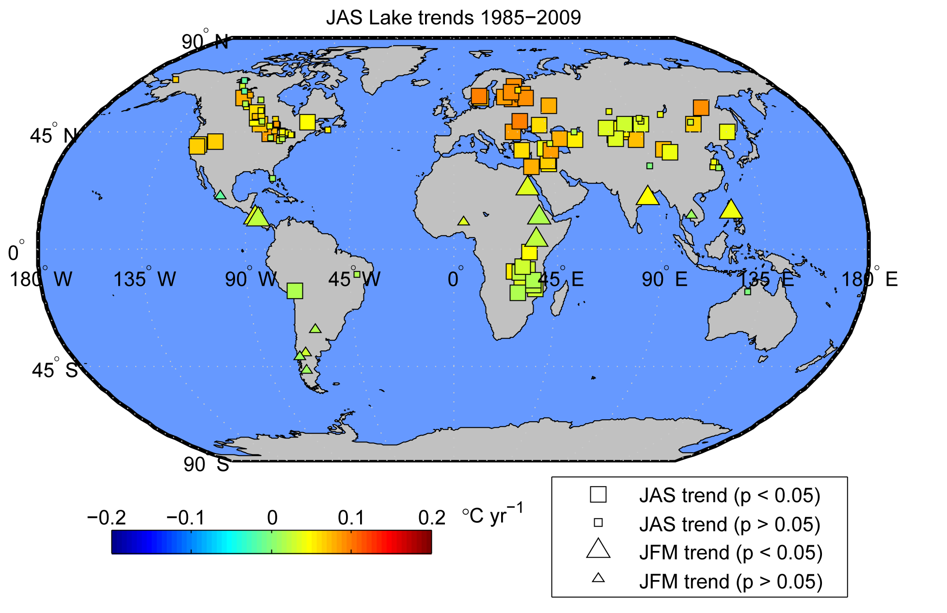
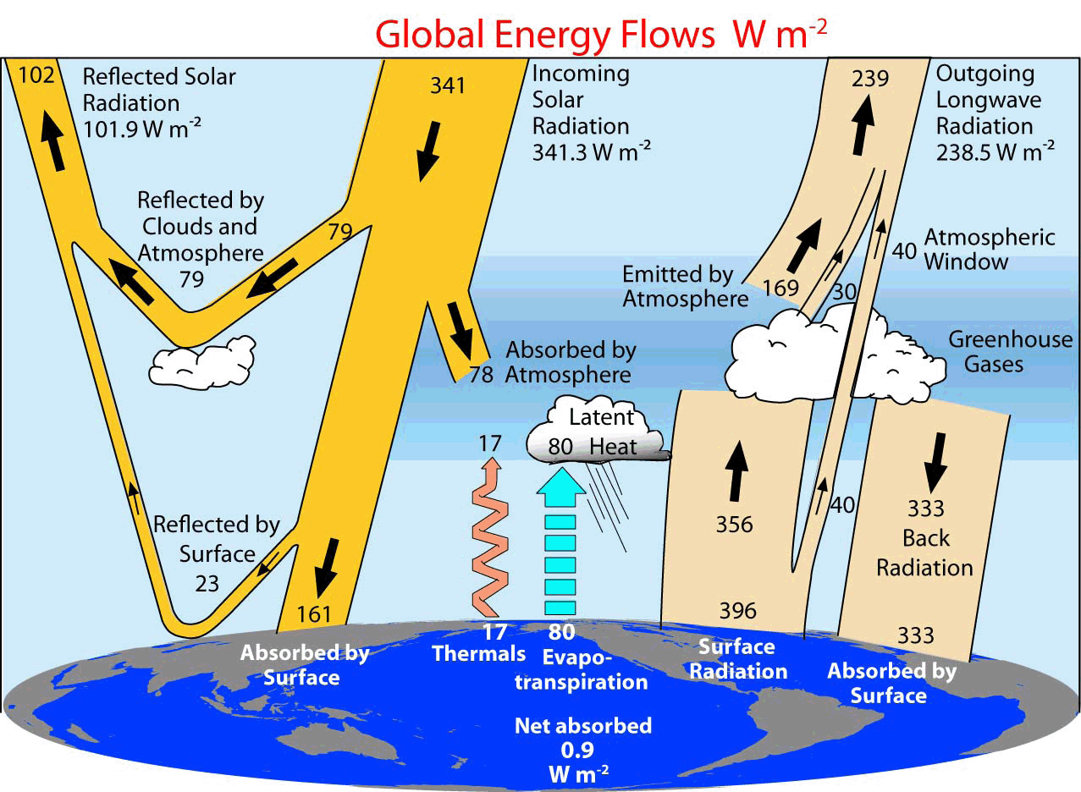
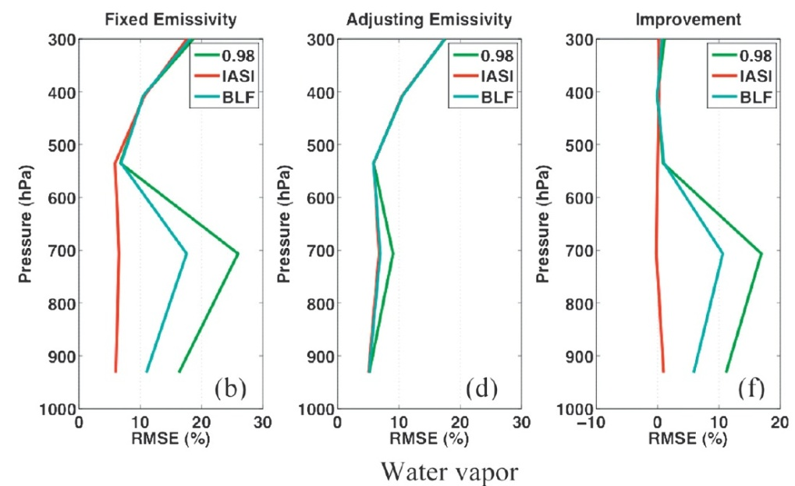
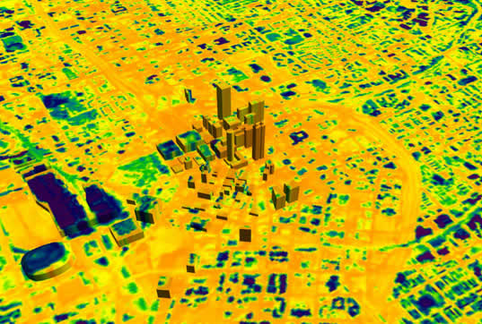
Earth Science Use of LST&E
Evapotranspiration (drought monitoring)
Understanding Climate Change
Surface Energy Balance Models
Urban Heat Island Studies
Atmospheric profile retrievals
Notes:
an error of 0.1 in the emissivity will result in climate models having errors of up to 7 Wm-2 in their upward longwave radiation estimates –a much larger term than the surface radiative forcing (~2-3 Wm-2) due to an increase in greenhouse gases (Zhou et al. 2003).

Slide 4
Theoretical Basis: Planck Formula
As the temperature increases the peak in the Planck function shifts to shorter and shorter wavelengths

Slide 5
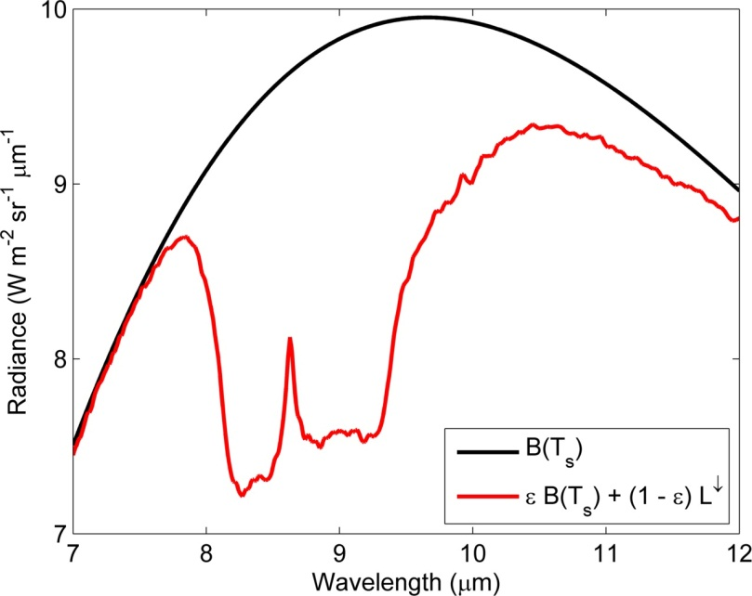
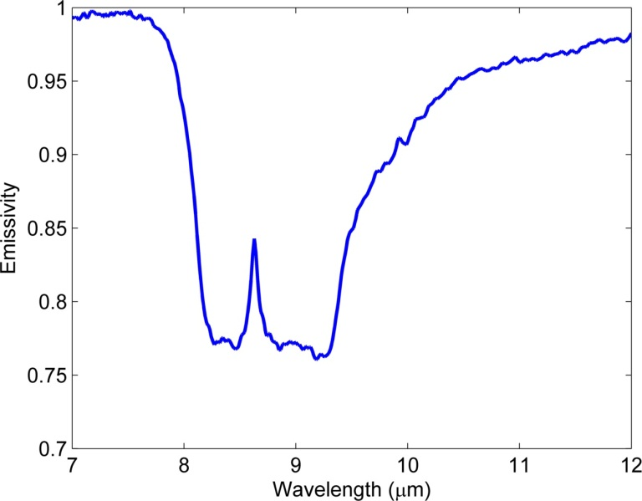
Spectral Emissivity
Materials are not perfect blackbodies, but instead emit radiation in accordance with their own characteristics. The ability of a material to emit radiation can be expressed as the ratio of the spectral radiance of a material to that of a blackbody at the same temperature. This ratio is termed the spectral emissivity:
for a material at a given wavelength,
the radiance is:

Slide 6
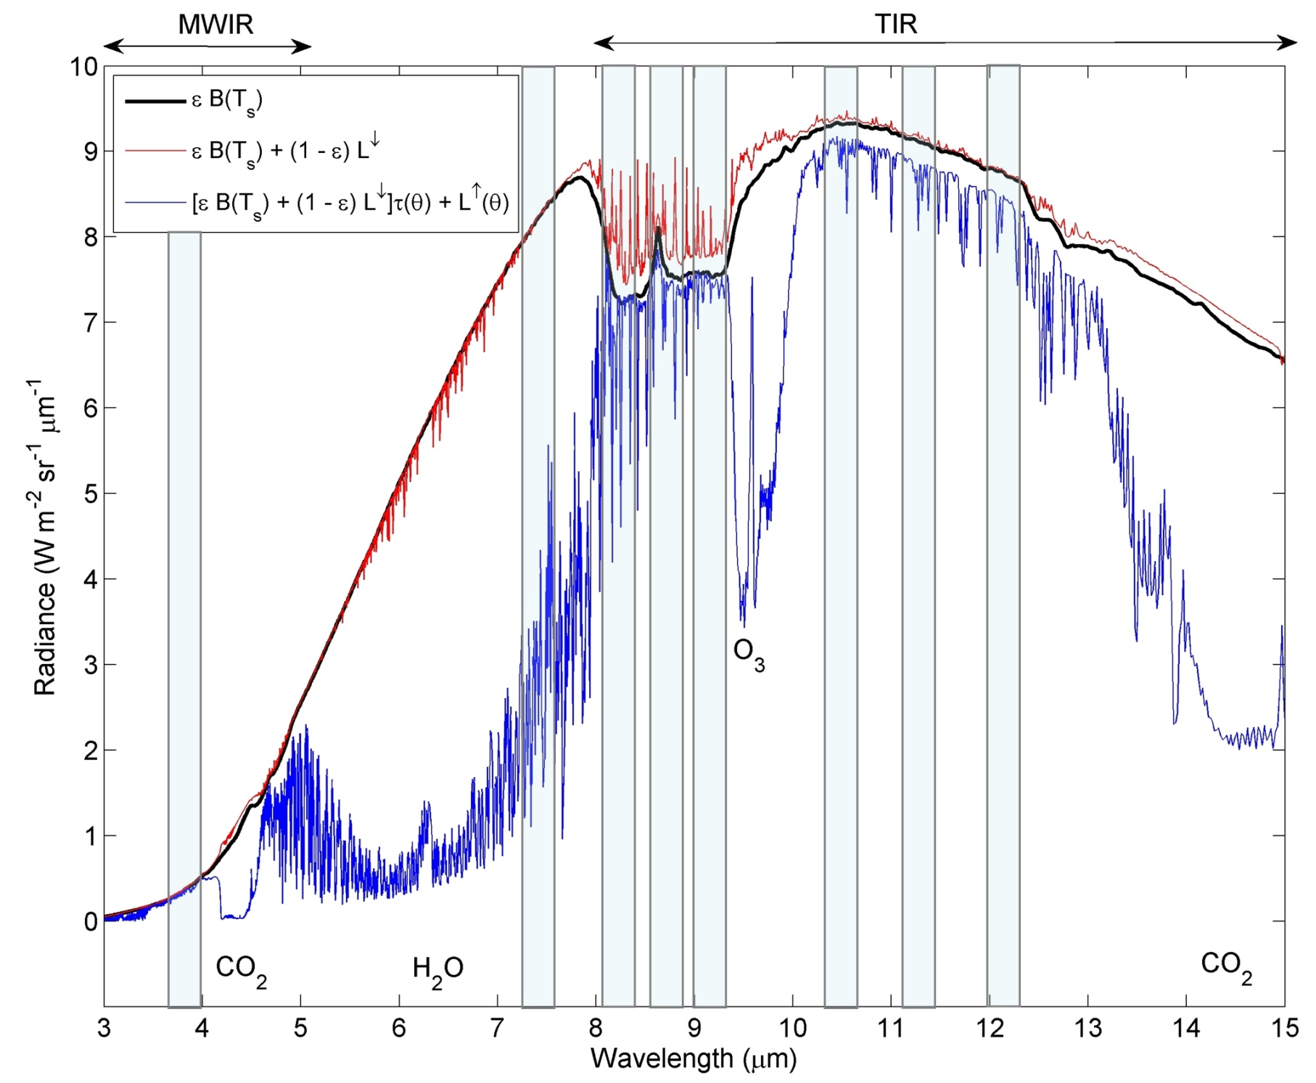
Notes:
Radiances curves of surface emission, surface emission + reflection, and at-sensor radiance, for a quartz emissivity spectrum

Slide 7
Current and planned MODIS LST&E Products
MODIS LST Products | Product Level | Dimensions | Spatial Resolution | Temporal Resolution | Algorithm | Output Products
MOD11_L2 | L2 | 2030 lines 1354 pixels/line | 1km at nadir | Swath 2x daily | Split-Window | - LST - Emissivity (bands 31, 32)
MOD11B1 | L3 | 200 rows 200 columns | ~5 km (v4) ~6 km (v5) | Sinusoidal 2x daily | Day/Night | - LST - Emissivity (bands 20-23, 29, 31,32)
MOD11C3 | L3 | 360ºx180º Global | 0.05º x 0.05º | Monthly | Day/Night + Split-Window | - LST - Emissivity (bands 20-23, 29, 31-32)
None of the current algorithms produce emissivities at 1km resolution

Slide 8
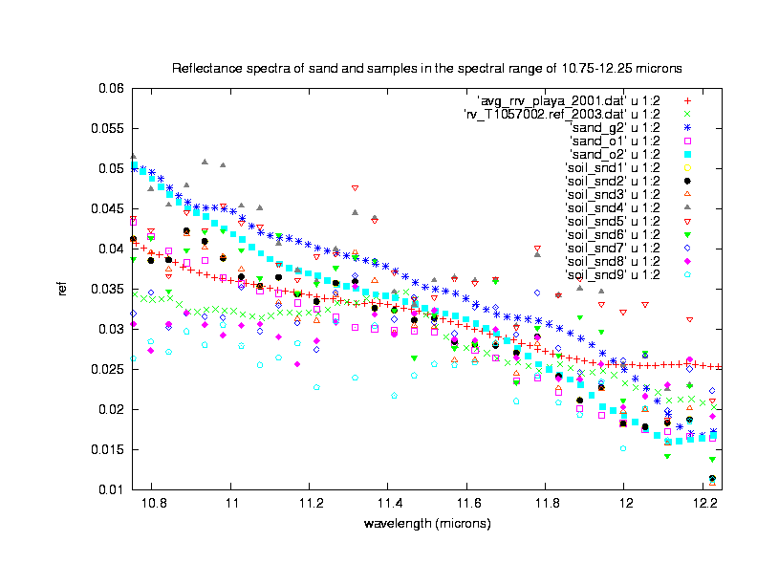
Lessons learned from the validation
of the C5 MODIS LST products
1, For the 42 global test sites in different regions used in the C5 LST validation,
the LST errors are well within 1K in all sites but five desert sites where some
LSTs may be underestimated by more than 3K.
2, The two fundamental causes for the
large LST errors in desert regions are
daytime LSTs are beyond the up
limit (Ts-air + 16K) used in algorithm
development, and
(B) The 0.015 variation range of emis
values in MODIS bands 31 and 32
for soil and sand samples (as shown in
the variation range of the reflectance
values in the right plot) corresponds to
large LST errors.
emissivity = 1 - reflectance
Courtesy Z. Wan

Slide 9
Summary of R-based validation of the C5 MODIS LST products at 32 new sites besides 10 old sites
Site | Location | Latitude, Longitude (º) | Land-cover Type (id #) | MOD11 or MYD11_L2 | type of atmos. profiles | mean (std) of LST errors (K)
11 12 13 14 15 16 17 18 19 20 21 22 23 24 25 26 27 28 29 30 31 32 33 34 35 36 37 38 39 40 41 42 | Recife, Brazil Moree, Australia Port Elizabath, S. Africa WLT Alert,Canada South Pole McMurdo,Antarctica Dye-2, Greenland Summit, Greenland Cherskij, Russia Gaze, Tibet, China Hainich, Germany Paris, France near Paris, France Nimes, France near Nimes, France Milan, Italy near Milan, Italy Cuneo, Italy Payerne, Switzerland Nenjiang, China Yichun, China Harbin, China near Harbin, China Algiers, Algeria Dar-El-Beida,Algeria Niamey, Niger Near Niamey, Niger Tamanrasset, Algeria Bechar, Algeria Farafra, Egypt SVU, Egypt In-salah, Algeria | 7.96 S, 34.94 W 29.555 S, 149.86 E 33.95 S, 23.59 E 82.4 N, 62.33 W 89.95 S, 0.05 E 77.75 S, 164.1 E 66.481 N, 46.28 W 72.58 N, 38.475 W 68.75 N, 161.27 E 32.3 N, 84.06 E 51.079 N, 10.452 E 48.8 N, 2.35 E 48.45 N, 2.25 E 43.84 N, 4.37 E 43.828 N, 4.535 E 45.485 N, 9.21 E 45.297 N, 9.26 E 44.53 N, 7.62 E 46.855 N, 6.965 E 49.07 N, 125.23 E 47.76 N, 128.88 E 45.73 N, 126.65 E 45.9 N, 127.1 E 36.72 N, 3.03 E 36.65 N, 3.28 E 13.5 N, 2.14 E 13.58 N, 2.07 E 22.856 N, 5.455 E 31.62 N, 2.33 W 27.04 N, 27.97 E 26.285 N, 32.78 E 27.18 N, 2.6 E | evergreen forest (2) open shrubland (7) evergreen forest (2) shrubland (7)/snow(15) snow/ice (15) snow/ice (15) snow/ice (15) snow/ice (15) snow (15)/shrubland(7) open shrubland (7) mixed forest (5) urban (13) cropland (12) urban (13) cropland (12) urban (13) cropland (12) cropland (12) cropland (12) cropland(12)/snow(15) mixed forest (5) urban (13) cropland (12) urban (13) cropland (12) urban (13) grassland (10) bare soil (16) in desert bare soil (16) in desert bare soil (16) in desert bare soil (16) in desert bare soil (16) in desert | MOD11 MOD11 MYD11 MOD11 MOD11 MOD11 MOD11 MOD11 MOD11 MOD11 MOD/MYD MYD11 MYD11 MYD11 MYD11 MYD11 MYD11 MYD11 MYD11 MOD11 MOD11 MOD11 MOD11 MOD11 MOD11 MOD11 MOD11 MOD/MYD MOD/MYD MYD11 MYD11 MOD/MYD | radiosonde radiosonde radiosonde radiosonde radiosonde radiosonde NCEP NCEP radiosonde NCEP radiosonde radiosonde radiosonde radiosonde radiosonde radiosonde radiosonde radiosonde radiosonde radiosonde radiosonde radiosonde radiosonde radiosonde radiosonde radiosonde radiosonde radiosonde radiosonde radiosonde radiosonde radiosonde | 0.4 (0.4) -0.8 (0.9) -0.2 (0.9) 0.2 (0.8) -0.5 (0.6) 0.1 (0.3) 0.0 (0.5) 0.1 (0.5) 0.3 (0.5) -0.6 (0.2) -0.3 (0.5) 0.1 (0.4) 0.0 (0.6) 0.1 (0.4) -0.1 (0.6) -0.3 (0.7) -0.3 (0.6) 0.0 (0.5) 0.0 (0.5) -0.3 (0.6) 0.1 (0.6) 0.2 (0.8) 0.1 (0.8) -0.2 (0.9) -0.5 (0.7) -0.3 (1.0) -0.9 (1.1) -1.9 (1.2) -1.5 (0.6) 0.9 (0.4) -1.6 (0.5) -3.0 (0.8)
Courtesy Z. Wan

Slide 10
New Refinements for the C6 Daily MODIS LST PGE (PGE16)
Two new sets of coefficients in the generalized split-window algorithm were developed for bare soil/sand pixels in separate conditions of daytime and nighttime, and the range of (LST – Ts-air) is set as from 8 – 29K for daytime LST and from -10 – 4K for nighttime LST, in order to well address the problems of very wide temporal variation range for daytime LST changes and possible large uncertainties in Ts-air values provided by the M*D07_L2 products.
Table 1A, Mean and standard deviation of LST difference values in the C6, C5 and C41 MOD11B1 Products at some typical sites in 2007.
site name | latitude/longitude | land cover type | daytime LST |  | nighttime LST
 |  |  | C5 - C6 | C41 – C6 | C5 – C6 | C41 – C6
Lake Tahoe | 39.11, -120.03 | inland lake | 0.01 ±0.16 | 0.43 ±0.16 | -0.06 ±0.18 | -0.12 ±0.18
Mojave | 35.129, -115.65 | open shrublands | 0.01 ±0.17 | 1.48 ±0.19 | -0.12 ±0.17 | 1.41 ±0.17
Tamanrasset | 22.78, 5.52 | bare soil/sand | -2.84 ±0.16 | -0.68 ±0.20 | -1.80 ±0.17 | -0.44 ±0.19
In-salah | 27.22, 2.5 | bare soil/sand | -3.50 ±0.20 | -0.20 ±0.24 | -2.27 ±0.17 | -0.01 ±0.18
Sonoran | 31.9, -114.47 | bare soil/sand | -3.27 ±0.18 | -1.01 ±0.22 | -2.71 ±0.18 | -1.18 ±0.31
north Tassili | 27.0, 7.65 | bare soil/sand | -3.79 ±0.19 | -0.70 ±0.24 | -2.95 ±0.16 | -0.48 ±0.17
Table 2A, Mean and standard deviation of emissivity values in band 29 in the C6, C5 and C41 MOD11B1 Products at some typical sites in 2007.
site name | latitude/longitude | land cover type | mean and standard deviation in the whole year
 |  |  | C6 | C5 | C41
Lake Tahoe | 39.11, -120.03 | inland lake | 0.986 ± 0.007 | 0.985 ± 0.007 | 0.982 ± 0.011
Mojave | 35.129, -115.65 | open shrublands | 0.915 ± 0.020 | 0.921 ± 0.020 | 0.923 ± 0.016
Tamanrasset | 22.78, 5.52 | bare soil/sand | 0.926 ± 0.009 | 0.917 ± 0.018 | 0.931 ± 0.020
In-salah | 27.22, 2.5 | bare soil/sand | 0.820 ± 0.018 | 0.856 ± 0.062 | 0.806 ± 0.038
Sonoran | 31.9, -114.47 | bare soil/sand | 0.763 ± 0.022 | 0.838 ± 0.075 | 0.759 ± 0.032
north Tassili | 27.0, 7.65 | bare soil/sand | 0.716 ± 0.019 | 0.814 ± 0.097 | 0.714 ± 0.029
Courtesy Z. Wan

Slide 11
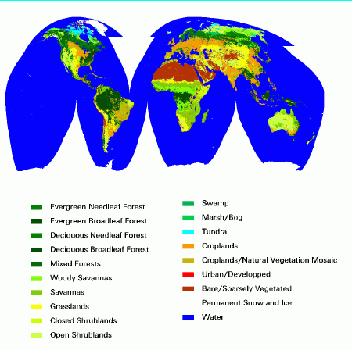
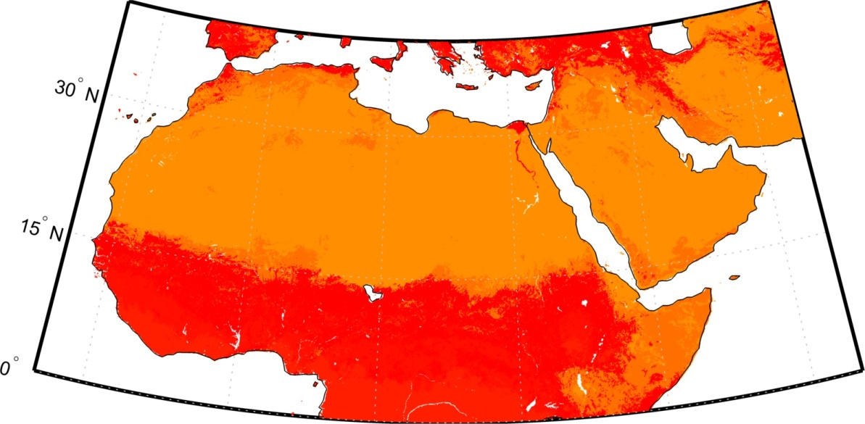
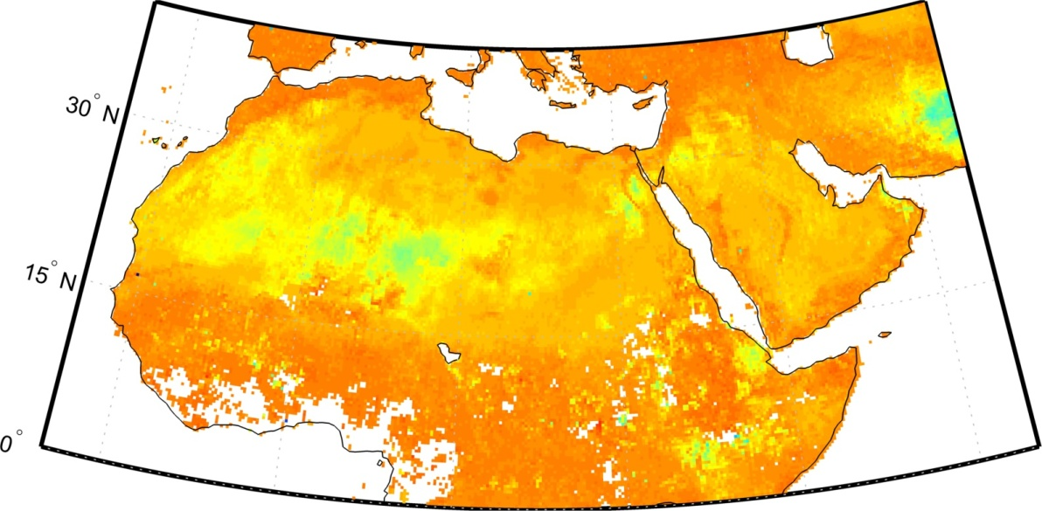
Split Window: Classification versus actual emissivity
MOD11 band 32
MOD21 band 32
MOD 11 classified as bare and assigned single emissivity but a wide range in emissivity as seen with MOD21

Slide 12
Current and planned MODIS LST&E Products
MODIS LST Products | Product Level | Dimensions | Spatial Resolution | Temporal Resolution | Algorithm | Output Products
MOD11_L2 | L2 | 2030 lines 1354 pixels/line | 1km at nadir | Swath 2x daily | Split-Window | - LST - Emissivity (bands 31, 32)
MOD11B1 | L3 | 200 rows 200 columns | ~5 km (v4) ~6 km (v5) | Sinusoidal 2x daily | Day/Night | - LST - Emissivity (bands 20-23, 29, 31,32)
MOD11C3 | L3 | 360ºx180º Global | 0.05º x 0.05º | Monthly | Day/Night + Split-Window | - LST - Emissivity (bands 20-23, 29, 31-32)
MOD21_L2 | L2 | 2030 lines 1354 pixels/line | 1km at nadir | Swath 2x daily Monthly | ASTER-TES | - LST - Emissivity (bands 29, 31, 32)
** Planned, dynamic emissivity retrieval algorithm same as used with ASTER. Produces T&E at 1km resolution

Slide 13
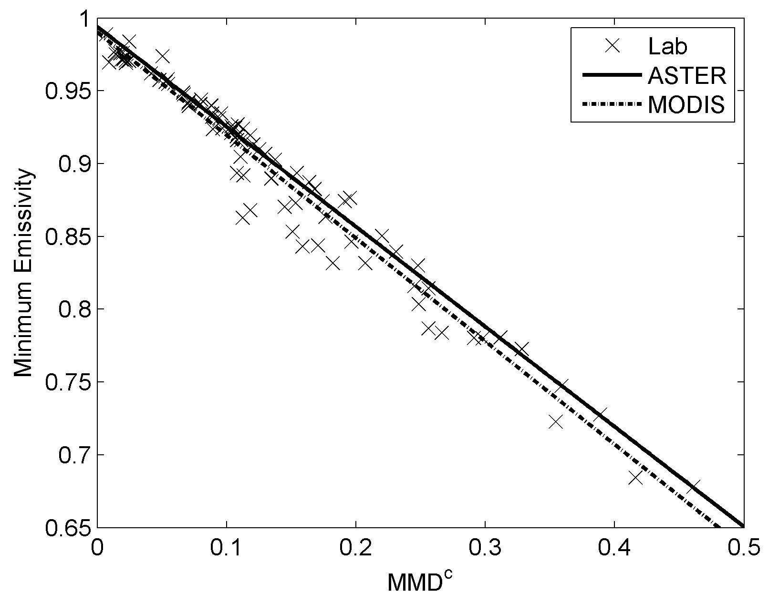
The Temperature Emissivity Separation (TES) Algorithm (MOD21)
Observed Radiance
Surface Radiance:
Atmospheric Parameters: , ,
Estimated using radiative transfer code such as MODTRAN with
Atmospheric profiles and elevation data
Calibration curve for MODIS bands 29, 31, 32:

Slide 14
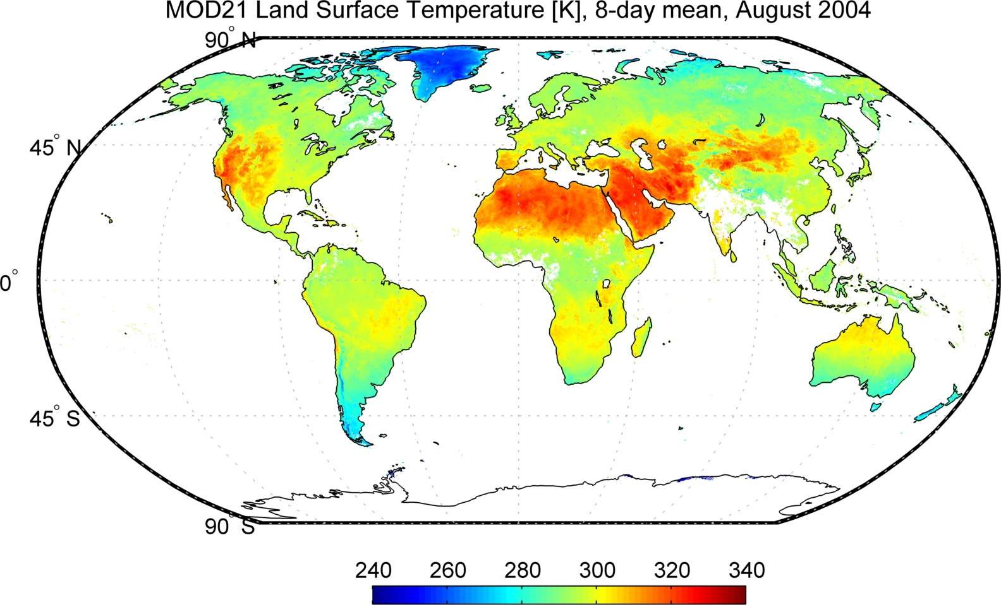
Generated using prototype MOD21 algorithm at MODAPS

Slide 15
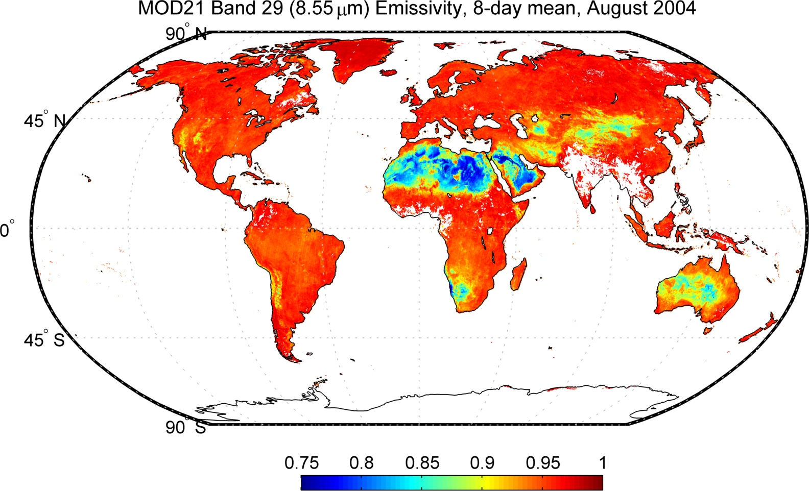
Generated using prototype MOD21 algorithm at MODAPS

Slide 16

Generated using prototype MOD21 algorithm at MODAPS

Slide 17
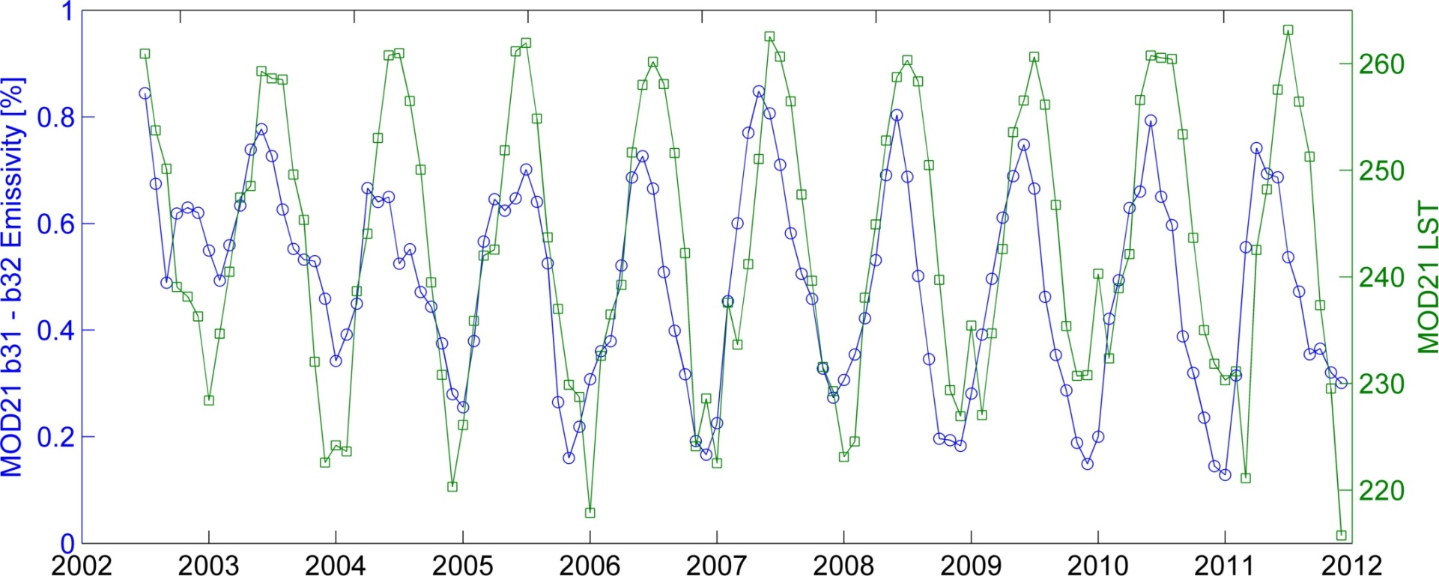
Monitoring snow melt on Greenland using MOD21 emissivity and LST
Central Greenland (70N, 41W)
Coarser grain size (more melt)
Band 32 decreases with increasing snow grain size, while Band 31 is invariant
Emissivity is an intrinsic property of the surface and will give more direct measure of snow/melt cycle on glaciers
Day and night emissivity retrievals increases yield during difficult periods (e.g. during winter cloudy conditions)

Slide 18
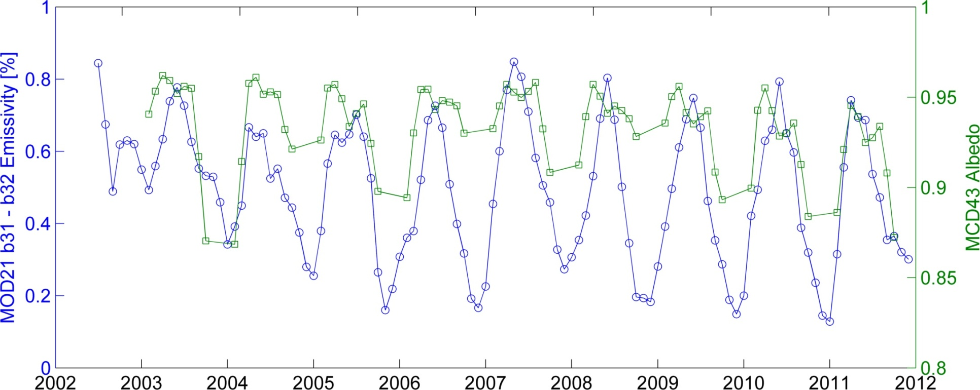
Comparison with MCD43 Albedo Product
Albedo detects snow melt too early due to shadowing effects from irregular snow surfaces (sastrugi) and high solar zenith angles (Stroeve et al. 2005)
Central Greenland (70N, 41W)
Missing albedo data during winter months due to low solar zenith angle and clouds
Emissivity has higher sensitivity to snow melt intensity than albedo
Emissivity is retrieved both day and night resulting in higher data yield under more difficult conditions during wintertime
Albedo often detects snow melt too early due to shadowing from weathered snow features such as sastrugi

Slide 19
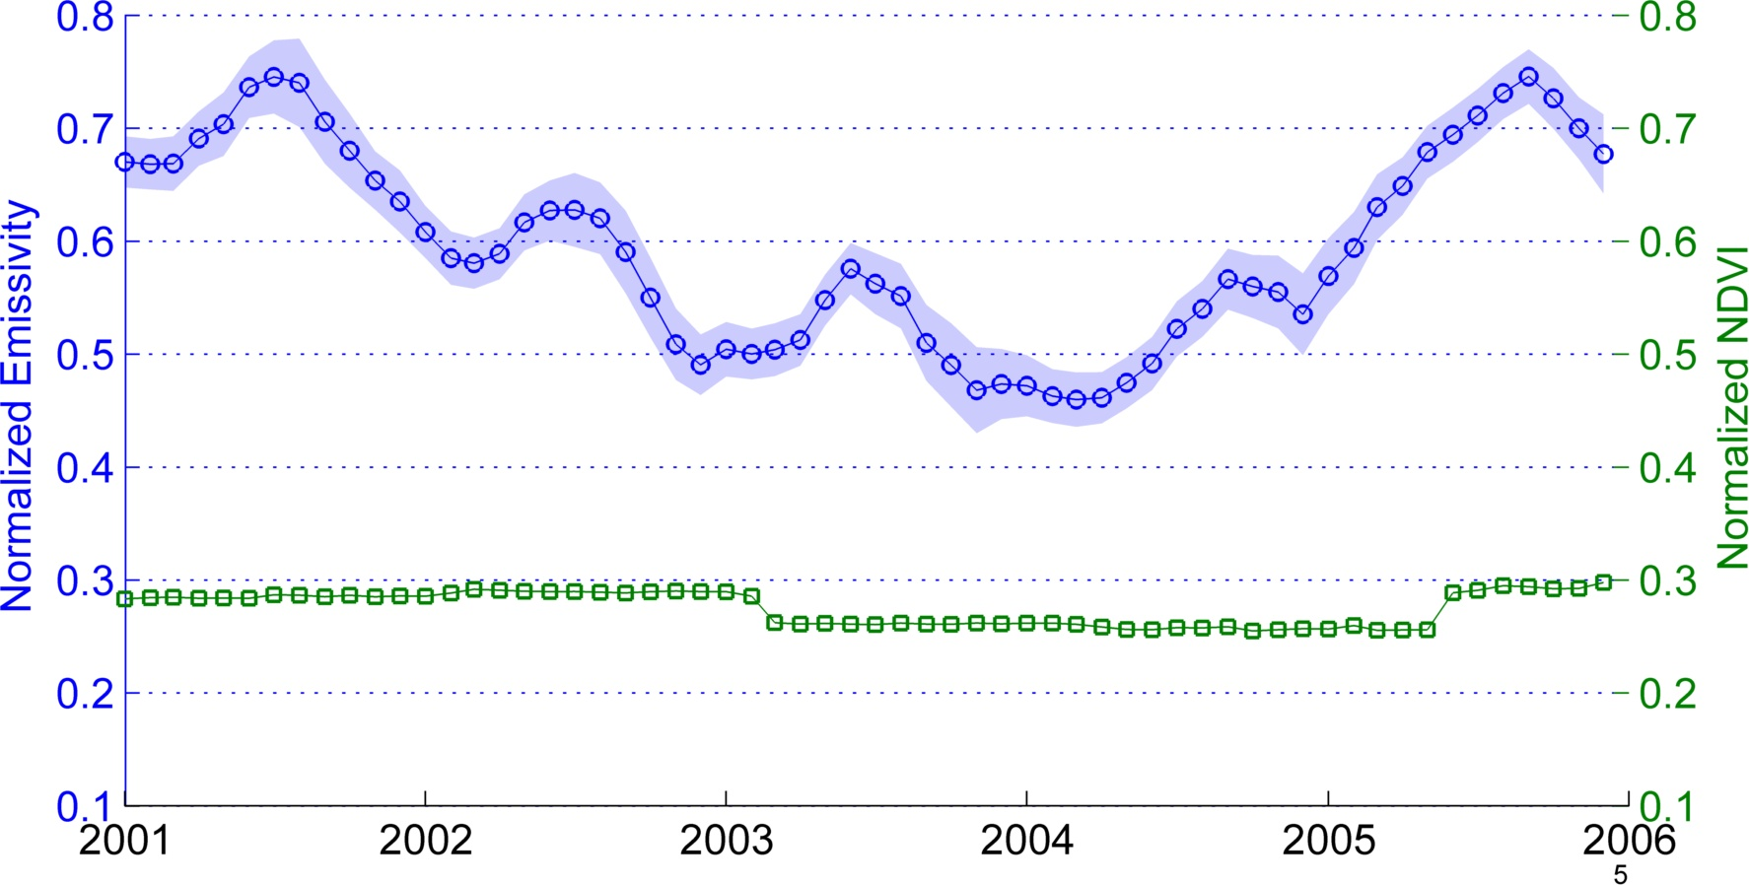
Monitoring land degradation (desertification) in dryland regions using MOD21 band 29 emissivity
Jornada Experimental Range, New Mexico
Land degradation
Recovery
Emissivity and NDVI normalized to their maximum and minimum ranges
Band 29 emissivity sensitive to background soil and dry/green vegetation
NDVI unable to make distinction between background soil and dry vegetation
Emissivity able to better capture seasonal trends and interannual trends than NDVI

Slide 20
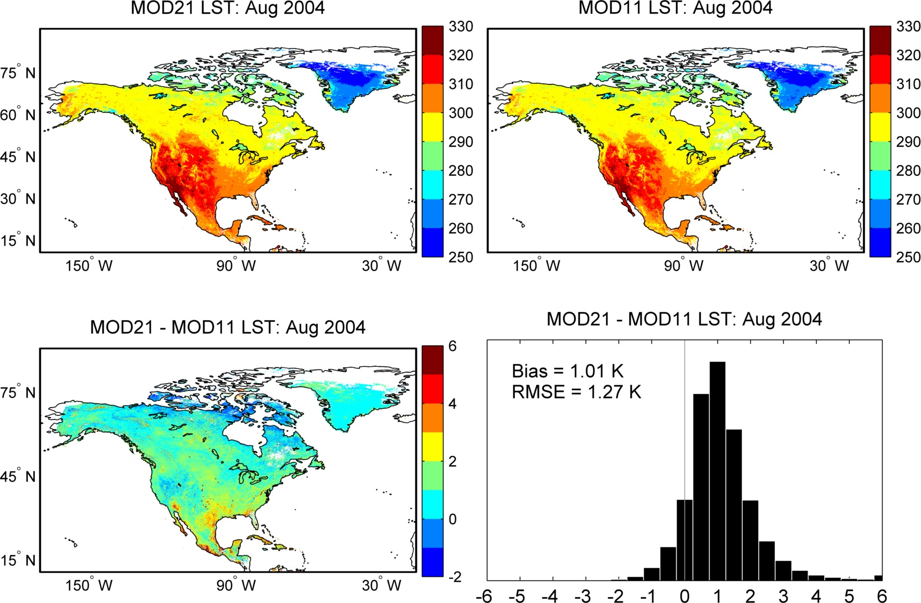
MOD21 and MOD11 LST Comparison
Large LST differences over bare regions and regions of high humidity – will these be smaller in Collection 6 ?

Slide 21
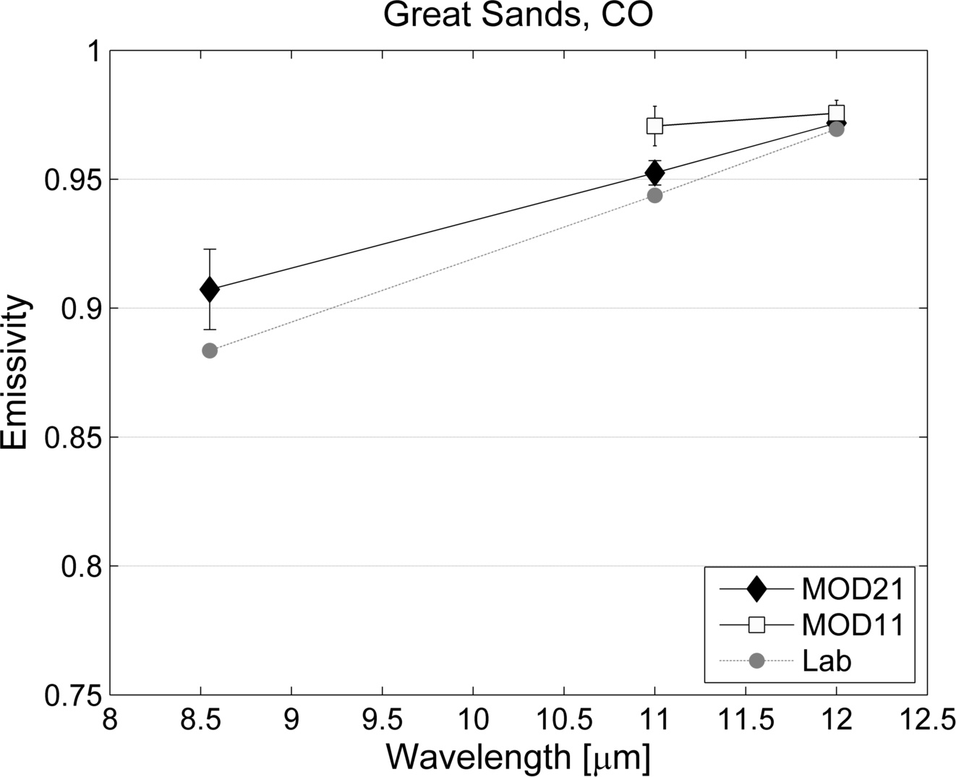
Emissivity Validation: Great Sands, Colorado
MOD11 classification set too high

Slide 22
LST&E Validation Sites

Slide 23
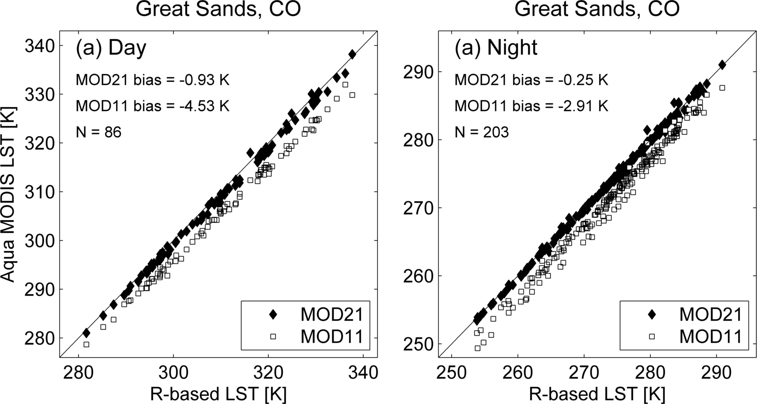
LST Validation: Great Sands, Colorado
** Radiance-based LST validation using lab-measured sand samples collected at dune site

Slide 24
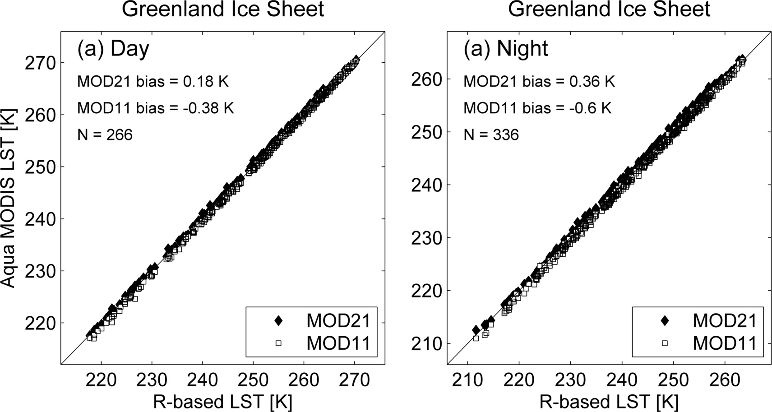
LST Validation: Greenland ice sheet
Similar accuracy over Greenland (<1 K)

Slide 25
LST Validation summary: Graybody surfaces (forest, snow/ice, grassland)
MOD21 and MOD11 have similar accuracy over graybody surfaces (<1 K)

Slide 26
LST Validation summary: Bare surfaces
(pseudo-invariant sand sites)
Sites | Obs | MOD11 |  | MOD21 |  | MOD11 | MOD21
 |  | Bias (K) |  |  |  | RMSE (K)
Algodones, CA | 956 | -2.89 | -0.05 |  |  | 3.04 | 1.07
Great Sands, CO | 546 | -4.53 | -0.93 |  |  | 4.63 | 1.17
Kelso, CA | 759 | -4.55 | -1.48 |  |  | 4.62 | 1.67
Killpecker, WY | 463 | -4.51 | -1.19 |  |  | 4.58 | 1.42
Little Sahara, UT | 670 | -3.71 | -0.60 |  |  | 3.79 | 0.89
White Sands, NM | 742 | -0.73 | -0.29 |  |  | 1.07 | 0.95
MOD11 cold bias of up to ~5 K over bare sites
(due to overestimated classification emissivity)

Slide 27
When looking for trends we need to worry about long-term calibration!
Excellent calibration until 2009. Since 2009 channel 29 calibration started to degrade

Slide 28
Similar analysis to previous slides but notice how range of Aqua data has increased

Slide 29
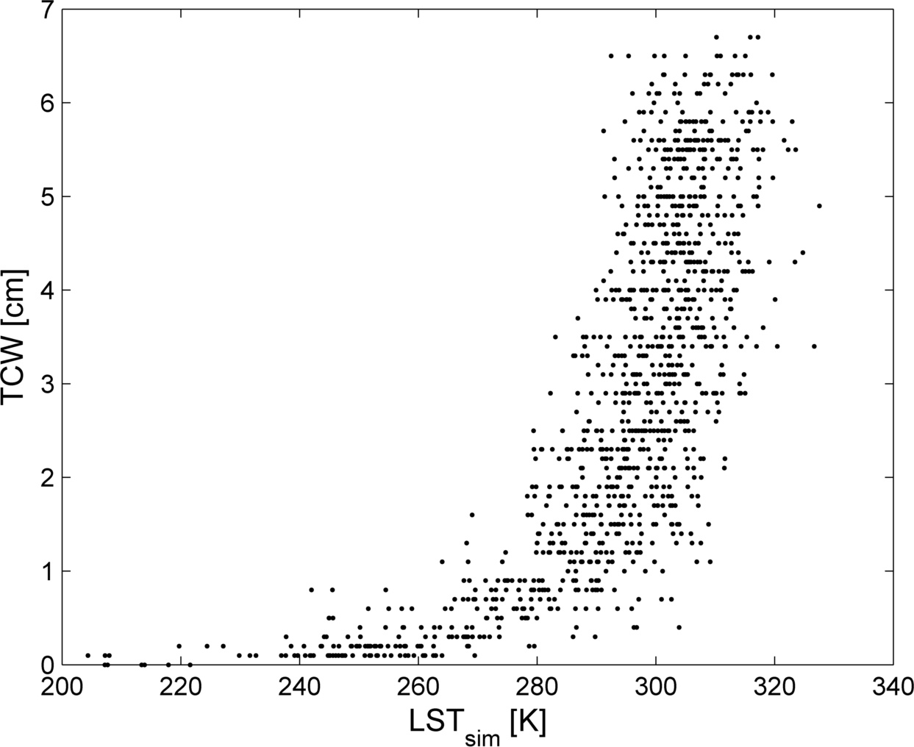
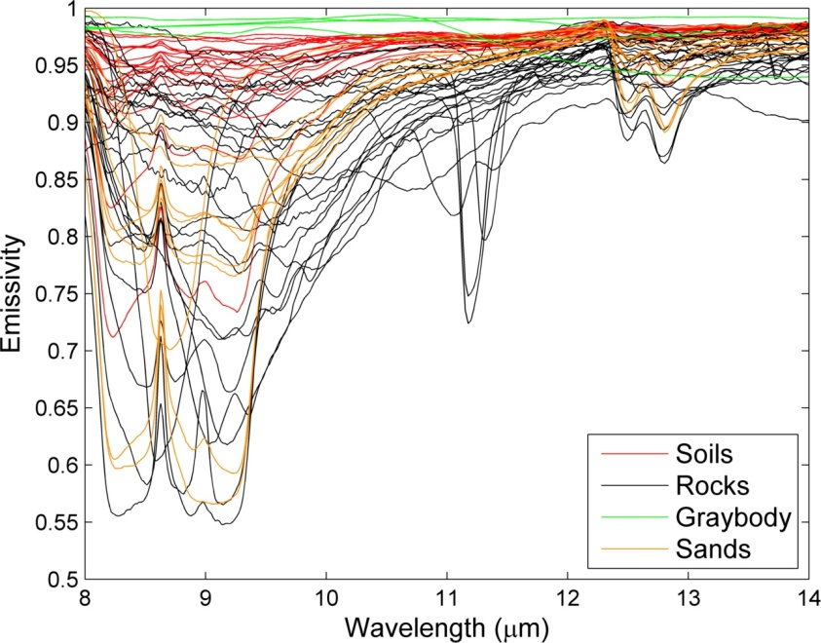
MOD21 LST&E Uncertainty Analysis
LST&E Uncertainty Simulator (LSTE-US) developed at JPL
  Global set of radiosonde profiles (382 from 1-6 cm total water vapor)
  Broad range of surface characterization (>100 spectra from ASTER spectral library)
  At-sensor radiances simulated for any given sensor’s spectral response
Error contributions modeled:
    Model or Algorithmic error
    Atmospheric compensation error
    Measurement noise error (NEDT)
    Cloud contamination
Notes:
Uncertainty analysis is critical for developing Earth System Data Records (ESDRs), e.g. LST with long-term consistency, continuity and accuracy
Current products only include qualitative information in QC data planes

Slide 30
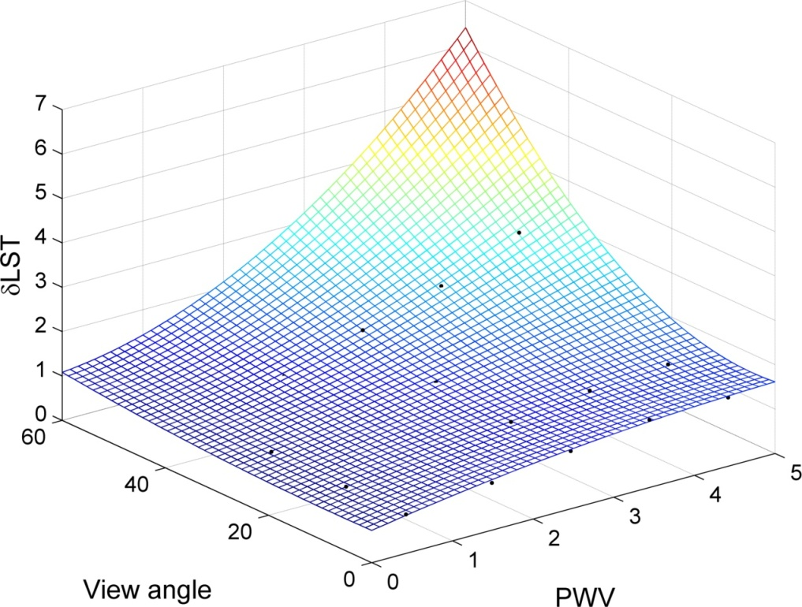
MOD21 Uncertainty Parameterization
a_{i} = regression coefficients dependent on surface type (gray, bare, transition)
SVA = sensor view angle
TCW = total column water estimate (cm), e.g. from MOD07, NCEP
TCW

Slide 31
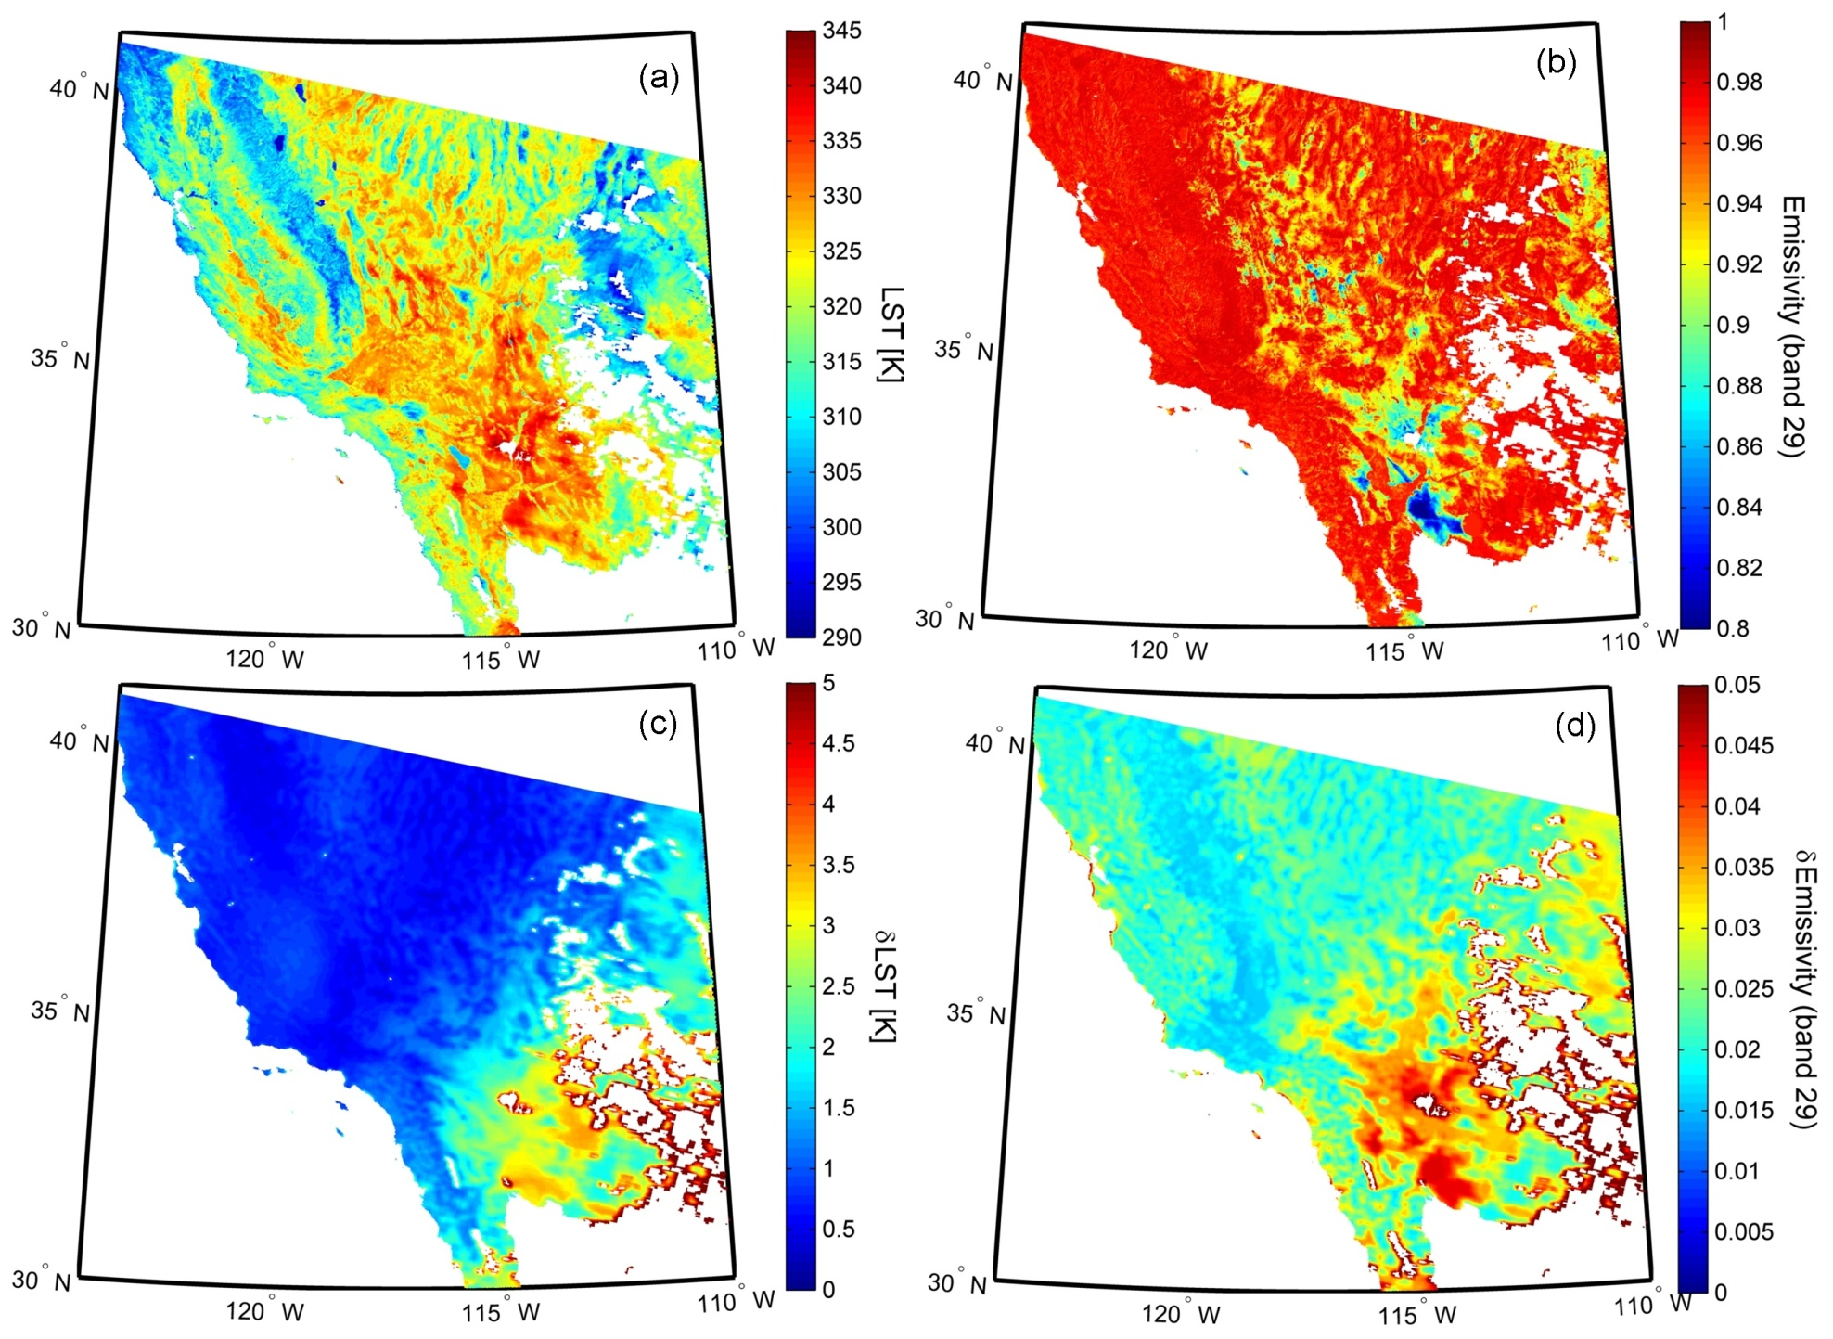
MOD21 LST&E Retrievals with Uncertainty
Emissivity
Band 29
LST
LST
Uncertainty
Emissivity
Uncertainty

Slide 32
Future Work
Continue to evaluate improvements in C6 to current MODIS algorithms
Continue with development and optimization of MOD21 prototype algorithm at MODAPS (Ginny Kalb)
Complete global 8-day test for summer and winter data
Expand validation to use global set of sites
Speed up grid-to-granulation process
Improve water vapor scaling (WVS) method interpolation over bare surfaces using Kriging approach
Incorporate option to use AIRS v6 profiles instead of MYD07 to improve accuracy of Aqua retrievals
Release MOD21 with Collection 6

Slide 33
The End
National Aeronautics and Space Administration
Jet Propulsion Laboratory
California Institute of Technology
Pasadena, California
www.nasa.gov

Slide 34
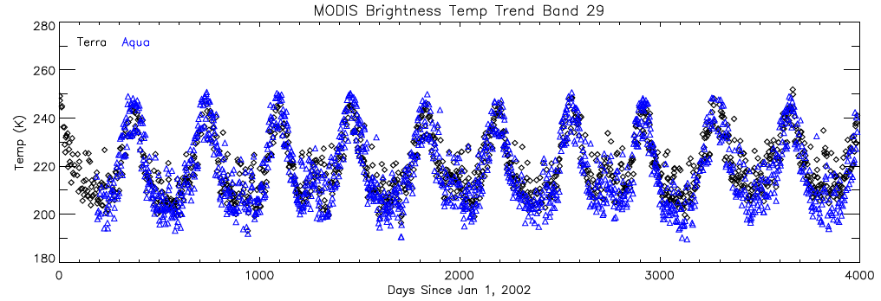
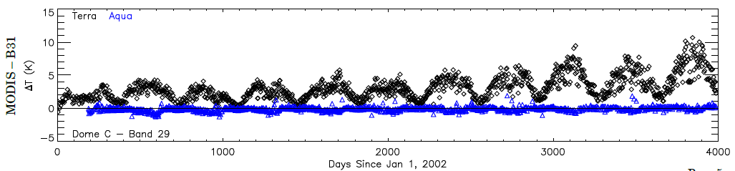
Analysis repeated by Brian Wenny and observed similar problem using Dome C. Problem is less severe in Collection 6 due to change in how a0 coefficient implemented in calibration equation

Slide 35
Trends (deseasonlized)
Trends calculated using the Breaks For Additive Season and Trend (BFAST) algorithm
Central Greenland (70N, 41W)
Increasing snow pack accumulation
Emissivity is more sensitive to snow variations than albedo
Decreasing emissivity trends indicate an increase in snowpack and is consistent with observations of increased precipitation over Greenland due to a warmer climate

Slide 36
Split Window: Classification versus physical emissivity
MOD11 band 31
MOD21 band 31
MOD11 classified as bare and assigned single emissivity but a wide range in emissivity is seen with MOD21

