Slide 1
C6 Land Water Mask
Sadashiva Devadiga, Pete Ma and Mark Carroll

Slide 2
Summary
Compared the C5 Land Water Mask to the C6 LWM. Computed the difference statistics from the 7 class LW mask.
C6 land water mask shows improvement in definition of small inland water features, lakes, shorelines and Improvement in definition of rivers.
C6 LW Mask addresses the issue of geolocation shift observed in the C5 LW Mask at high latitude (e.g. tile h17v00).
Statistically, 93% of the classes matched between the two versions of land water mask.

Slide 3
Confusion matrix comparing C5 vs C6 water mask.
 | C5 Mask | 0 | 1 | 2 | 3 | 5 | 6 | 7
C6 Mask |  | Shallow Ocean | Land | Shoreline | Shallow Inland | Deep Inland | Mod. Ocean | Deep Ocean | Total
0 | Shallow Ocean | 66,064,777 | 2,494,034 | 3,179,627 | 165,235 | 809 | 45,889,107 | 956,637 | 118,750,226
1 | Land | 541,970 | 646,883,341 | 4,862,811 | 1,204,525 | 8,095 | 16,423 | 192 | 653,517,357
2 | Shoreline | 545,582 | 12,370,392 | 2,519,087 | 895,621 | 984 | 6,010 | 379 | 16,338,055
3 | Shallow Inland | 72,016 | 5,411,904 | 2,366,318 | 5,893,698 | 623,283 | 43 | - | 14,367,262
5 | Deep Inland | 123 | 558 | 915 | 614,639 | 245,001 | - | - | 861,236
6 | Mod. Ocean | 5,270,037 | 86,763 | 211,545 | 3,962 | - | 36,370,514 | 7,586,840 | 49,529,661
7 | Deep Ocean | 1,814,187 | 5,129 | 12,196 | 57 | - | 7,549,884 | 836,966,734 | 846,348,187
 | Total | 74,308,692 | 667,252,121 | 13,152,499 | 8,777,737 | 878,172 | 89,831,981 | 845,510,782
Class 4, Ephemeral water, is not populated in either mask so has been omitted from the table.

Slide 4
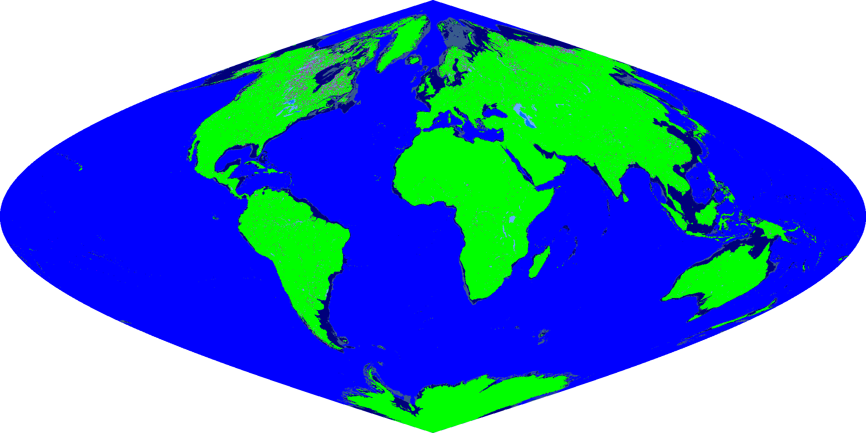
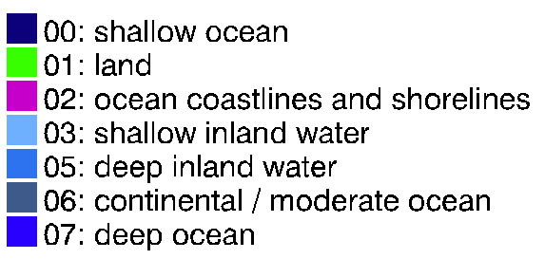
Global Image of C6 LW Mask

Slide 5
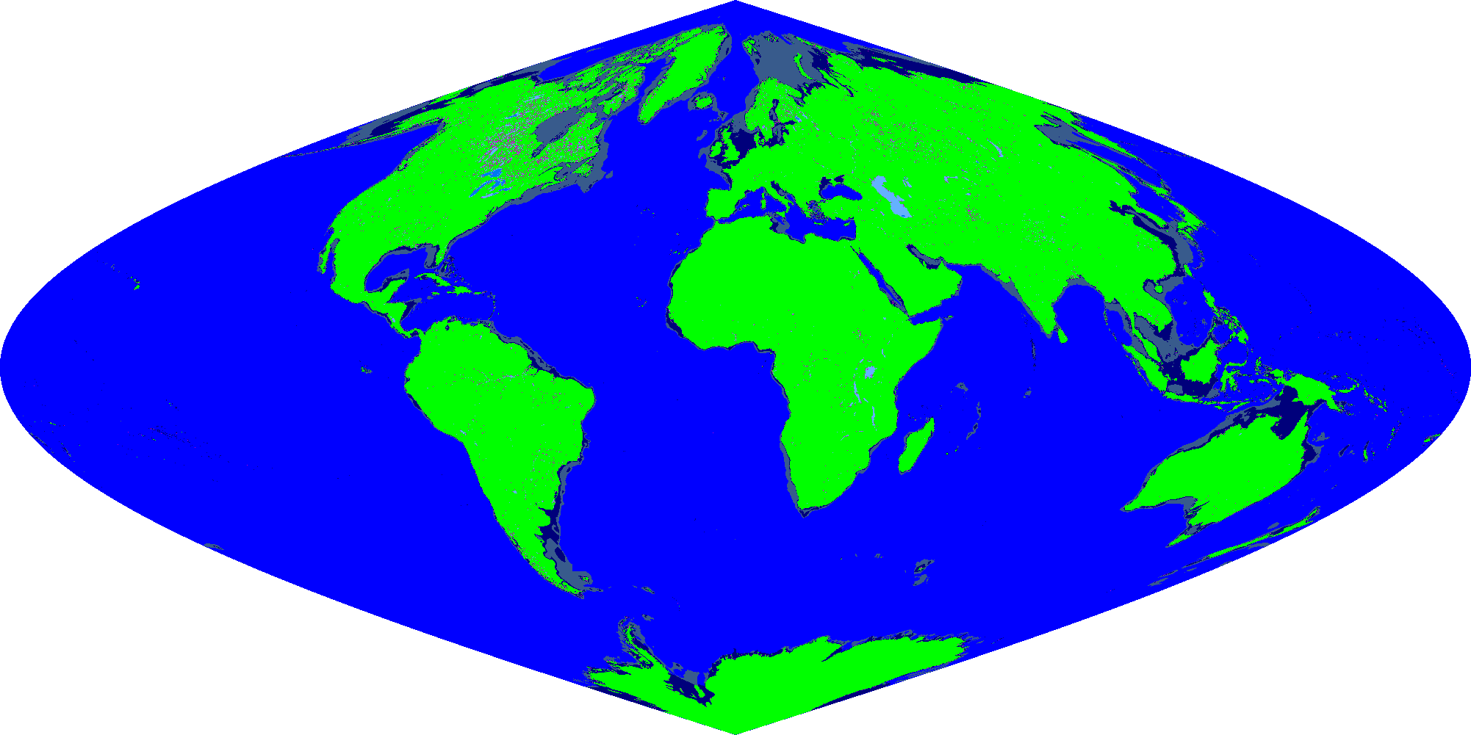
Global Image of C5 LW Mask

Slide 6
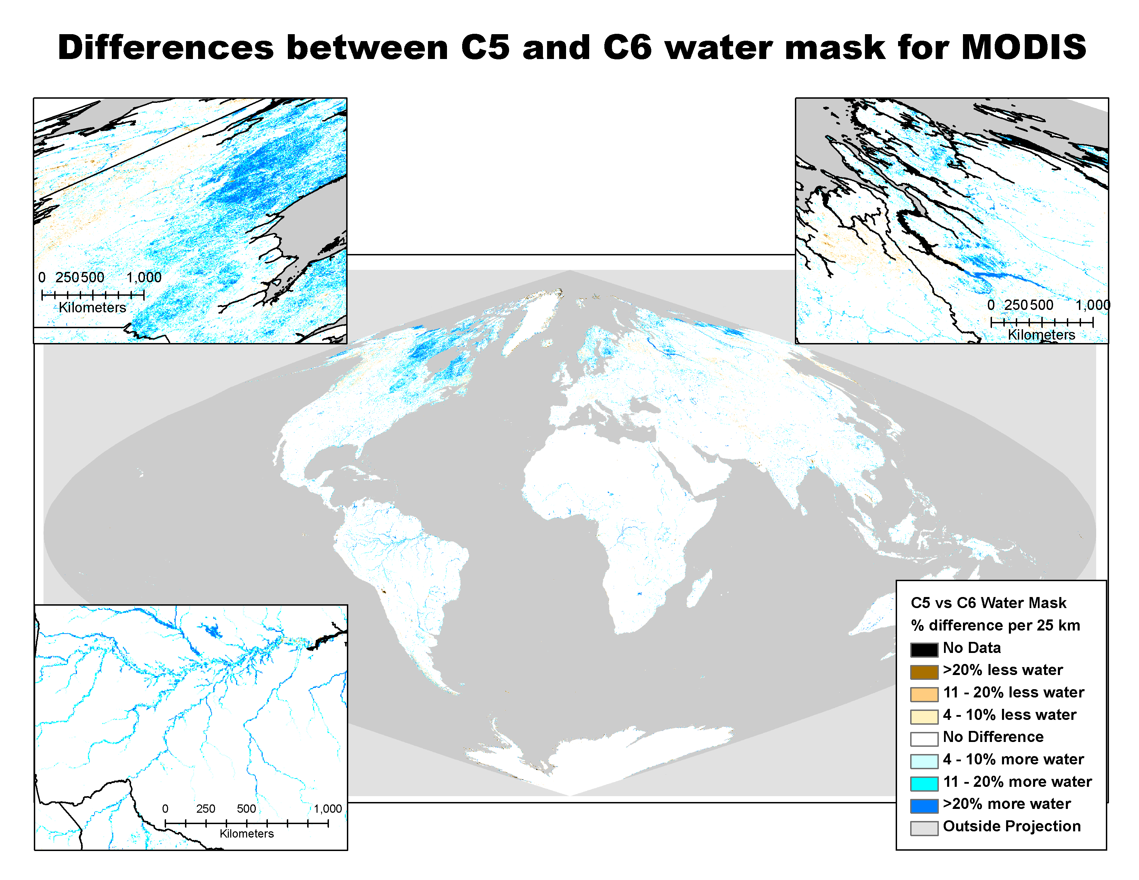
The differences between the Collection 5 vs the Collection 6 water mask for MODIS. Differences are represented as percent difference per 25km grid cell for visibility with more water shown in shades of blue and less water shown in shades of brown.
Source: White paper on C6 LW Mask posted at http://landweb.nascom.nasa.gov/cgi-bin/QA_WWW/

Slide 7
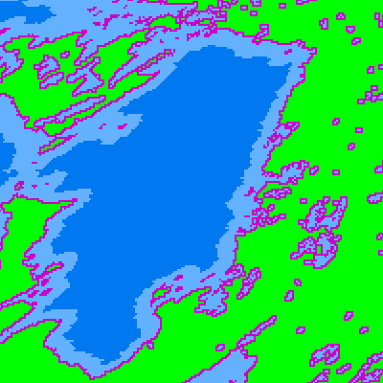
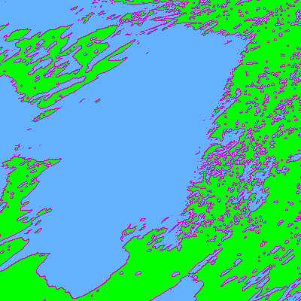
MOD12Q1.A2001001.h12v04.004.2004358134126.hdf
MOD44WA1.A2000055.h12v04.005.2010251165201.hdf
The spatial subset of the tiles above show large and small lakes over Canada.
There is a significant improvement in defined shorelines, and small inland water bodies.

Slide 8
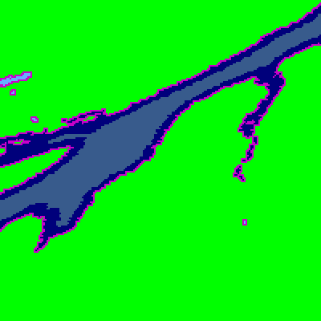
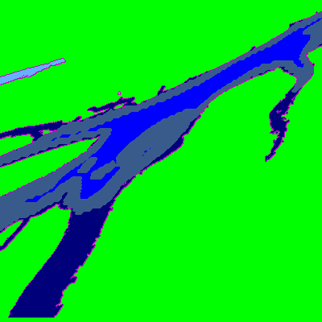
MOD12Q1.A2001001.h17v00.004.2004358134250.hdf
MOD44WA1.A2000055.h17v00.005.2010251165201.hdf
The spatial subset of the tiles above show tile h17v00.
There is a significant improvement in geolocation. Which resolves the previous issue noted.

Slide 9
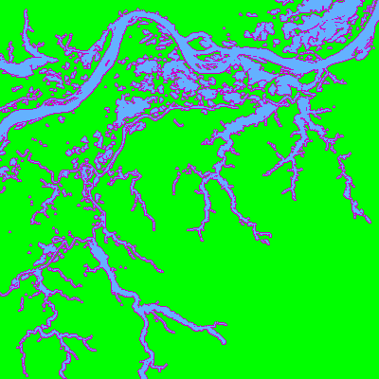
MOD12Q1.A2001001.h12v09.004.2004358134134.hdf
MOD44WA1.A2000055.h12v09.005.2010251165201.hdf
The spatial subset of the tiles above show the Amazon river in Northern Brazil.
There is a significant improvement in defined rivers and streams.

Slide 10
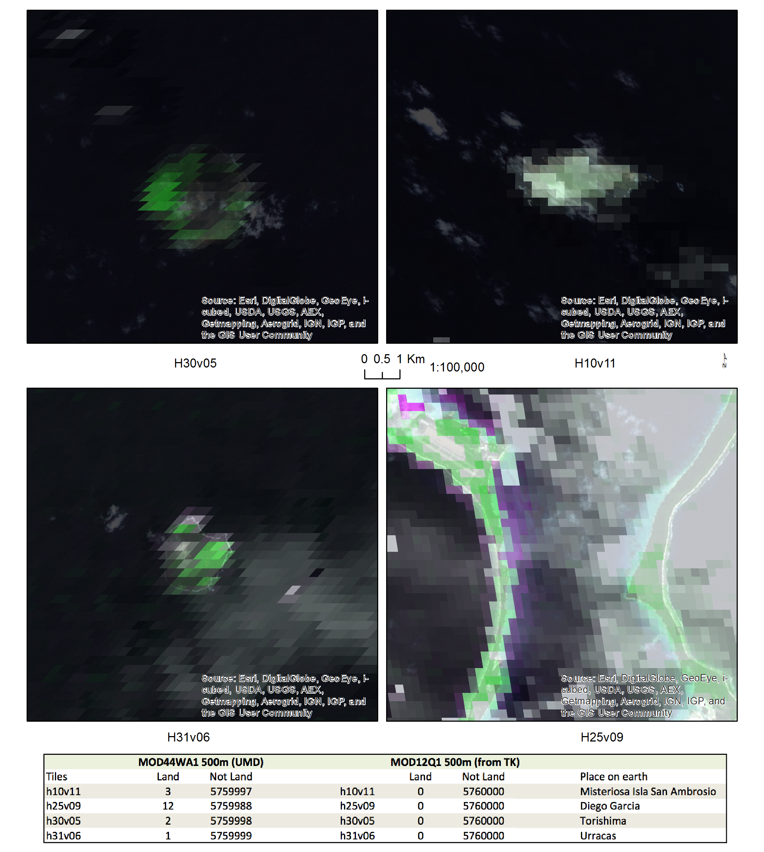
A tile level comparison of LW Mask showed four tiles of C6 LW Mask, where new land values were detected. For these same tiles, no land pixels were found in the C5 LWM.
These four tiles contain little islands. The images on the left show overlay of RGB composite reflectance image from MOD09Q1 on the high resolution google images of island.

