Slide 1
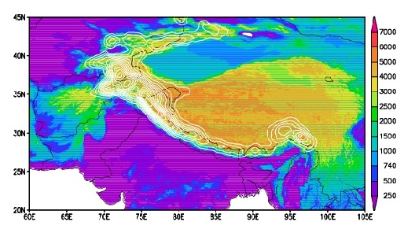
Impacts of absorbing aerosols on snowpack in the Himalayas/ Tibetan Plateau and regional hydroclimate
William K-M. Lau,
Co-authors: K-M. Kim, M-K. Kim, R.Gautam, T.J.Yasunari, C.Hsu,
P. Colarco, A. da Silva
MODIS Science Tem Meeting, Silver Spring MD April 15-17, 2013

Slide 2
Possible causes for accelerated melting of glacier and snowpack in the Himalayas/Tibetan Plateau region
Greenhouse gases warming
Snow-darkening
- Satellite signal detection
- Impacts on hydrology
Atmospheric heating and feedback
– hypothesis testing/validation
Lau et al 2010, ERL; Yasunari et al. 2011, ACP, Ritesh et al. 2013, Atm. Environ
Kim et al 2013 (in preparation), Yasunari et al 213 ( in preparation)

Slide 3
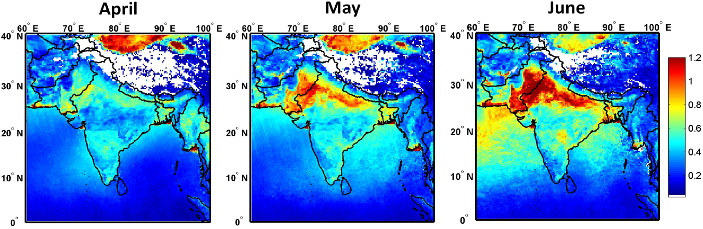
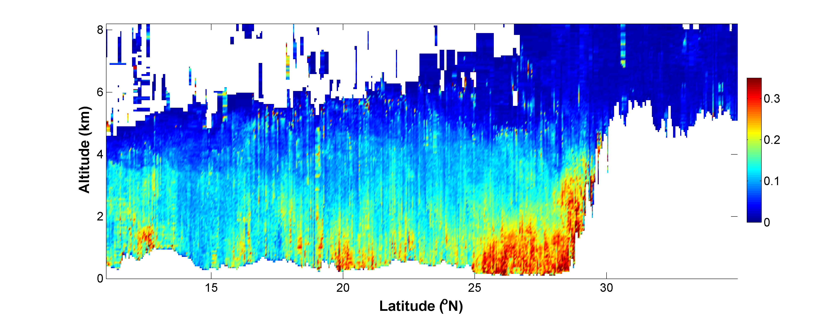
Aerosol Optical Depth from Aqua MODIS (2003-09)
Gautam, Hsu, Lau (2010)
CALIOP Extinction Coefficient indicate aerosols piling up against the southern slopes of the Himalayas.
CALIOP data March 15-June 15 2007-10
Himalayas
Tibetan Plateau
EHP hypothesis
Lau et al 2006,
2008, Lau and Kim
2010
km⁻¹
Notes:
This slide shows A progressive buildup and increase in aerosol loading is clearly visible over northern India, associated with enhanced westerly-wind-blown dust transport from the Thar Desert into the IGP and Himalayan foothill region during the pre-monsoon season.
And the dust loading is also observed to pile up against the southern slopes of the Himalayas, reaching elevated altitudes near the Himalayan snow cover, as indicated by CALIPSO lidar measurements.

Slide 4
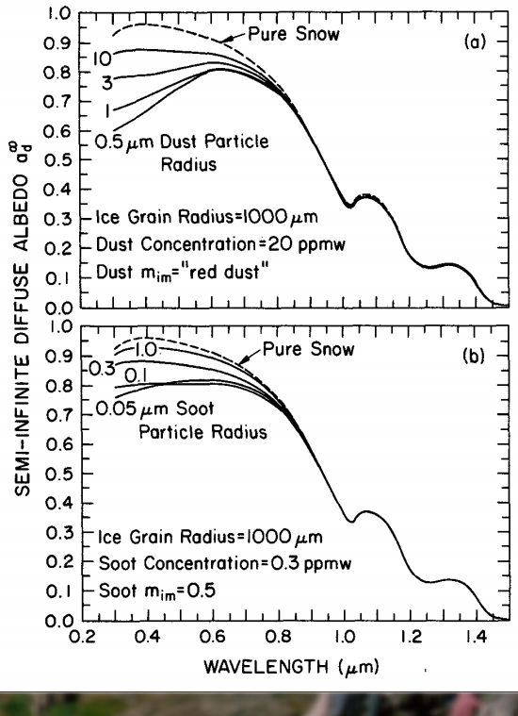
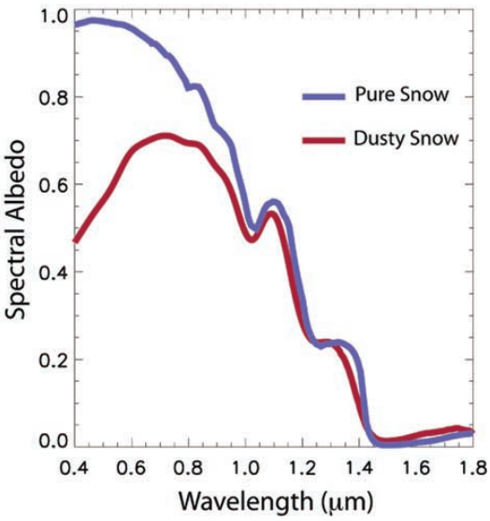
Satellite Detection of Snow Darkening effect
Warren and Wiscombe, 1980
Dust and black carbon effectively reduce snow albedo in the visible wavelengths
Painter et al., 2009
Field Spectral Measurements

Slide 5
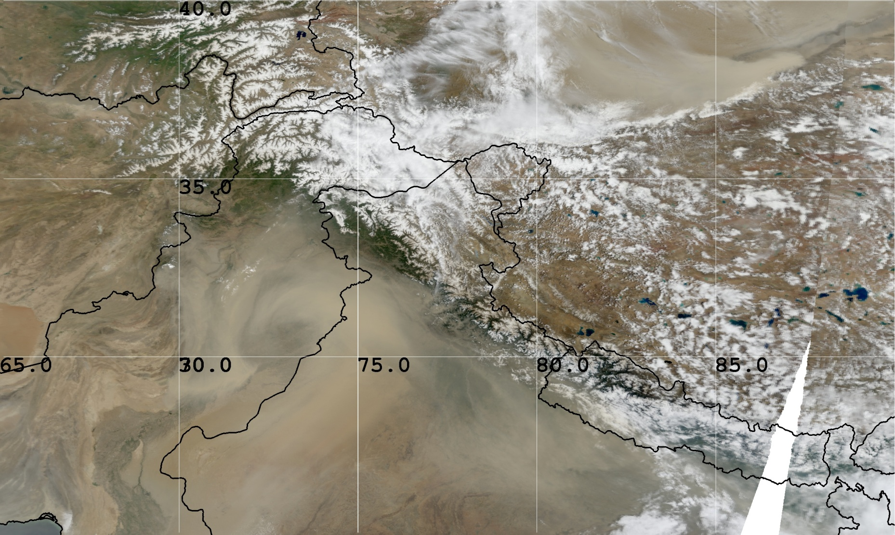
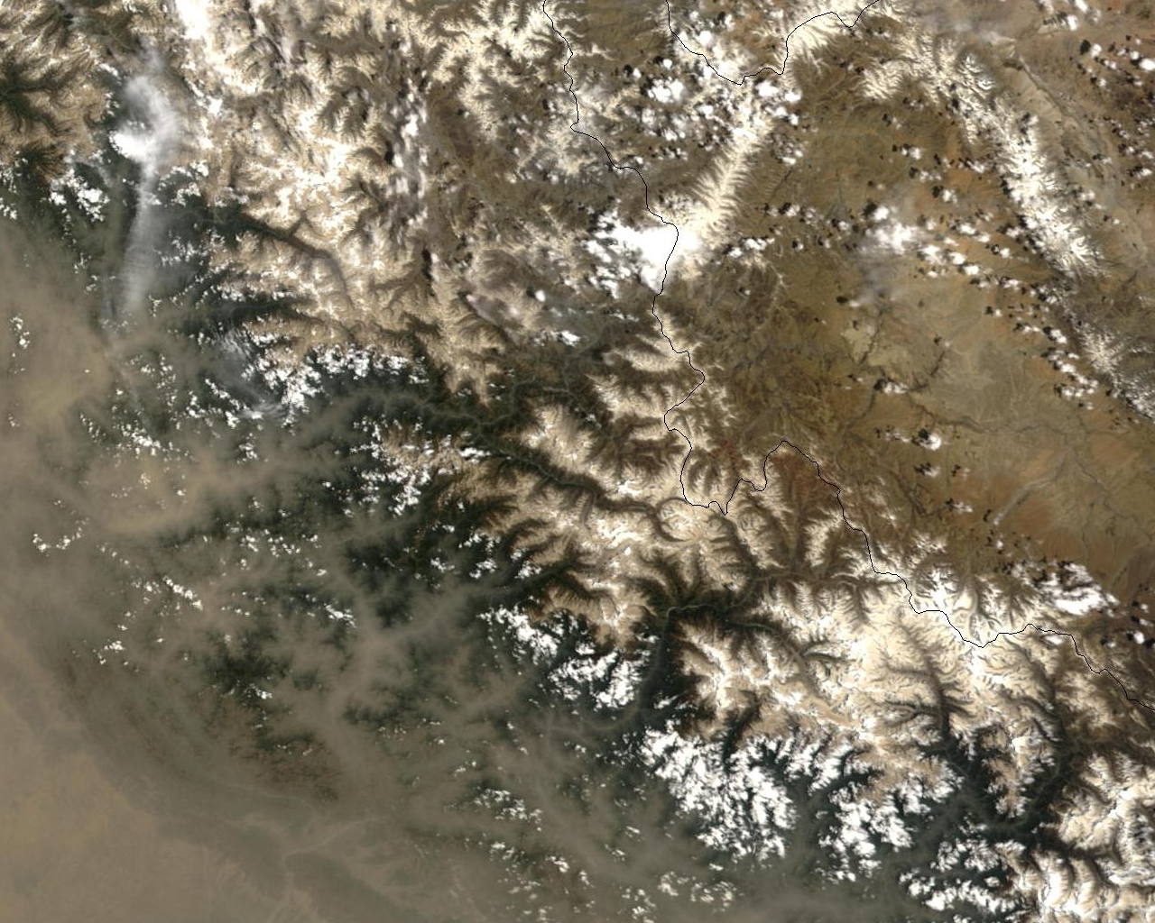
Dust Storm over southern Asia, 9 June 2003, Terra/MODIS
Hindu-Kush Karakoram
Zoom-in over western Himalaya
Western Himalaya

Slide 6
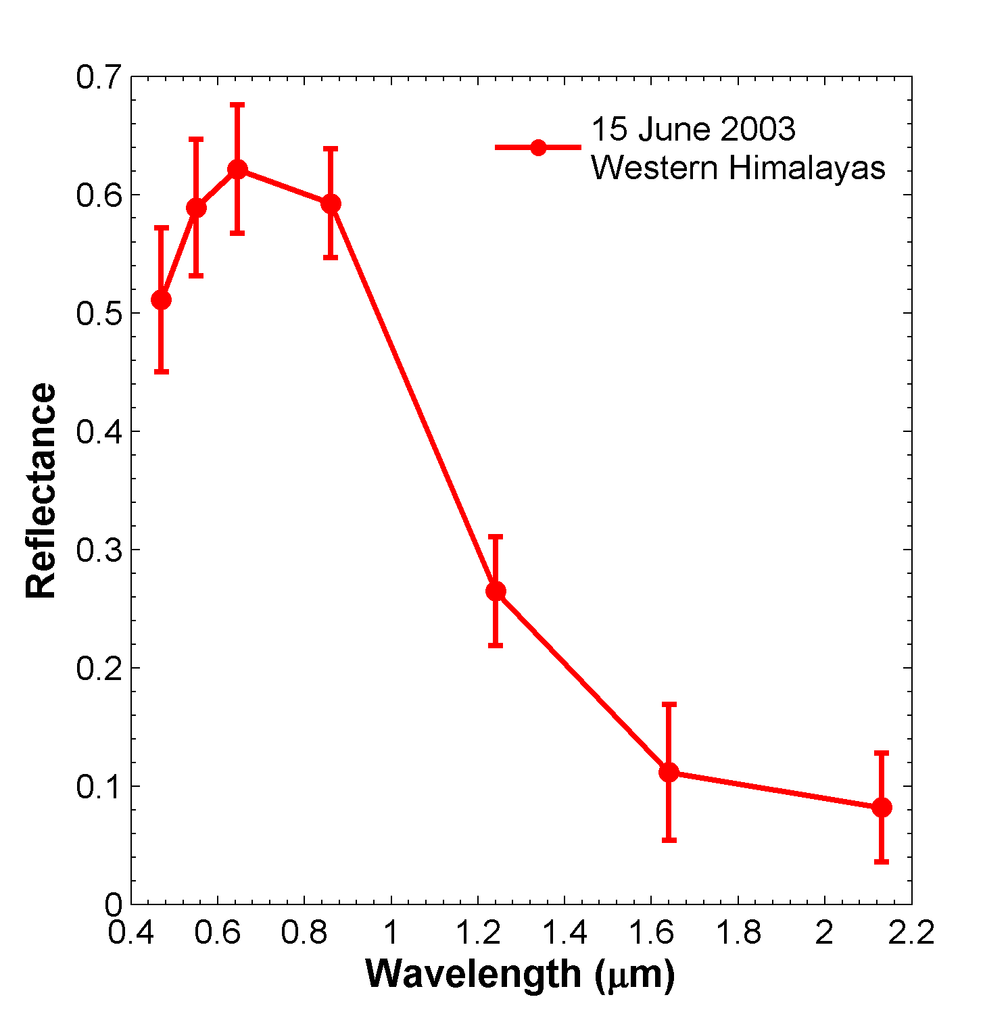
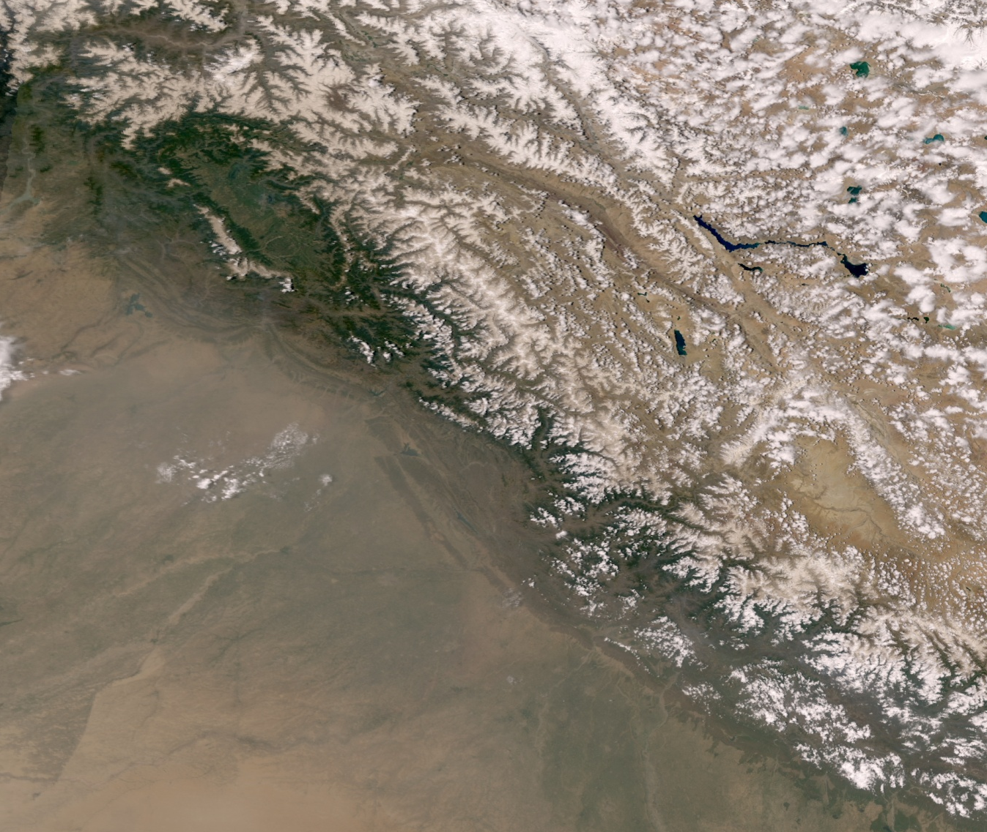
Enhanced absorption in visible wavelengths
VIS-NIR gradient
15 June (few days after dust event)
MODIS spectral surface reflectance (MOD09) over snow-covered region in the western Himalayas, collocated with MODIS Snow Cover Fraction swath data.

Slide 7
Seasonal variation of spectral Reflectance over western Himalaya
R_{0.47μm} - R_{0.86μm}
(a) Seasonal variations of surface reflectance (February-June, MOD09), shown as 15 day averages, (b) Absolute difference of surface reflectance between 0.47 and 0.86 µm, averaged for 6–15 June 2003. Positive difference is generally found over the Karakoram, while dust-laden western Himalaya and southern Hindu-Kush region are characterized by negative differences.

Slide 8
Impacts of the snow darkening effect on regional hydrology
Snow-darkening physics package implemented in the NASA GEOS-5 earth system model
7- years of model integration from reply run GEOS-5 replay run experiment
Control: with snow darkening (SND) physics module (dust and BC)
Anomaly experiment: without SND

Slide 9
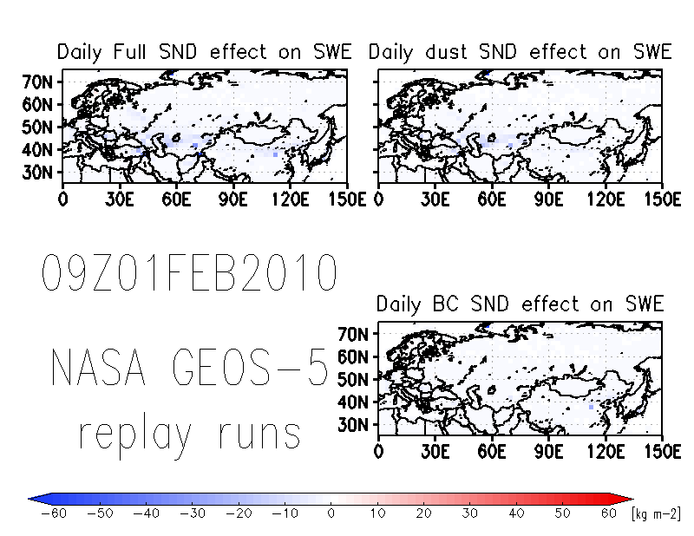
Notes:
Daily migration of snow darkening (SD) effect in 2010 on snow water equivalent (SWE) for full SD effect (dust, BC, and OC; left top), and dust SD effect (dust only; right top), and BC SD effect (BC only; right bottom).

Slide 10
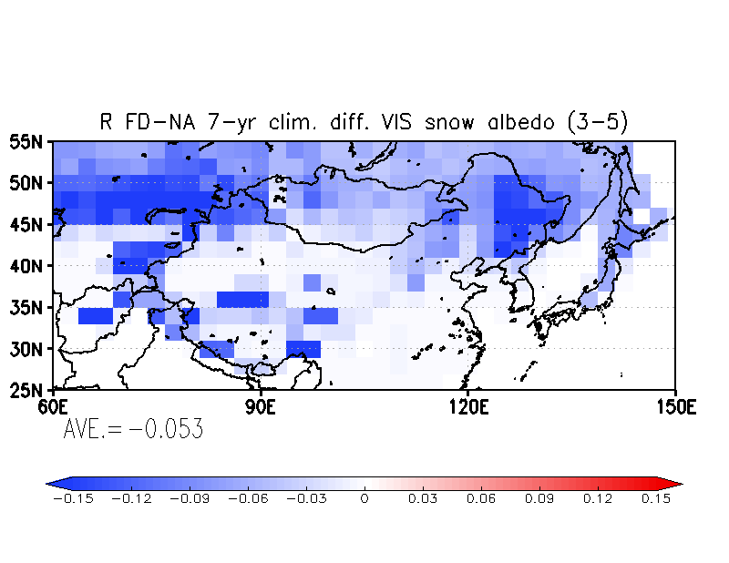
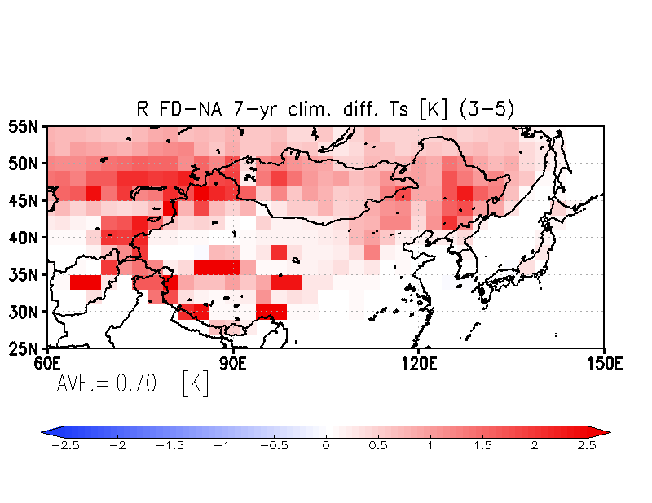
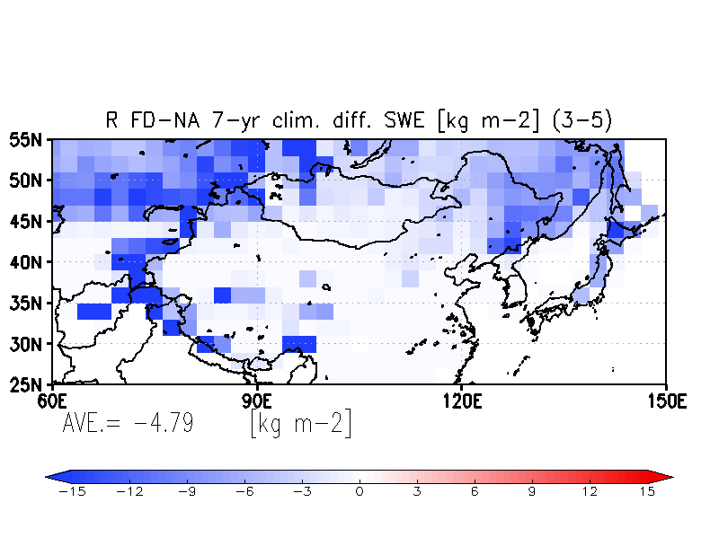
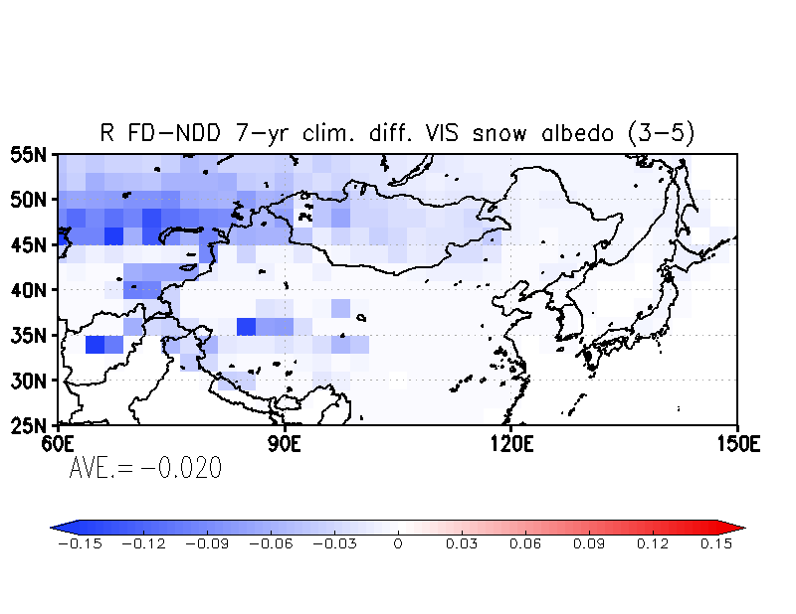
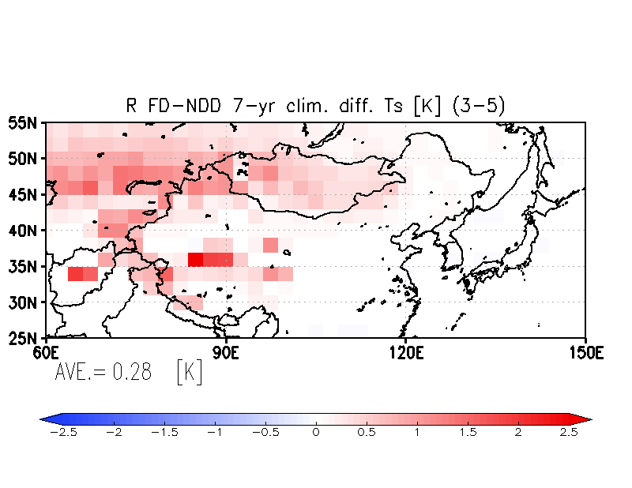
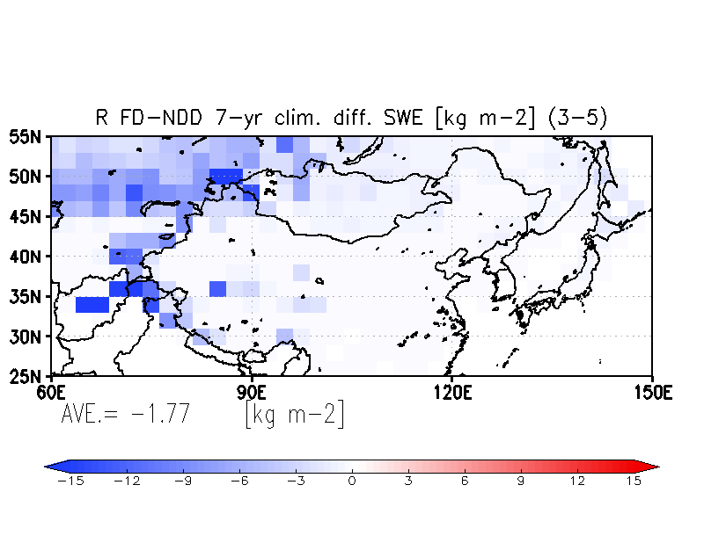
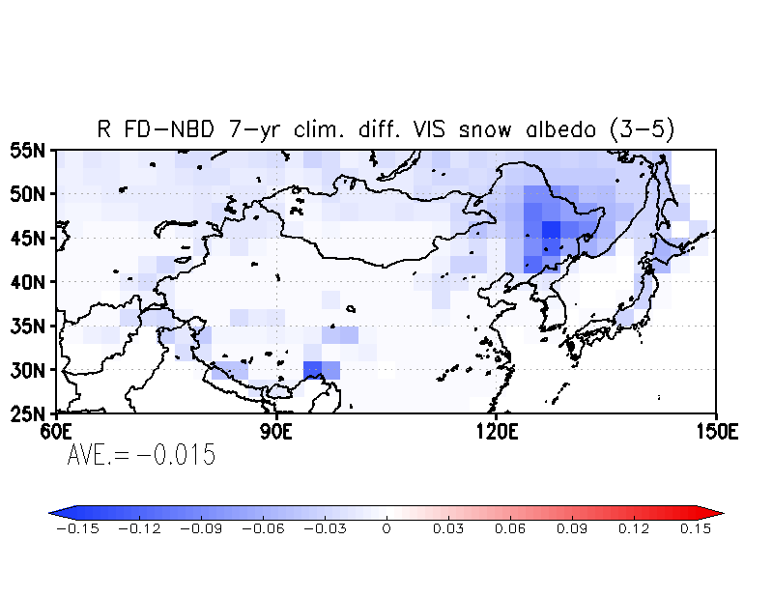
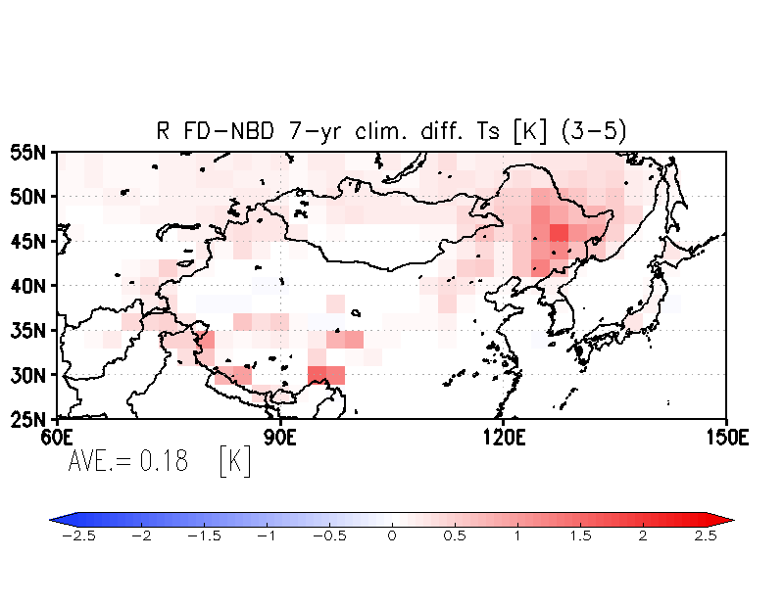
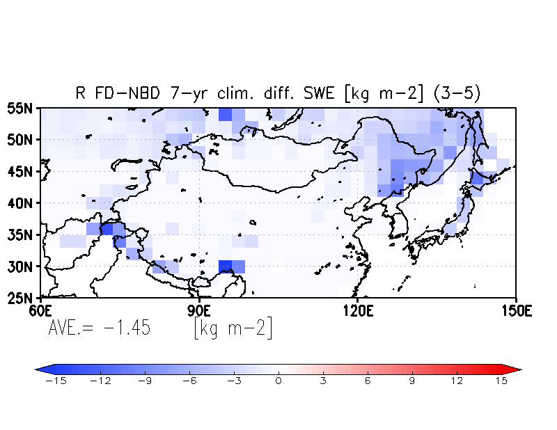
7-year replay run climatology in MAM on snow darkening (SD) effect over HTP
Full SD (dust, BC, and OC) – Non SD
VIS snow albedo
surf. skin Temp.
SWE
Full SD (dust, BC, and OC) – Non dust SD (Dust only influence)
VIS snow albedo
surf. skin Temp.
SWE
Full SD (dust, BC, and OC) – Non BC SD (BC only influence)
VIS snow albedo
surf. skin Temp.
SWE
Notes:
The climatology of 7-year snow darkening effect for visible (VIS) snow albedo, surface skin temperature, and snow water equivalent (SWE) . The 1st, 2nd , and 3rd rows show the full snow darkening effect (SDE) by dust, BC, and OC (full darkening minus non darkening), dust SDE (full darkening minus non dust darkening), and BC SDE, respectively. Around Gobi and Taklamakan desert regions and the Himalayas and Tibetan regions, dust SDE is dominant. The western Himalayas is more dominant by the dust SDE and it is consistent with Gautam et al. (2013). The BC SDE is clearly seen over the Himalayas and northeastern China. The clear separation of the dust and BC SDE was seen in 7-year climatology in East Asia. The full SDE enhanced by dust, BC, and OC together and clear influences are seen over the Himalayas and northern part of East Asia.

Slide 11
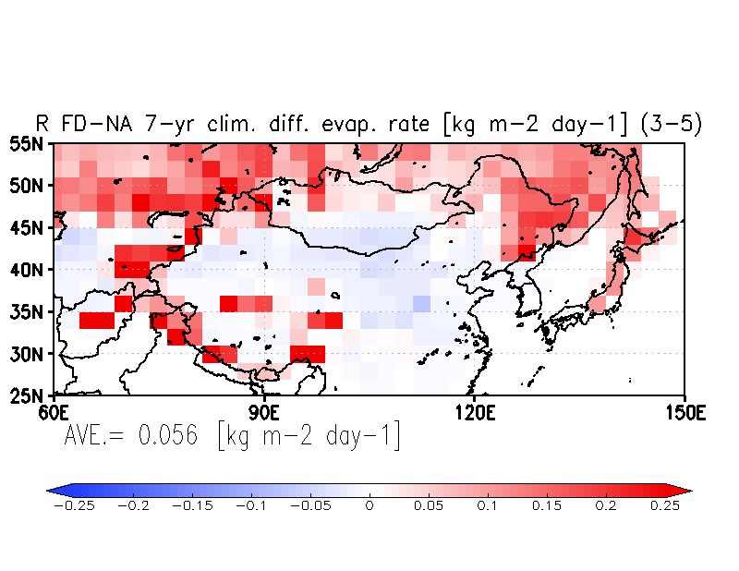
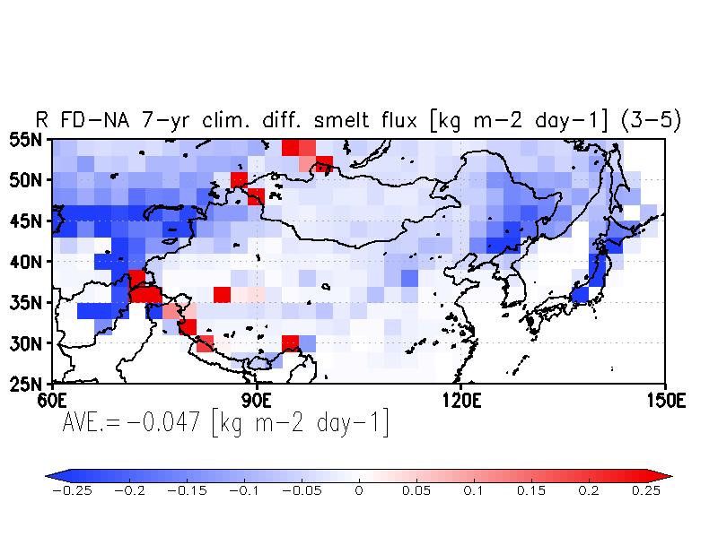
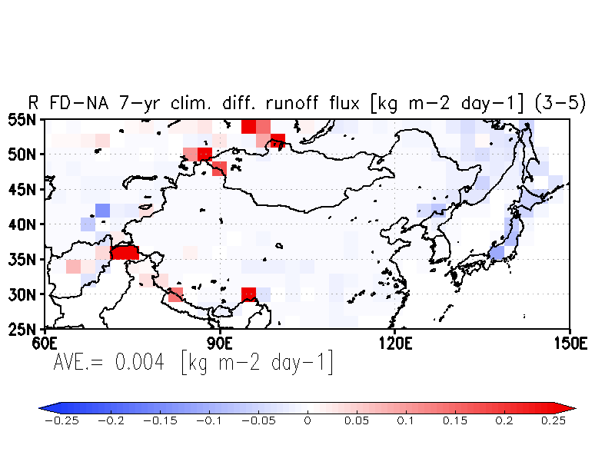
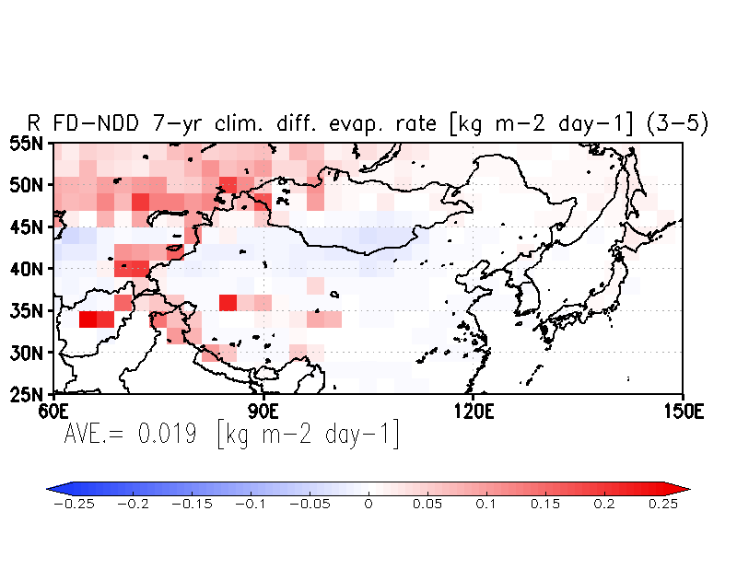
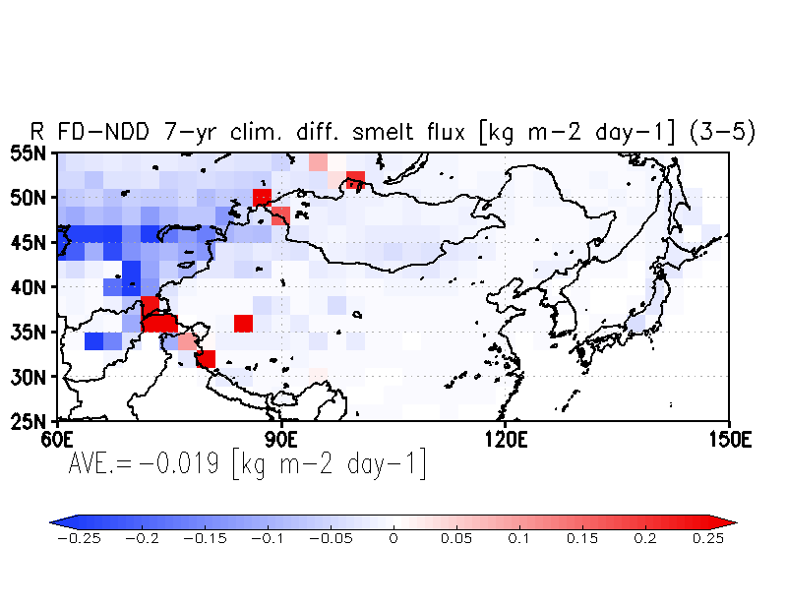
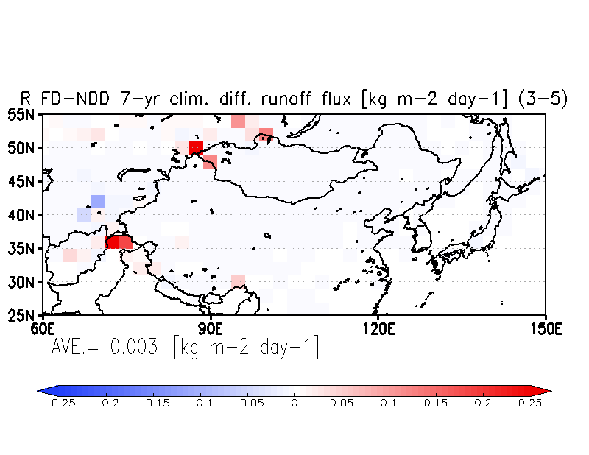
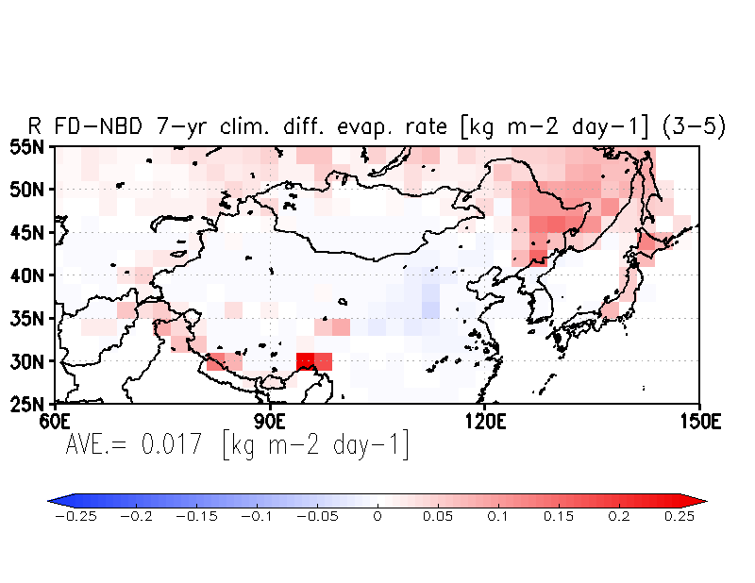
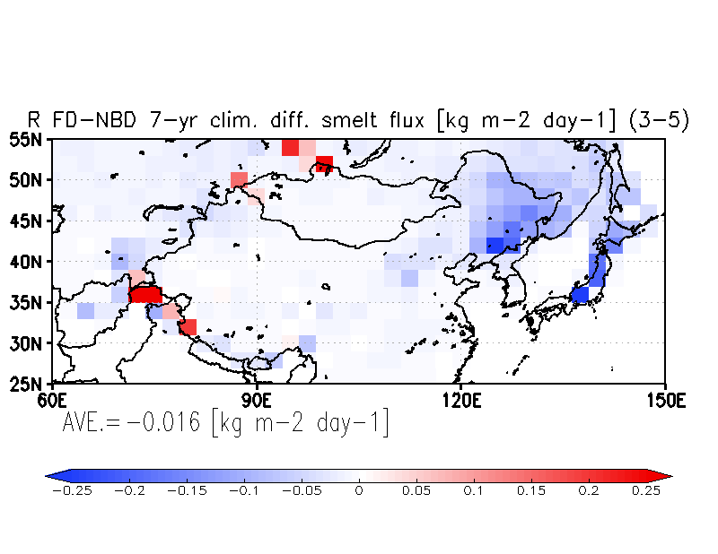
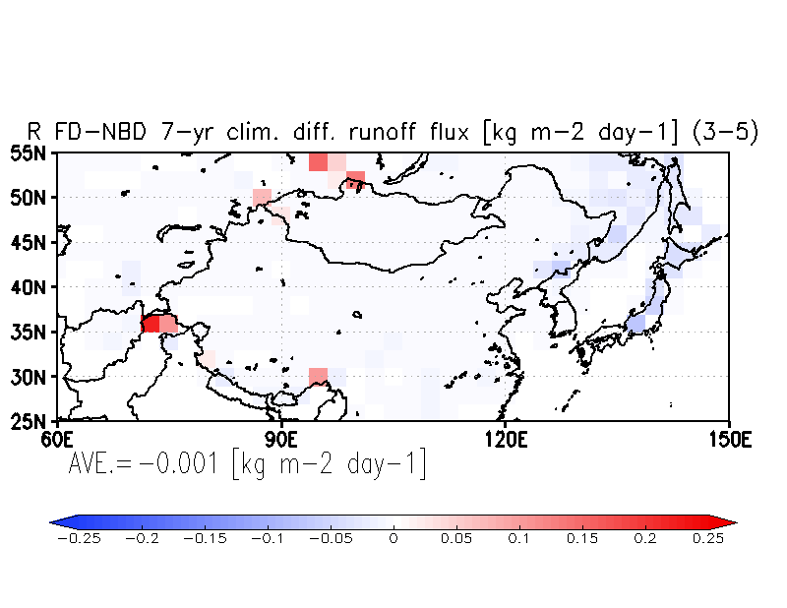
7-year replay run climatology in MAM on snow darkening (SD) effect over HTP
Full SD (dust, BC, and OC) – Non SD
Evaporation rate
Snow melt flux
Runoff flux
Full SD (dust, BC, and OC) – Non dust SD (Dust only influence)
Evaporation rate
Snow melt flux
Runoff flux
Full SD (dust, BC, and OC) – Non BC SD (BC only influence)
Evaporation rate
Snow melt flux
Runoff flux
Notes:
The climatology of 7-year snow darkening effect for evaporation rate, snow flux, and runoff flux. The 1st, 2nd , and 3rd rows show the full snow darkening (SD) effect by dust, BC, and OC (full darkening minus non darkening), dust SD effect (full darkening minus non dust darkening), and BC SD effect, respectively. Over the western Himalayas, snow melting increased, evaporation increased, and runoff increased only at limited places by the SD effect. This indicates that most of the melt water can be used for more evaporation rather than runoff in the replay run experiments. The areas of the reduction of snow melt flux in blue mean that probably less available melting snow in the SD case than that in non SD case.

Slide 12
Summary of SND effect on runoff
(no atmospheric feedback)
Snow melt flux (SMF) = ∂ SWE/ ∂ t
SMF = P - E- R
ΔP = 0 , for no atmospheric feedback
ΔSMF < 0 due to SND effect
ΔE > 0 , more SW absorption → warmer surface increases evaporation
Δ R = - (ΔE +ΔSMF)
< 0 drying up of season snow cover over Eurasia land
> 0 melting of permanent snowpack on slopes of Tibetan Plateau

Slide 13
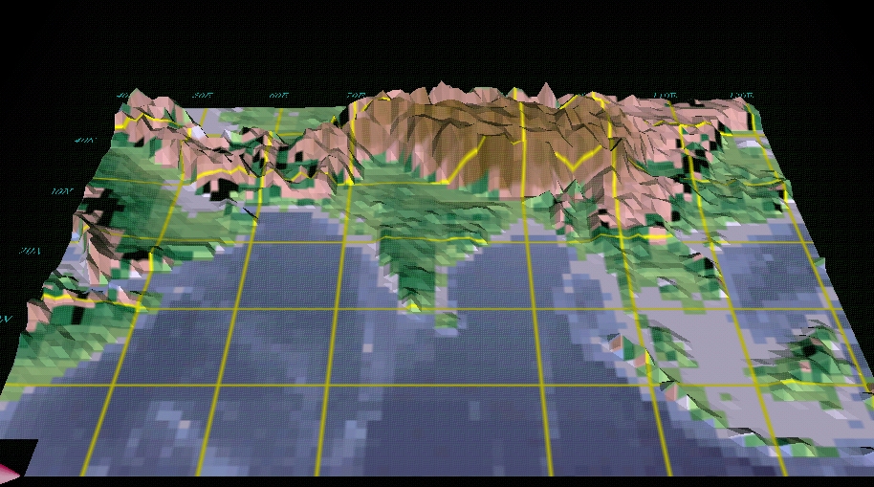

The Elevated Heat Pump Hypothesis
(Lau et al. 2006, Lau and Kim 2006, Lau et al. 2008)
“Clean”
Monsoon
Somali Jet
May -June
Polluted (dust and BC) monsoon
Somali Jet
May-June

Slide 14
Datasets
Variables | Period | Source
Aerosol Index | 1979-2000 | TOMS (Nimbus-7, Earth probe)
Aerosol optical depth | 2001-2011 | MODIS(Aqua, Terra)
Snow water equivalent (SWE) | 1979-2011 | SSMR&SSM/I, AMSR-E
TS PRCP SLP, U, V, T, Q, ω |  | CRU GPCP MERRA
Notes:
In this study, We used different aerosol variables, AI and AOD for different period of 1979 to 2000 and 2001 to 2011. CRU surface temperature, GPCP precipitation, and MERRA pressure level data are used in this study.

Slide 15
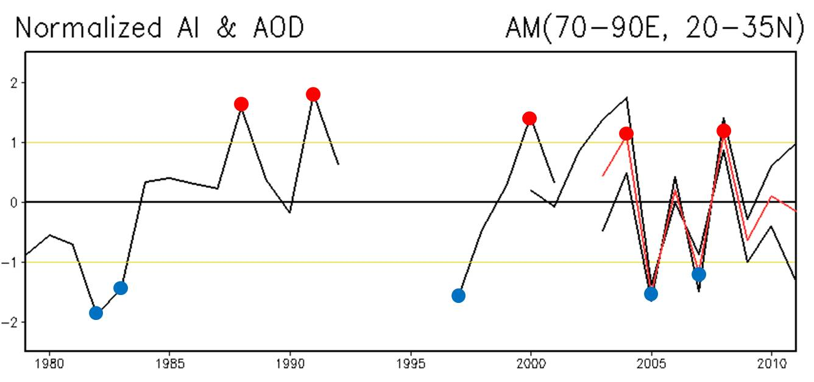
Normalized Aerosol Index (NAI)
•
High aerosol years
Aqua AOD
TOMS AI (Nimbus 7)
+1 σ
-1 σ
Standard deviation
EP TOMS AI
•
Terra AOD
Low aerosol years
Mean AOD
Notes:
This figure is normalized time series of AI and AOD. Every original time series from different sources is separately normalized for case selection. As we know, standard deviation of normalized time series is one. So, we can judge which year is higher and which year is lower with criteria over and below one standard deviation of NAI, respectively. (We did not consider linear trend because of short period)

Slide 16
Composite Analysis (Tsfc)
High aerosol year (AM)
High minus Low (April to May)
High aerosol year (MJ)
High minus Low (May to June)

Slide 17
Composite Analysis (SWE)
High aerosol year (AM)
High minus Low (AM)
High aerosol year (MJ)
High minus Low (MJ)

Slide 18
Atmospheric Heating and Moisture Increase
High minus Low (AM)
High minus Low (AM)
High minus Low (MJ)
High minus Low (MJ)
Notes:
This figure shows that elevated dust and black carbon absorbs solar radiation and heats atmosphere around the slopes of the tp, further enhancing the motion up and along the tp slopes. So, increased low level southwesterly brings in additional moisture from the Arabian sea and the Indian ocean to northern India and the Himalayan foothills.
The enhanced moisture increases convective instability, and spurs deep convection.

Slide 19
Anomalous Low and enhanced Precipitation
Notes:
The enhanced moisture increases convective instability, and spurs deep convection over the northeastern India in April to May and to central northern India in May to June.

Slide 20
Conclusions
Significant snow surface albedo reduction (~ 10-15%) due to darkening by desert dust over Himalayas can be detected from MODIS products.
Over Eurasia, under conditions of no atmospheric feedback, darkening by deposition of dust and BC over snow cover regions can lead to a surface temperature warming (up to 2º C) during the melting season;
SND reduces run-off over seasonal snow region but increased run off over permanent snowpack regions around slopes of the TP
Increased aerosols over IGP in April-May is associated with early melting and reduced snow cover over the Himalaya foothills and TP; increased rainfall over N. India foothills, B. of Bengal, and western Ghats; enhanced the Indian monsoon in May-June, due to both atmosphere heating and SND by absorbing aerosols, consistent with the EHP hypothesis (Lau et al 2006, 2010).
Results implies an under-estimate of land surface warming in extratropics if SND effect is not included (most IPCC models in AR5 do not include snow darkening effect). Ongoing MAP modeling investigation (PI: W. Lau) to explore enhanced heat wave/drought over Eurasia by SND effect.

Slide 21
Back-UP

Slide 22
Model sensitivity study of Snow Reflectance
Snow surface reflectance (with dust impurity)
TOA reflectance (with dust above snow)
Model sensitivity calculations of reflectance of (a) pure snow mixed with varying levels of dust impurity at solar zenith, viewing zenith, and relative azimuth angles of 30°, 20°, and 140°, respectively, and (b) reduction of TOA reflectance due to dust above clean snow, with VIS-NIR gradient shown as ratio of reflectance between 0.47 and 0.86 µm (secondary y axis).

Slide 23
Conclusions
From an observational viewpoint, this study underscores the possible effects
of mineral dust deposition towards snow darkening in the western
Himalayas, with potential implications to accelerated seasonal snowmelt
and regional snow-albedo feedbacks. Characteristic VIS-NIR gradient is
consistent with theoretical simulations of dust impurity-based reduction of
snow reflectance. While the role of black carbon in snow cannot be ruled out, our
satellite-based analysis suggests the observed spectral reflectance gradient
dominated by dust-induced solar absorption during pre-monsoon season.
Satellite data are useful in inferring dust deposition in snow; but
uncertainties remain and need to be further minimized (e.g. sub-pixel
contamination, atmospheric aerosol correction).
Ground-based measurements of aerosol properties, particularly dust and
BC, as well as coincident snow albedo (and impurity) characterization in
the Himalayas are required to quantify the aerosol-snow radiative
coupling in order to further understand effects of snow darkening.

Slide 24
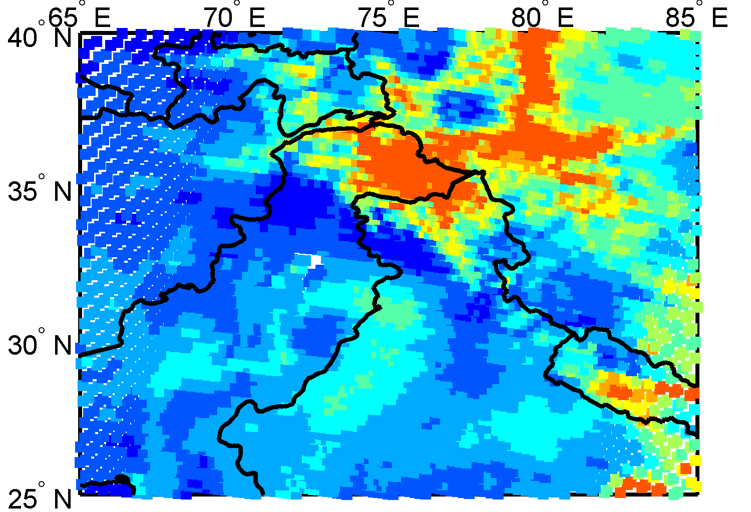
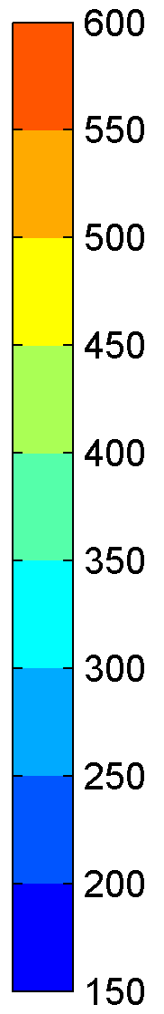
MODIS/Aerosol Optical Depth
CERES Top-of-Atmosphere Shortwave Flux
Wm⁻²
9 June 2003
Darkening observed over dust-laden western Himalaya with reduced TOA reflected shortwave flux (250-400Wm⁻²), compared to northern Hindu-Kush-Karakoram (400-500Wm⁻²), outside of dust front.

Slide 25
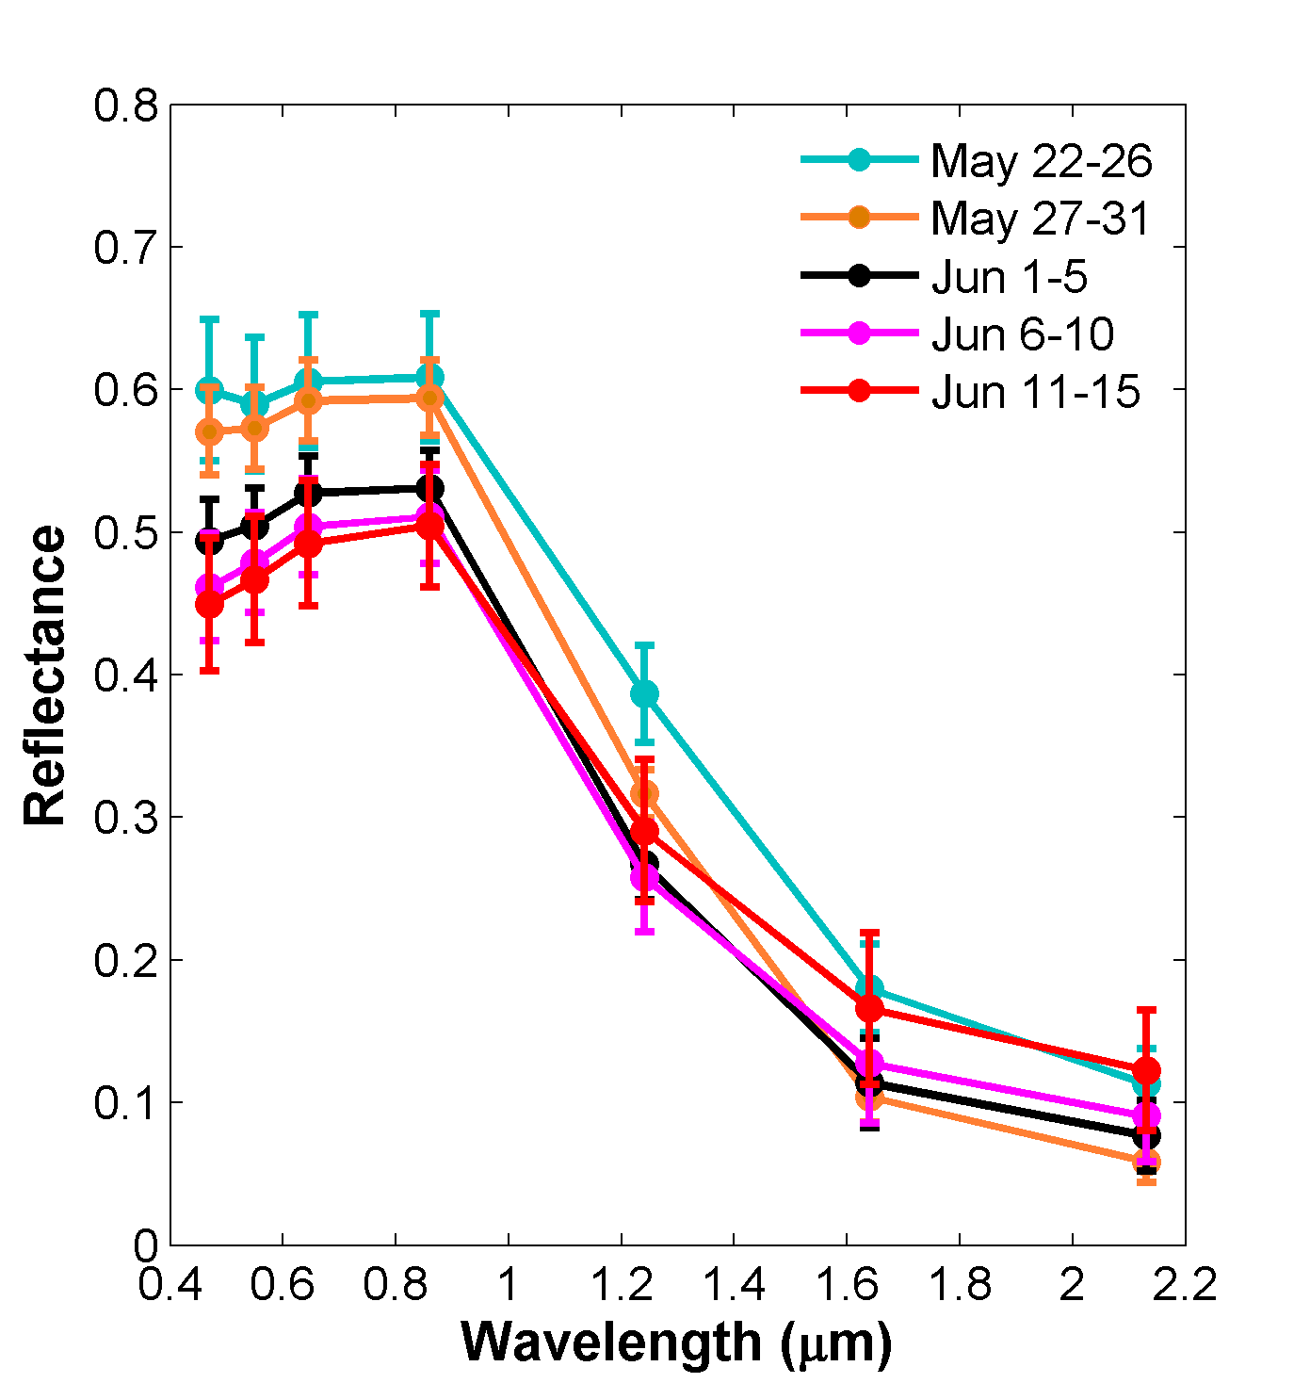
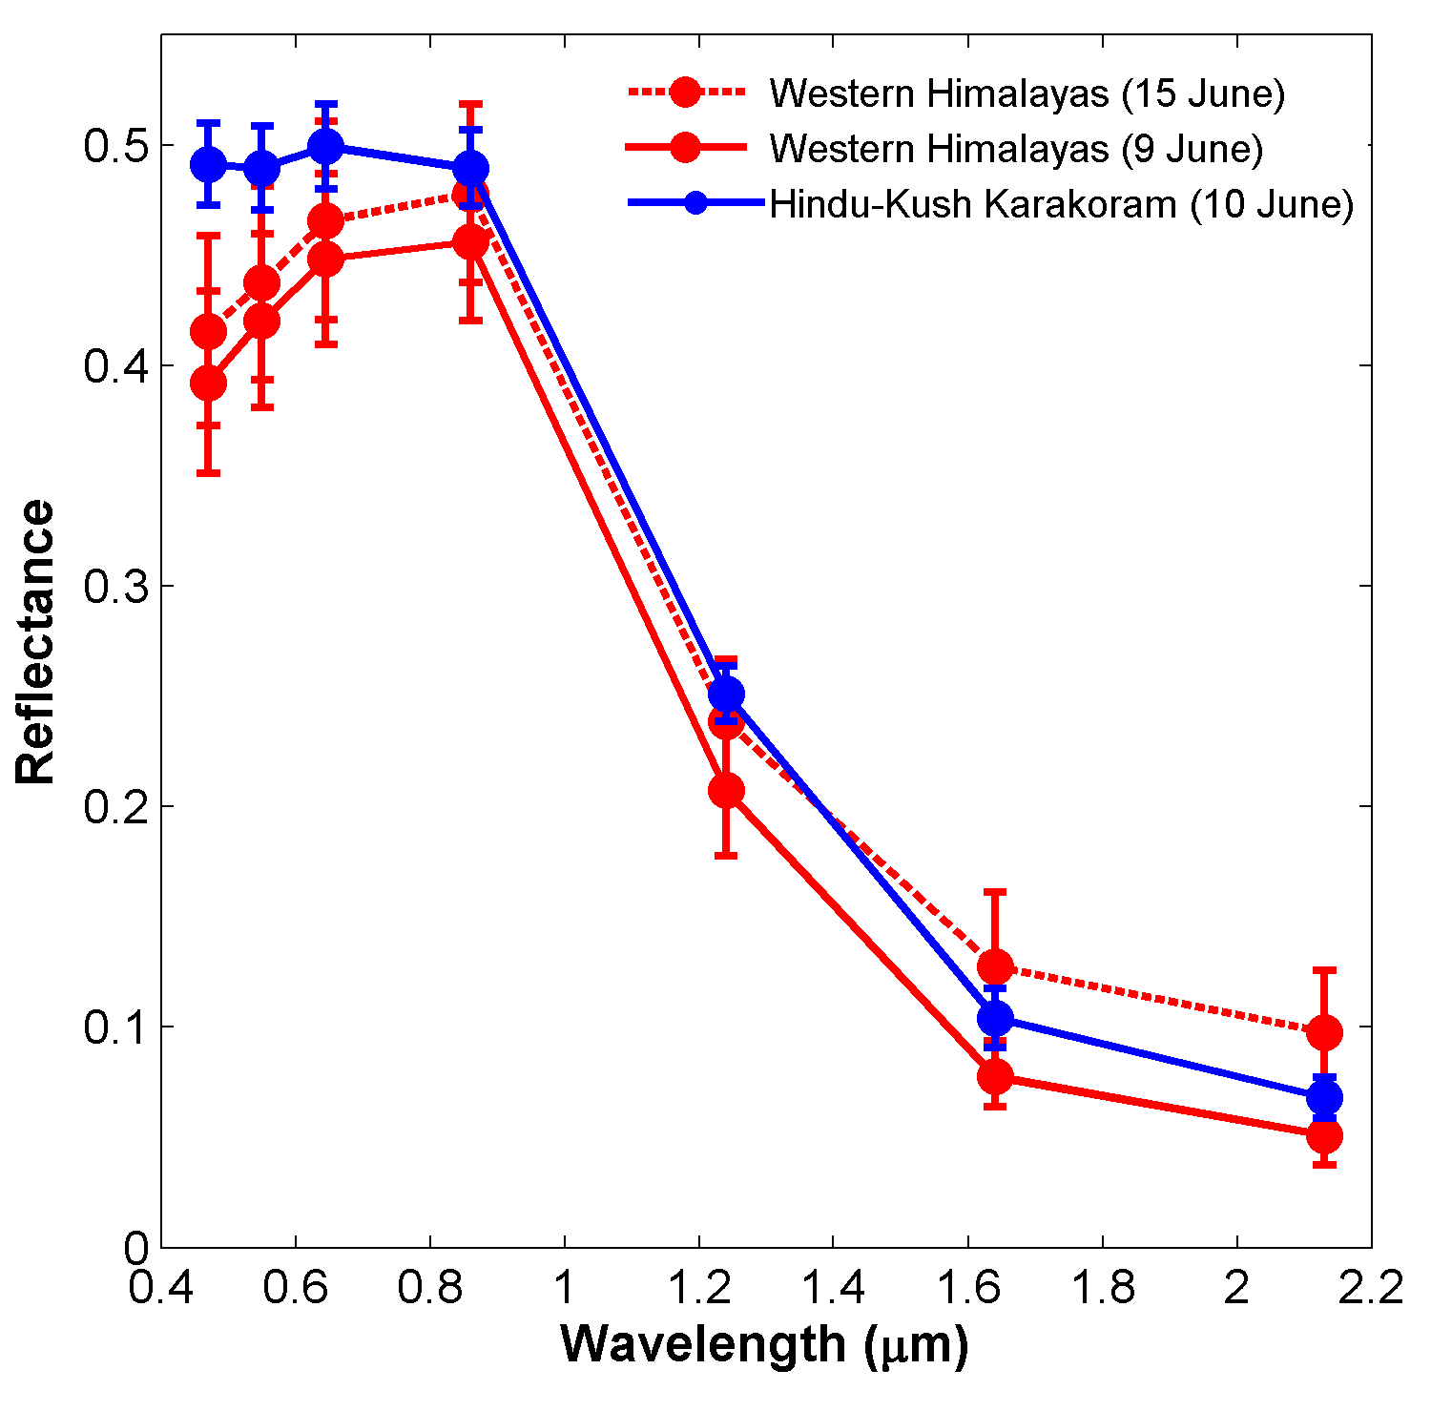
VIS-NIR gradient is also observed at TOA
MODIS Top-Of-Atmosphere (TOA) reflectance over the western Himalayan snow cover , associated with the gradient between wavelengths 0.47μm and 0.86μm (VIS-NIR) is observed for TOA reflectance.
In addition to aerosol extinction, the TOA reflectance is affected by other atmospheric effects such as Rayleigh scattering (particularly at the shorter wavelength, i.e. 0.47μm) and gaseous absorption.

Slide 26
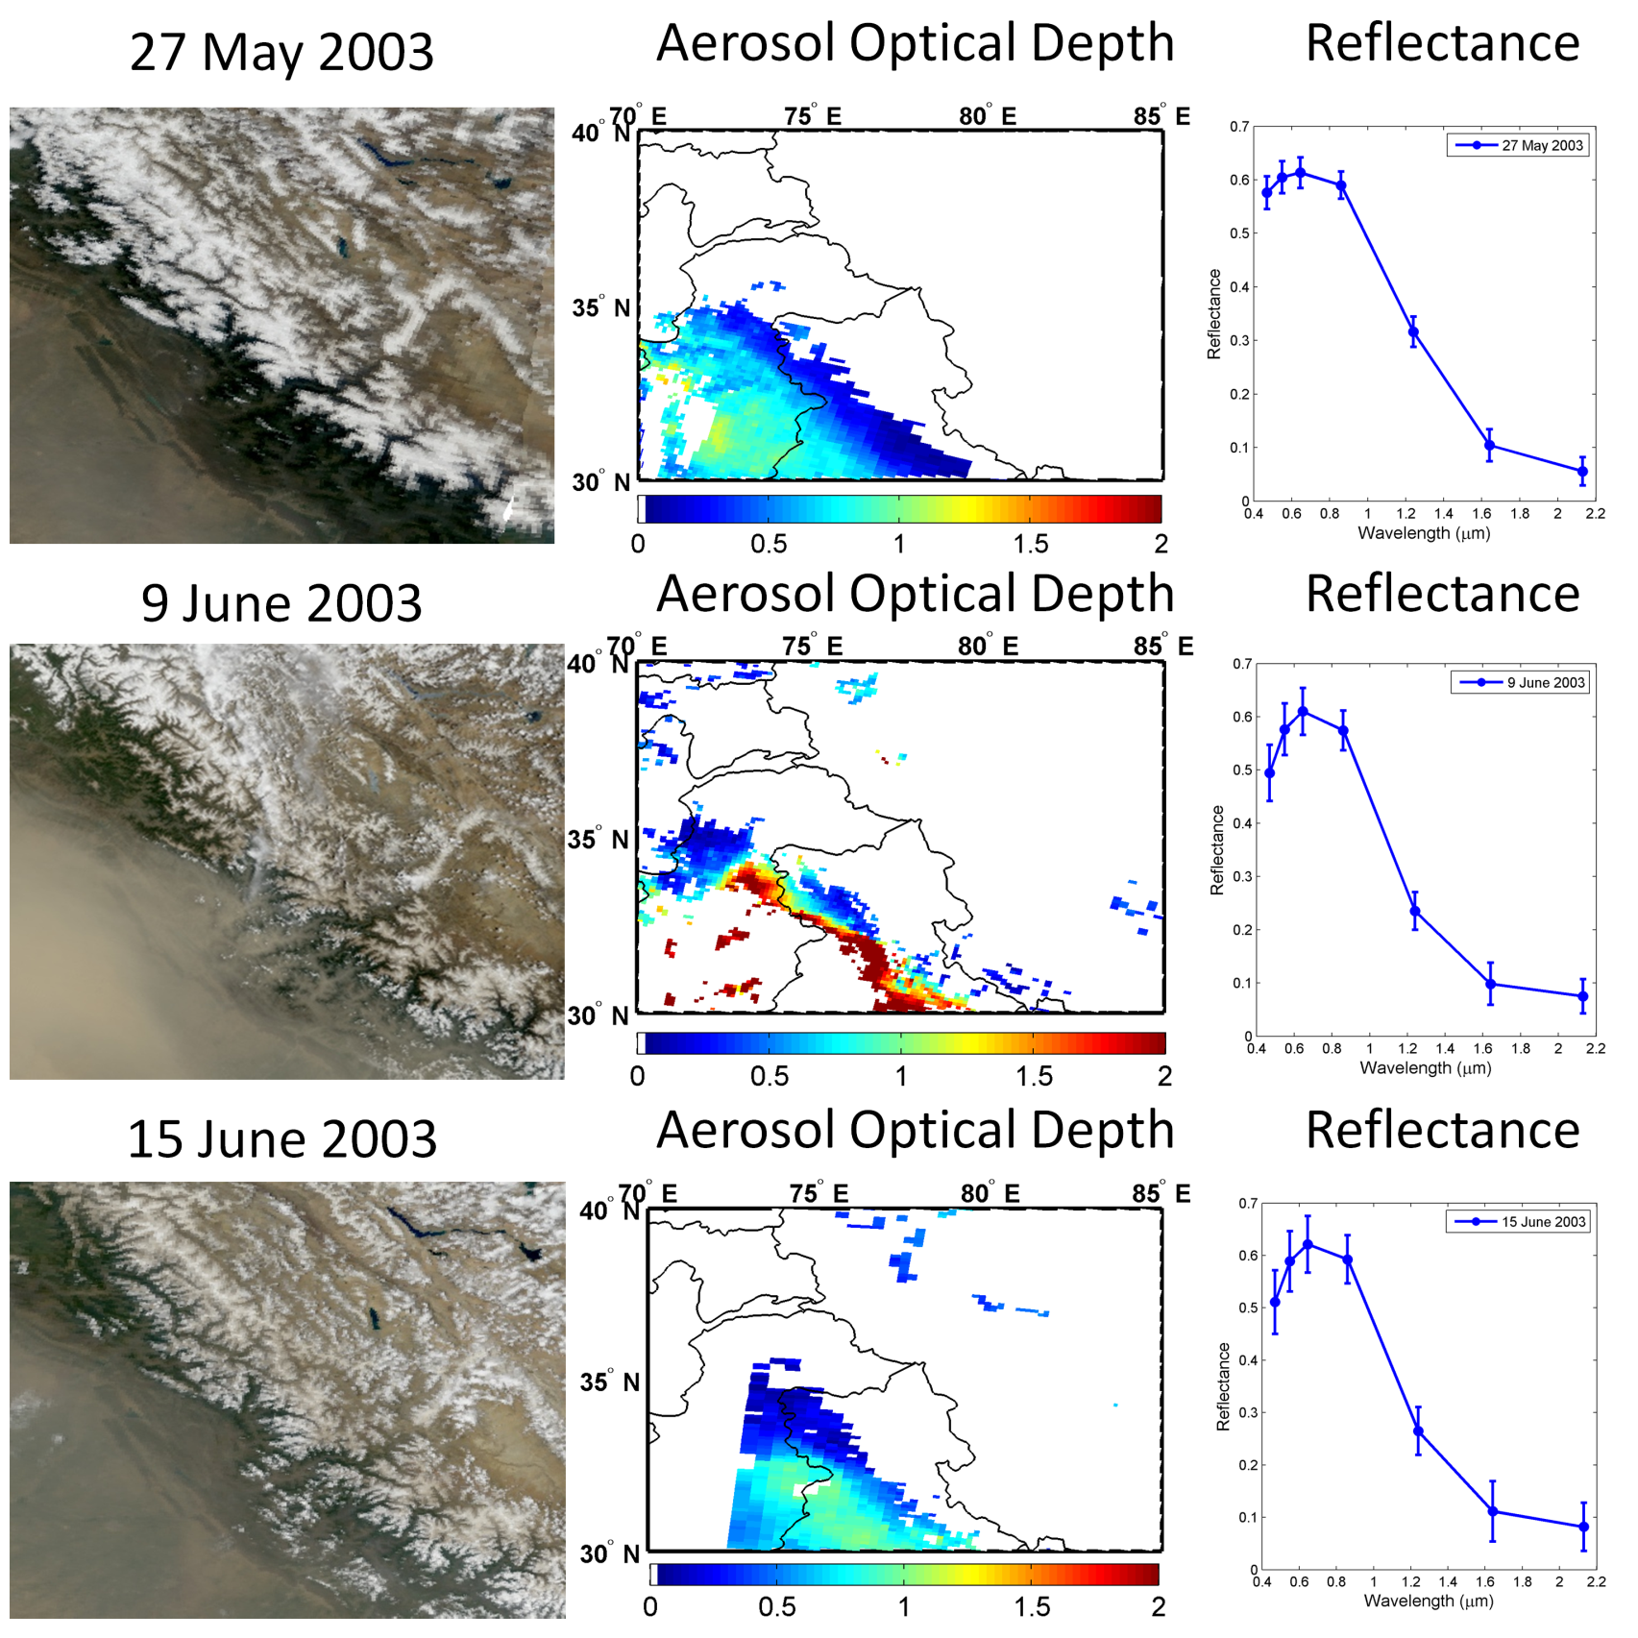
Comparison of Snow Surface Reflectance (MOD09) before and after dust event

Slide 27
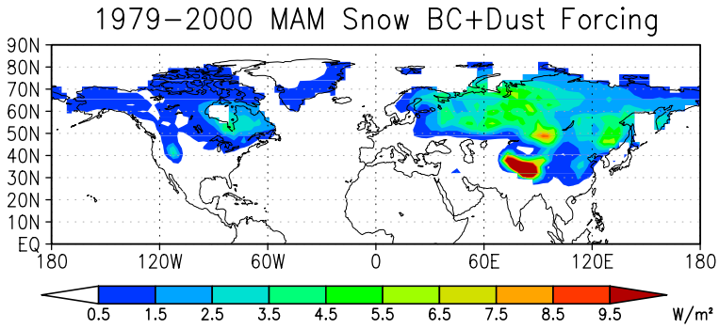
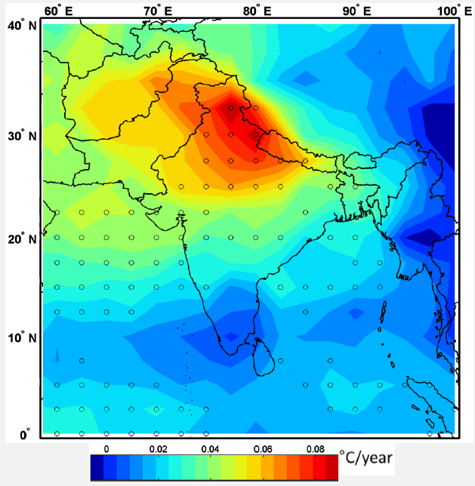
Accelerated Snowmelt due to Snow Darkening
Himalayas-Tibetan Plateau (HTP) are among the largest ice-covered
regions on Earth, major freshwater resource in Asia.
GCM simulations suggest climate warming and accelerated
snowmelt in the Himalayas, due to dust and black carbon
deposition, via snow-albedo feedbacks (Lau et al 2006, 2008, 2010).
Tropospheric Temp. Trend
May 1979-2007
Flanner et al. 2009
Gautam et al. 2009
Notes:
Himalayas-Tibetan Plateau (HTP) are among the largest ice-covered regions on Earth, major freshwater resource in Asia, partiiularly in S. Asia.
GCM simulations suggest climate warming and accelerated snowmelt in the Himalayas, due to dust and black carbon deposition, via snow-albedo feedbacks.
Flanner et al., 2009 showed enhanced forcing due to dust and BC deposition in snowpack in the northern hemisphere and a widespread dominant signal over the HTP.
We have also shown previously that this region is associated with an enhanced tropospheric temperature trend , especially in the pre-monsoon season, using microwave satellite measurements.
and it can be argued that aerosol solar absorption could be amplifying the overall GHG-warming signal.

Slide 28
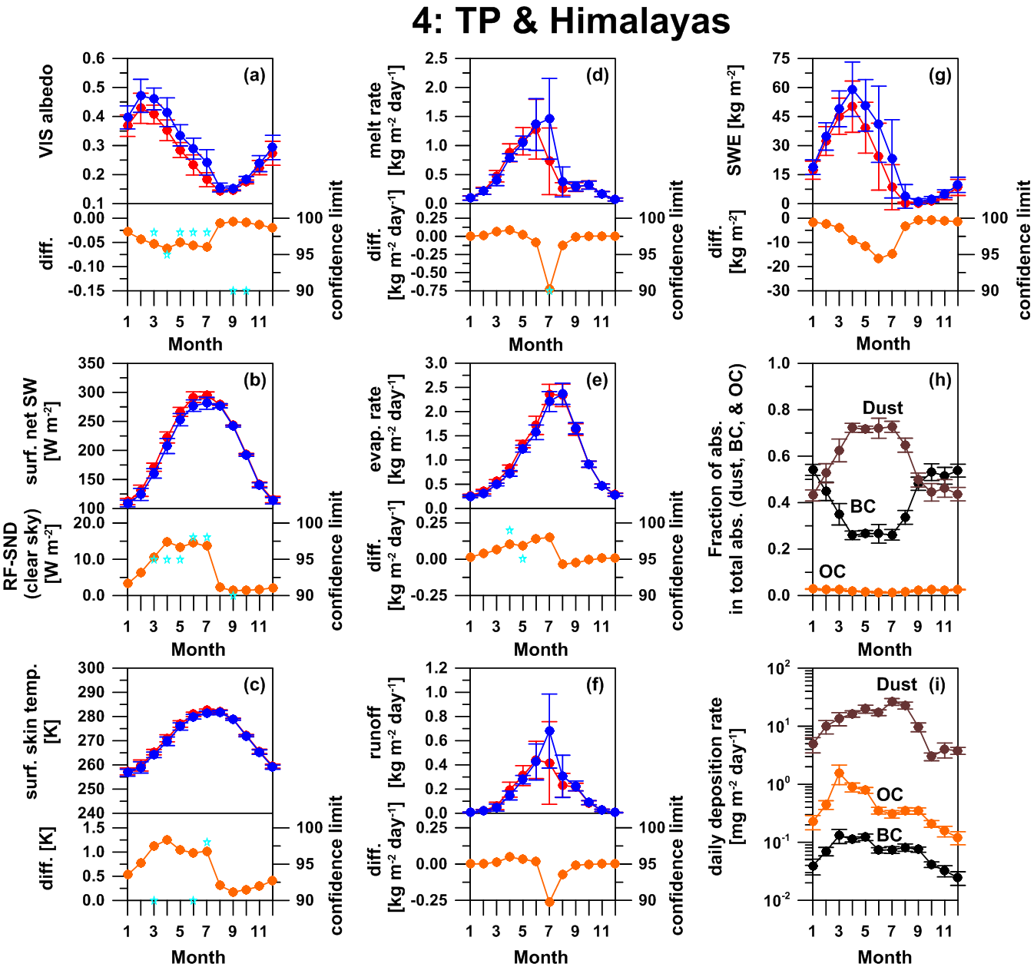
Notes:
Monthly mean climatology of full snow darkening (SD) effect over the domain of TP and Himalayas (lon.: 68.0-100.0,lat.:27.0-39.0). The variables are visible snow albedos, net shortwave assuming clear sky (i.e., radiative forcing at surface due to the snow darkening under clear sky condition), surface skin temperature, daily melt rate, daily evaporation rate, daily runoff rate, snow water equivalent (SWE), calculated fraction of absorption in the total absorption of impurities in snow (sum of dust, BC, and OC), and daily deposition rate of dust, BC, and OC. Lines with points in blue, red, and orange denote the data for non SD case, full SD case, and those difference (full SD minus non SD), respectively. The error bars and stars are standard deviation within 7 years for each data and statistically significance levels (right side scale), respectively.
Continuous full SD effect was seen from spring to summer in climatology over the domain of Tibetan Plateau and Himalayas (TPH). The fractions of BC and dust absorption contributions in total absorptions of dust, BC, and OC in snow was dominant from winter to spring and from spring to summer, respectively. The contribution of OC on the total absorption is minor over the region. This time lag of the contributions of BC and dust to the absorption over the TPH can possibly generate seasonally longer lasting SD effect and it is an importance to discuss the SD effect. Solar radiation in winter is of course weak and probably SD effect in winter is not so much important over the TPH. Hence, the time period from spring to summer is the main season of the SD effect over the TPH. If we can reduce the BC in the atmosphere, the SD effect by BC can be reduced and dust SD effect mostly caused by natural variability would only be responsible for the SD effect over the TPH.

